Slide 1
TRIVIAMARYLAND WORLD SERIES
triviamaryland.com
@triviamaryland

Slide 2
QUESTION # 1 ART
WHAT IS THE COMMON NAME OF THE 19TH CENTURY PAINTING WITH THE OFFICIAL TITLE ARRANGEMENT IN GREY AND BLACK NO. 1?

Slide 3
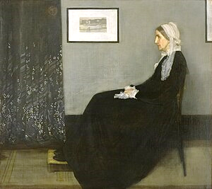
ANSWER # 1
WHISTLER’S MOTHER

Slide 4
QUESTION # 2 SCIENCE 3-PARTER
WHAT THREE ELEMENTS ARE CONSIDERED THE MOST FERROMAGNETIC, SUBSTANCES THAT ARE STRONGLY AFFECTED BY A MAGNETIC FIELD?

Slide 5
ANSWER # 2
NICKEL
COBALT
IRON

Slide 6
QUESTION # 3 THE MILITARY
WHAT HAS BEEN THE HIGHEST RANK IN THE BRITISH ARMY SINCE 1736?

Slide 7
ANSWER # 3
FIELD MARSHAL

Slide 8
QUESTION # 4 BASEBALL 3-PARTER
WHAT THREE MLB TEAMS HAVE NEVER HAD A PLAYER WIN THE LEAGUE MVP AWARD?

Slide 9
ANSWER # 4

Slide 10
QUESTION # 5 NAME’S THE SAME
THE CAPITAL CITY OF WHICH SOUTH AMERICAN COUNTRY SHARES ITS NAME WITH A UNIVERSITY IN WASHINGTON, D.C.?

Slide 11
ANSWER # 5
GUYANA (GEORGETOWN)

Slide 12
QUESTION # 6
NAME THE TV NETWORKS

Slide 18
QUESTION # 7 TECHNOLOGY
WHAT IS THE BRAND NAME OF THE SMARTPHONES AND TABLETS PRODUCED BY SONY?

Slide 19
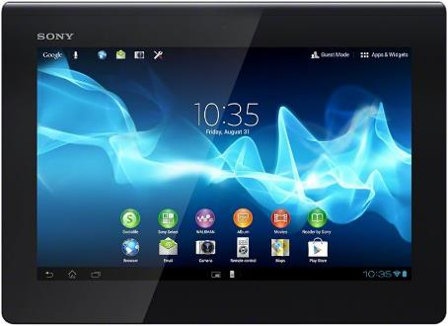
ANSWER # 7
XPERIA

Slide 20
QUESTION # 8 U.S. HISTORY
4-PARTER
WHAT WERE THE ‘FOUR FREEDOMS’ PROPOSED BY FRANKLIN ROOSEVELT IN A 1941 SPEECH?

Slide 21
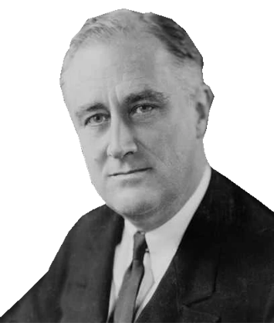
ANSWER # 8
SPEECH
WORSHIP
WANT
FEAR

Slide 22
QUESTION # 9 FOOD & DRINK
ACCORDING TO THE INTERNATIONAL BARTENDERS ASSOCIATION, WHAT ALCOHOLIC INGREDIENT IS MISSING FROM THIS LIST OF LONG ISLAND ICED TEA INGREDIENTS:
VODKA, GIN, RUM, TEQUILA, ?

Slide 23
ANSWER # 9
TRIPLE SEC

Slide 24
QUESTION # 10 MY THREE SONGS
3-PARTER
NAME THE THREE SONGS AND THE THEME

Slide 25
ANSWER # 10
SONGS
“THAT’S THE WAY LOVE GOES” - JANET JACKSON
“INSANE IN THE BRAIN” - CYPRESS HILL
“FREEDOM! ’90” - GEORGE MICHAEL
THEME
ALL SONGS CONTAIN A JAMES BROWN SAMPLE

Slide 26
HALFTIME
triviamaryland.com
@triviamaryland

Slide 27
QUESTION # 11 THE SOLAR SYSTEM
WHAT TWO LETTERS CAN BE ADDED TO THE NAME OF THE LARGEST MOON OF SATURN TO GET THE NAME OF THE LARGEST MOON OF URANUS?

Slide 28
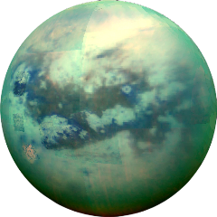
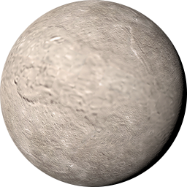
ANSWER # 11
IA (TITAN, TITANIA)

Slide 29
QUESTION # 12 TOYS & GAMES 2-PARTER
WHAT TWO VIDEO GAMES RELEASED IN THE 1980s WERE BASED ON NOVELS BY TOM CLANCY?

Slide 30
ANSWER # 12

Slide 31
QUESTION # 13 THEATRE
WHAT ACTOR/COMEDIAN STARRED IN THE ONE-MAN SHOW 700 SUNDAYS, WHICH RAN ON BROADWAY IN 2005 AND THEN AGAIN FROM 2013 TO 2014?

Slide 32
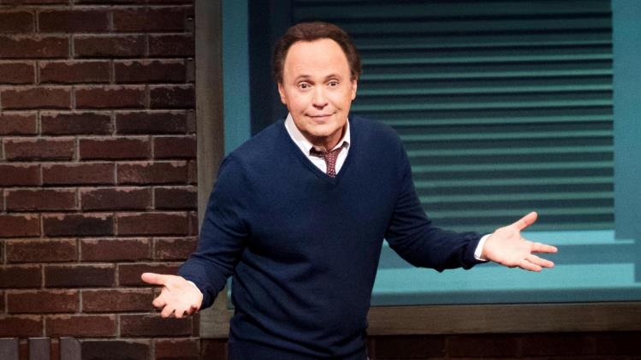
ANSWER # 13
BILLY CRYSTAL

Slide 33
QUESTION # 14 ANIMALS 2-PARTER
AS RECOGNIZED BY THE AMERICAN KENNEL CLUB, BESIDES THE COLLIE, WHAT TWO DOG BREEDS HAVE THE WORD ‘COLLIE’ IN THEIR NAMES?

Slide 34
ANSWER # 14
BORDER COLLIE
BEARDED COLLIE

Slide 35
QUESTION # 15 FOREIGN WORDS & PHRASES
THE NAME OF WHAT SMALL MAGNIFYING GLASS USED BY JEWELERS COMES FROM THE FRENCH FOR ‘IMPERFECT GEM’?

Slide 36
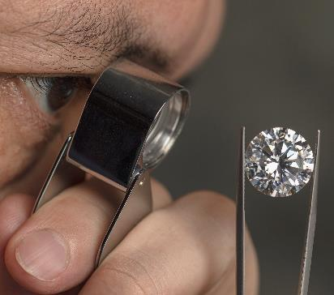
ANSWER # 15
LOUPE

Slide 37
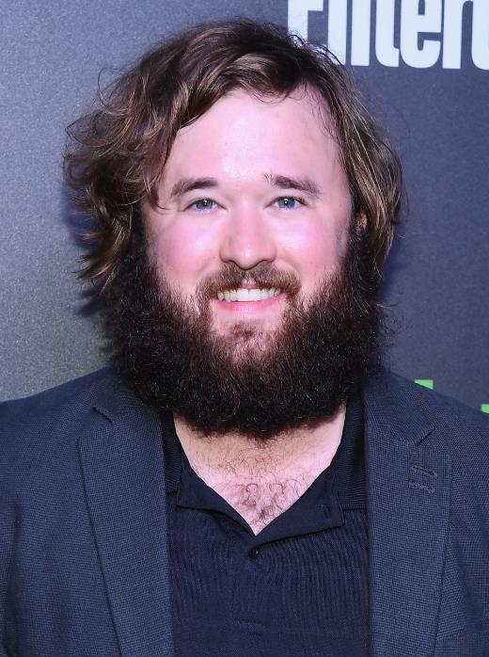
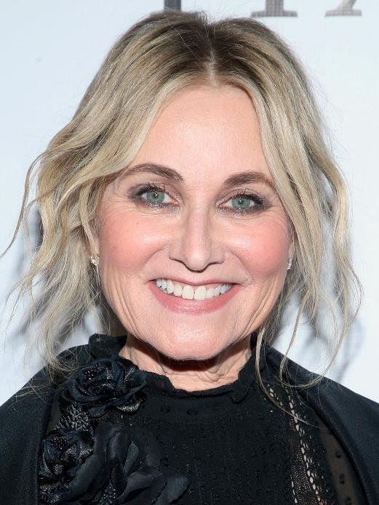
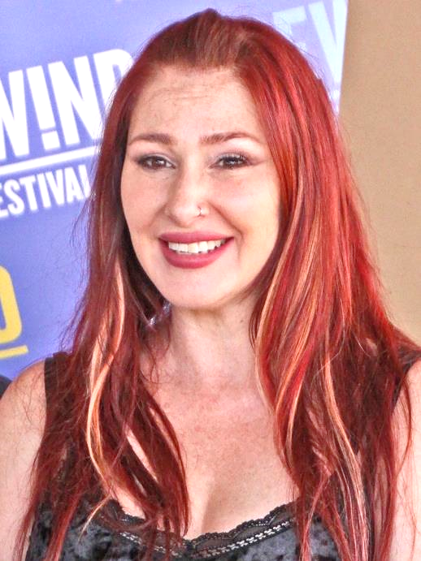
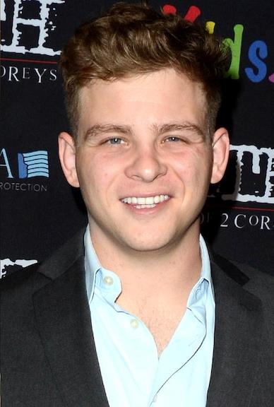
QUESTION # 16
NAME THE CHILD STARS (ALL GROWN UP)

Slide 38
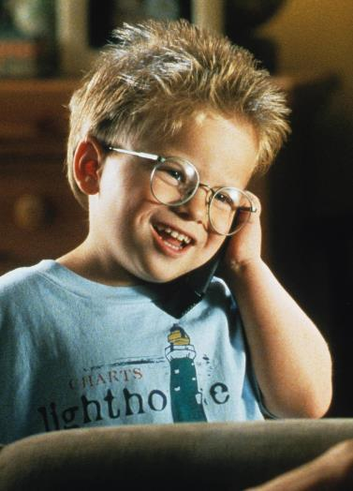
JONATHAN LIPNICKI

Slide 39
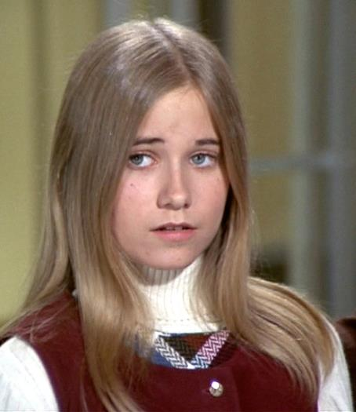
MAUREEN McCORMICK

Slide 40
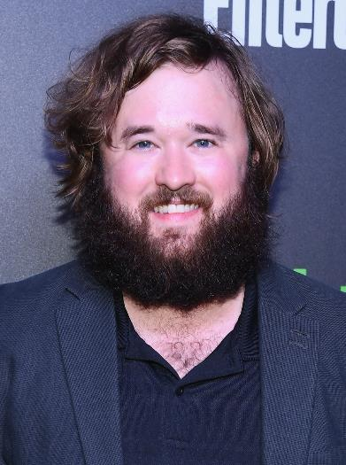
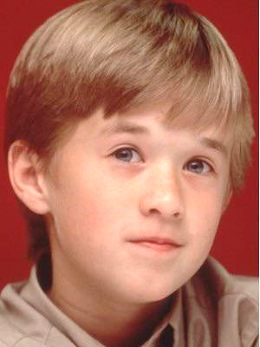
HALEY JOEL OSMENT

Slide 41
TATYANA ALI

Slide 42
TIFFANY

Slide 43
QUESTION # 17 COLLEGES & UNIVERSITIES
WHAT LIBERAL ARTS SCHOOL IN OHIO BECAME THE NATION’S FIRST COEDUCATIONAL COLLEGE AFTER ACCEPTING FOUR WOMEN AS FULL-TIME STUDENTS IN 1837?

Slide 44
ANSWER # 17

Slide 45
QUESTION # 18 TITLES IN COMMON 4-PARTER
GIVEN AN ACTOR FROM THE MOVIE AND THE ARTIST, PLEASE PROVIDE THE TITLES SHARED BY EACH MOVIE AND SONG
JAMES STEWART | U2
BRUCE WILLIS | KENDRICK LAMAR
MEL GIBSON | ROD STEWART
MICHELLE PFEIFFER | EAGLES

Slide 46
ANSWER # 18
JAMES STEWART/U2 - VERTIGO
BRUCE WILLIS/KENDRICK LAMAR - DIE HARD
MEL GIBSON/ROD STEWART - FOREVER YOUNG
MICHELLE PFEIFFER/EAGLES - TEQUILA SUNRISE

Slide 47
QUESTION # 19
LEGAL TERMINOLOGY
FROM THE LATIN FOR ‘TWISTED’, WHAT BRANCH OF CIVIL LAW DEALS WITH INJURIES TO ONE’S BODY, PROPERTY, BUSINESS, REPUTATION, OR PRIVACY?

Slide 48
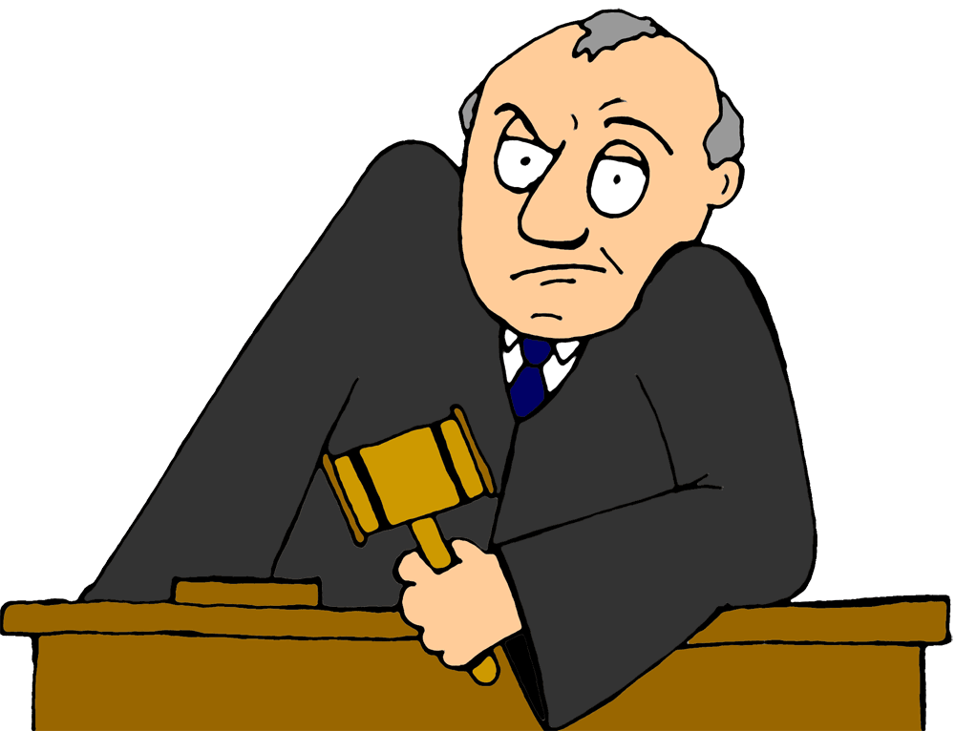
ANSWER # 19
TORT

Slide 49
QUESTION # 20 BET UP TO 15 POINTS U.S. PRESIDENTS
WHICH U.S. PRESIDENT OUTLIVED HIS FOUR IMMEDIATE SUCCESSORS AND LIVED TO SEE MORE SUCCESSORS ASCEND TO THE PRESIDENCY (EIGHT) THAN ANYONE ELSE?

Slide 50
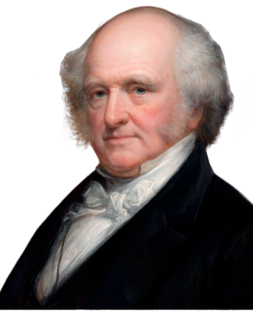
ANSWER # 20
MARTIN VAN BUREN

Slide 51
TRIVIAMARYLAND
triviamaryland.com @triviamaryland

Slide 52
TIEBREAKER QUESTION
IN WHAT YEAR WAS THE TV NETWORK HBO LAUNCHED?

Slide 53
TIEBREAKER ANSWER
1972

