Slide 1
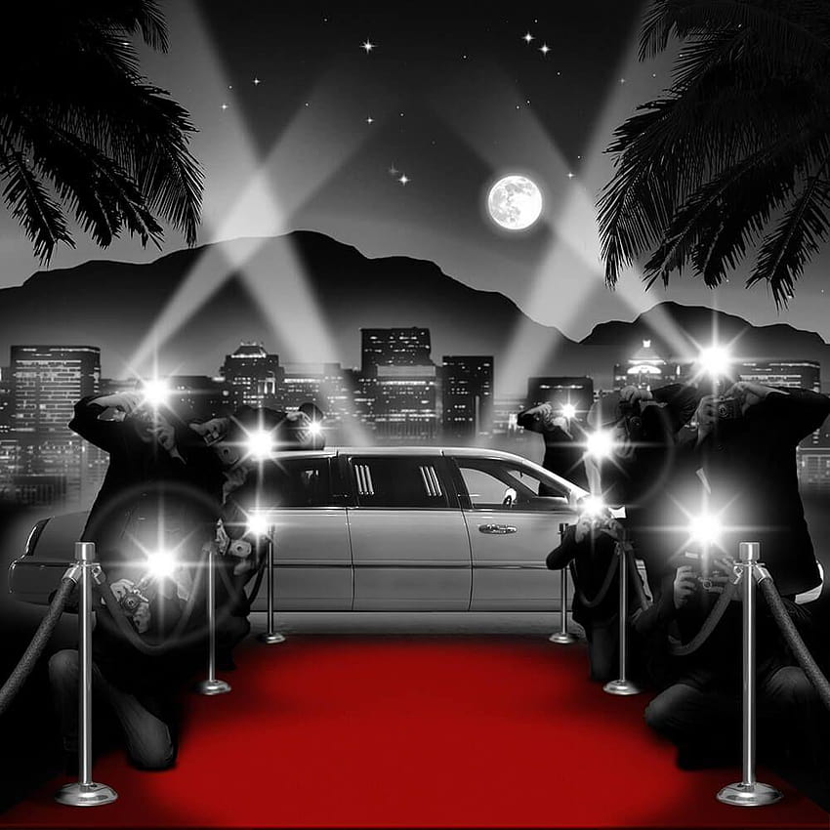
TRIVIAMARYLAND
WORLD SERIES

Slide 2

LITE
MARKSMEN
NO IDEA
PANTS PEERS
PARTIAL RECALL
PETE SAMPRAS
PROST!
SENIOR MOMENTS
SHAME THE NAME
SWEEP THE LEG
WASTED KNOWLEDGE
WHEN’S SUMMER?
YOUSE/YINZ
ALL OR NOTHING
ANDY’S TOYS
B SQUAD
CRABBY TOTS
CULT CLASSIC
FAT KIDS
FEAR THE CRAB
GOING BATTY
I BENT MY WOOKIE
I’M WITH STUPID
JOPPATOWNE CHRISTIAN
CHURCH FIGHTING
COMMUNION WAFERS
LABATT BLUE

Slide 3
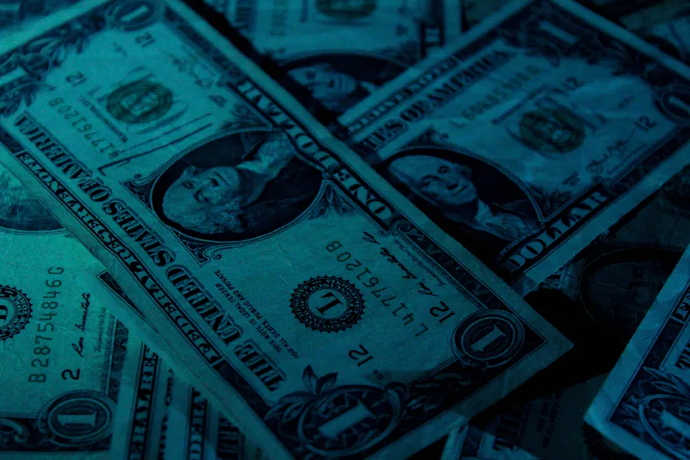
1ST PLACE - $500
2ND PLACE - $350
3RD PLACE - $100
4TH PLACE - $50
5TH PLACE - $50 GIFT CARD
6TH PLACE - $25 GIFT CARD
7TH PLACE - $15 GIFT CARD

Slide 4
QUESTION # 1
IN THE NEWS
LAST MONTH, NEW ZEALAND DECLARED A STATE OF EMERGENCY WHEN WHAT CYCLONE SWEPT THROUGH ITS NORTH ISLAND, CAUSING OVER $8 BILLION IN DAMAGES?

Slide 5
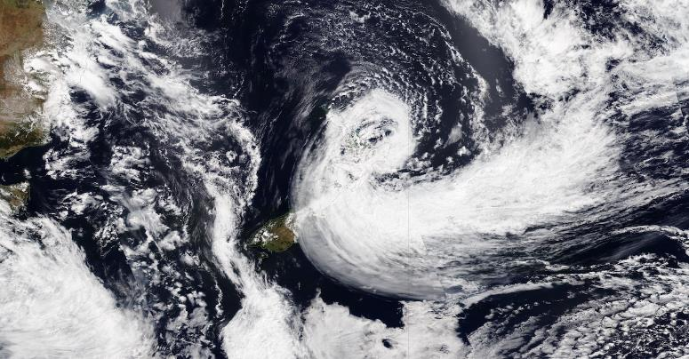
ANSWER # 1
GABRIELLE

Slide 6
QUESTION # 2
BASEBALL
3-PARTER
OF THE CURRENT TEAMS THAT HAVE REACHED THE WORLD SERIES AT LEAST TWICE, WHICH THREE TEAMS HAVE NEVER WON THE CHAMPIONSHIP?

Slide 7



ANSWER # 2

Slide 8
QUESTION # 3
COMMON BONDS
WHAT TYPE OF CANDY IS NAMED IN A HOLIDAY POEM FROM 1823 AND IS ALSO THE NAMESAKE FOR A CHARACTER FEATURED IN AN 1892 BALLET?

Slide 9
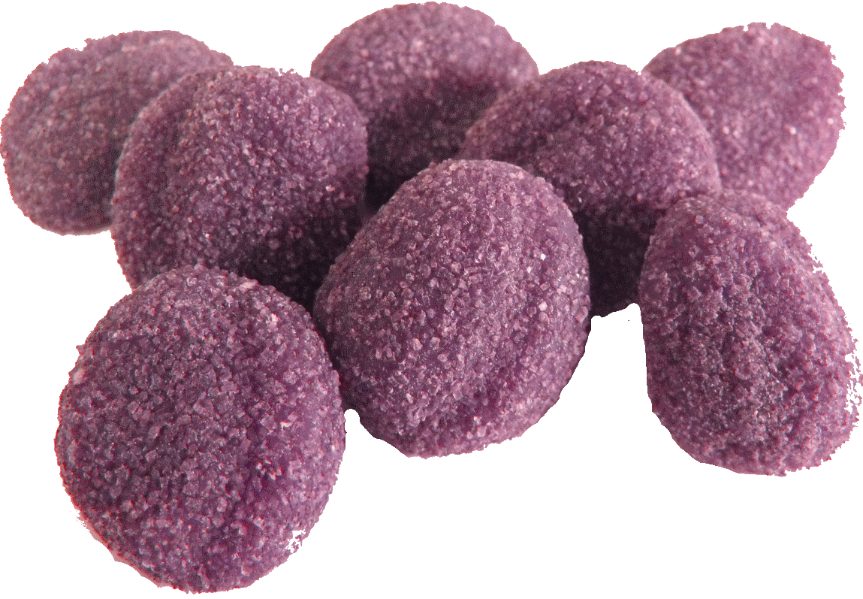
ANSWER # 3
SUGAR PLUM

Slide 10
QUESTION # 4
U.S. PRESIDENTS
2-PARTER
WHICH TWO 19TH CENTURY PRESIDENTS SERVED PART OF THEIR TERMS UNDER THE NATIONAL UNION PARTY?

Slide 11
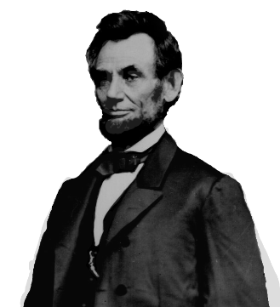
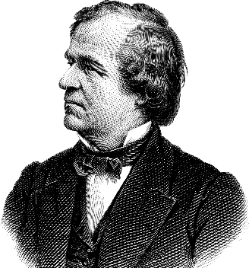
ANSWER # 4
ABRAHAM LINCOLN
ANDREW JOHNSON

Slide 12
QUESTION # 5
FUN WITH NUMBERS
WHAT IS THE NEXT YEAR THAT WILL BE WRITTEN USING EXACTLY FOUR ROMAN NUMERALS?

Slide 13
ANSWER # 5
2040
(MMXL)

Slide 14
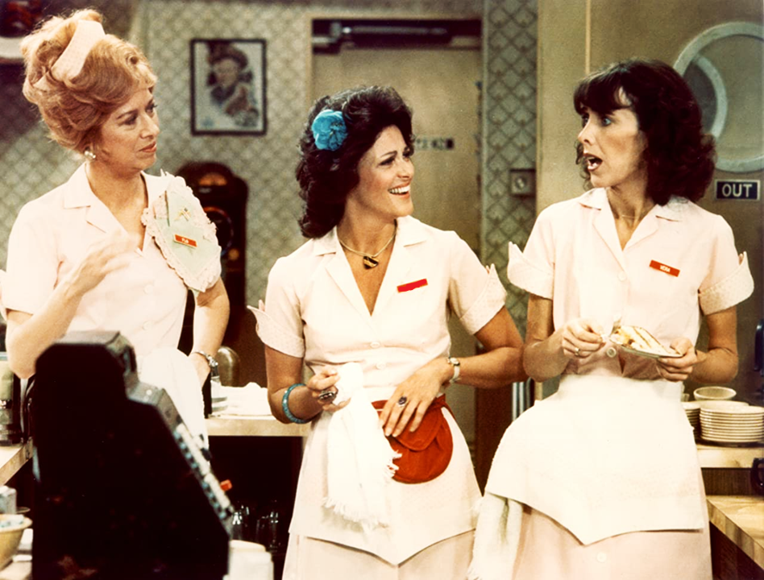
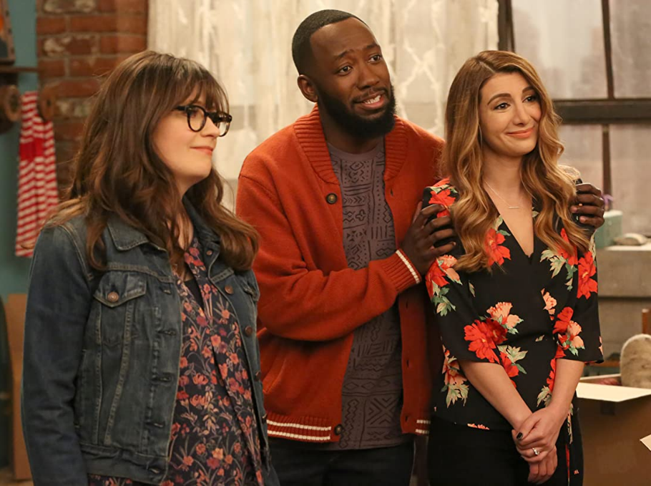
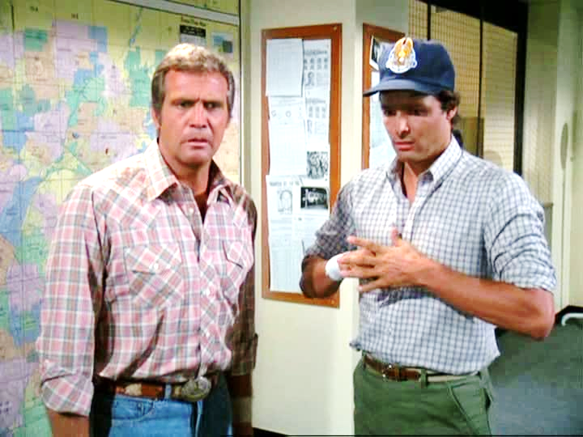
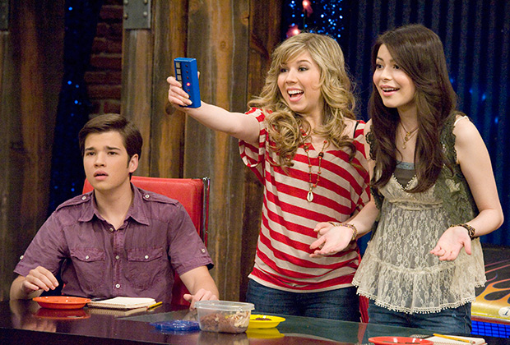
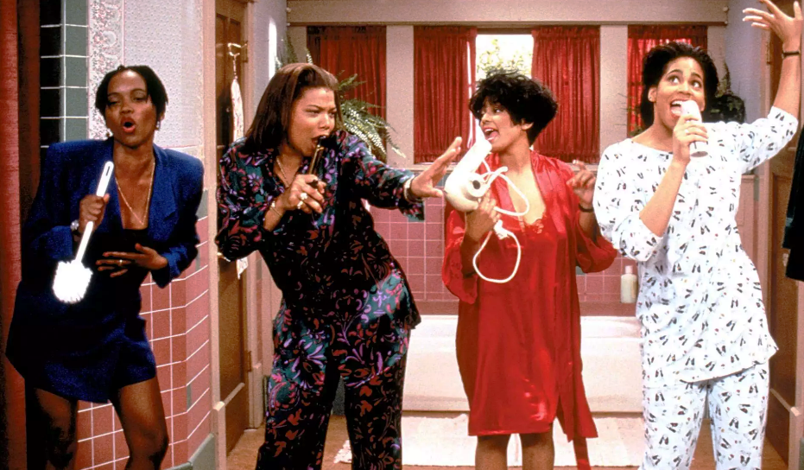
QUESTION # 6
NAME THE TV SHOWS AND THE THEME

Slide 15
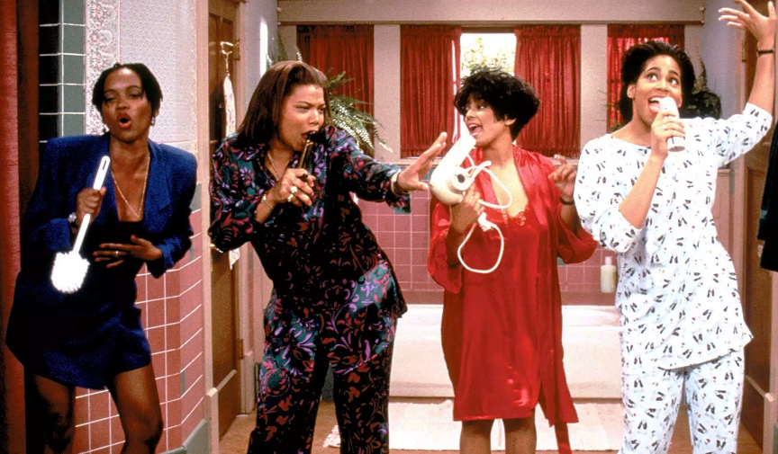
LIVING SINGLE

Slide 16

NEW GIRL

Slide 17
THE FALL GUY

Slide 18
ALICE

Slide 19
iCARLY

Slide 20
THEME
CAST MEMBERS PERFORMED THE THEME SONG

Slide 21
QUESTION # 7
U.S. HISTORY
IN THE SUPREME COURT CASE McCULLOCH V. MARYLAND, CHIEF JUSTICE JOHN MARSHALL DECLARED THAT “THE POWER TO” DO WHAT “INVOLVES THE POWER TO DESTROY”?

Slide 22
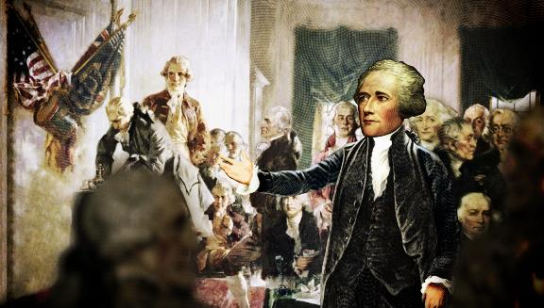
ANSWER # 7
TAX

Slide 23
QUESTION # 8
BOOKS & AUTHORS
2-PARTER
SINCE 2021, WHAT TWO NOVELS BY STEPHEN KING HAVE REACHED #1 ON THE NEW YORK TIMES BESTSELLER LIST?

Slide 24


ANSWER # 8

Slide 25
QUESTION # 9
MONEY
RELEASED IN MARCH 2022, WHO BECAME THE FIRST OPENLY LGBT WOMAN DEPICTED ON A U.S. COIN?

Slide 26
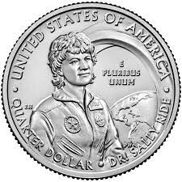
ANSWER # 9
SALLY RIDE

Slide 27

QUESTION # 10
MUSIC
3-PARTER
NAME THE title, GROUP, AND MOVIe soundtrack on which this song originally appeared:

Slide 28
ANSWER # 10
TITLE
“KING OF WISHFUL THINKING”
GROUP
GO WEST
SOUNDTRACK
PRETTY WOMAN

Slide 29
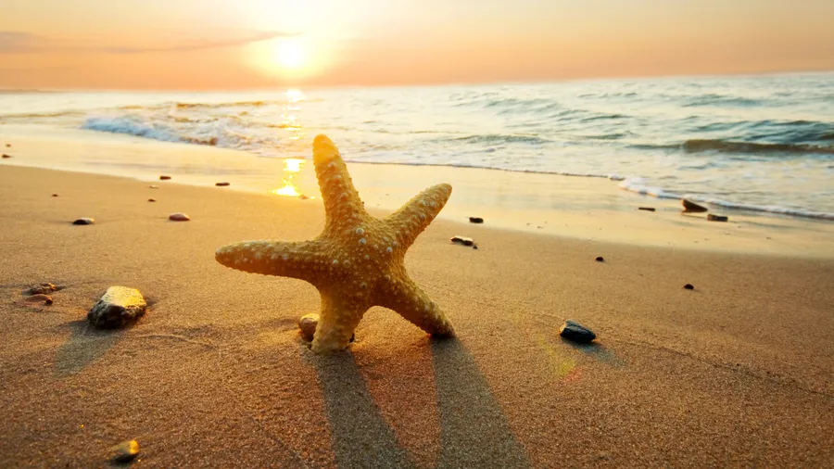
HALFTIME

Slide 30
QUESTION # 11
PODCASTS
WHAT COMEDIAN HOSTS THE WTF PODCAST, WHICH WAS LAUNCHED IN 2009 AND HAS RELEASED OVER 1,200 EPISODES?

Slide 31
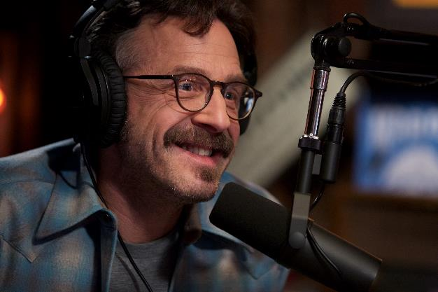
ANSWER # 11
MARC MARON

Slide 32
QUESTION # 12
FUN & GAMES
2-PARTER
THE NAMES OF WHICH TWO U.S. STATES CANNOT BE SPELLED OUT COMPLETELY USING THE FULL ALLOTMENT OF TILES IN THE STANDARD VERSION OF SCRABBLE?

Slide 33

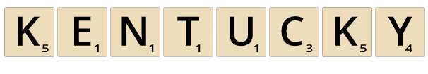
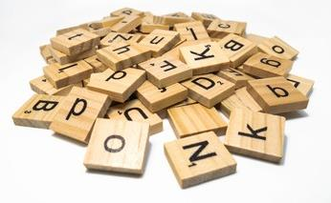
ANSWER # 12

Slide 34
QUESTION # 13
SCIENCE
  THE LAW THAT SAYS A BODY IN FLUID IS ACTED ON BY FORCE PROPORTIONAL TO HOW MUCH FLUID IT DISPLACES IS NAMED FOR WHOM?

Slide 35
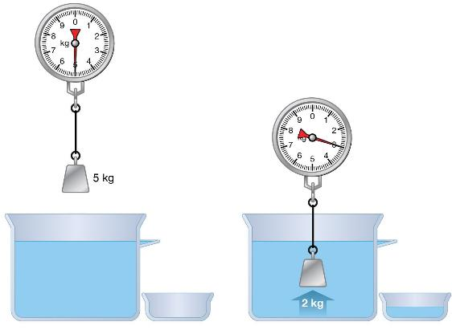
ANSWER # 13
ARCHIMEDES

Slide 36
QUESTION # 14
MEDICAL ABBREVIATIONS
2-PARTER
IF AN ENT COMPLETES A ‘T&A’, WHAT TWO SURGERIES ARE PERFORMED AT THE SAME TIME?

Slide 37
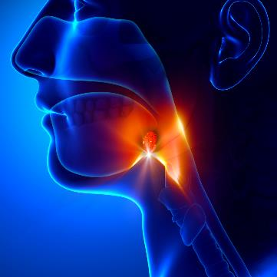
ANSWER # 14
TONSILLECTOMY
ADENOIDECTOMY

Slide 38
QUESTION # 15
FICTIONAL CHARACTERS
WHAT LOONEY TUNES CHARACTER WAS INTRODUCED IN A 1935 SHORT FILM ALONGSIDE A CAT NAMED BEANS?

Slide 39

ANSWER # 15
PORKY PIG

Slide 40
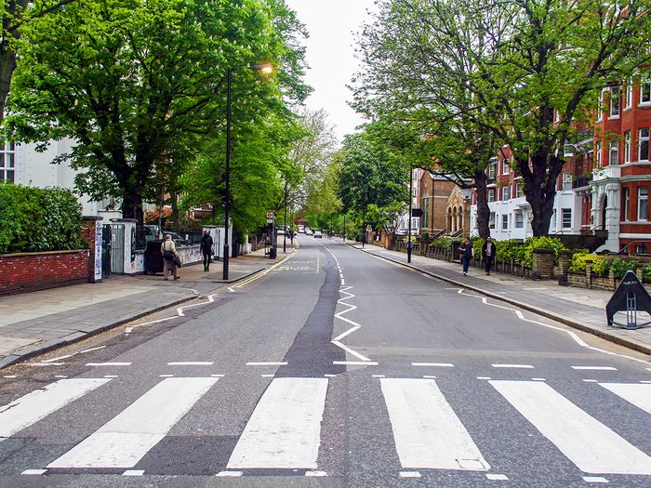
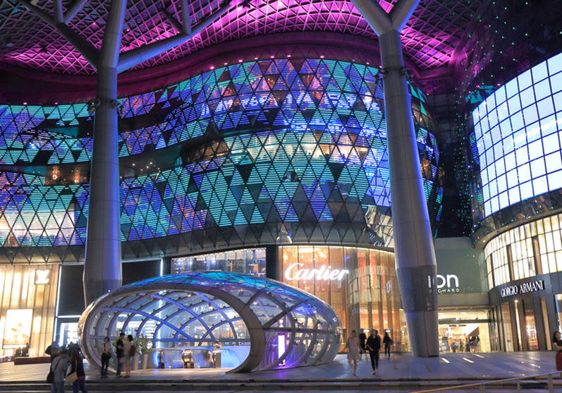
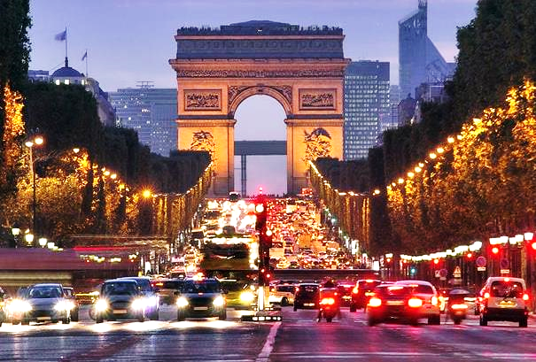
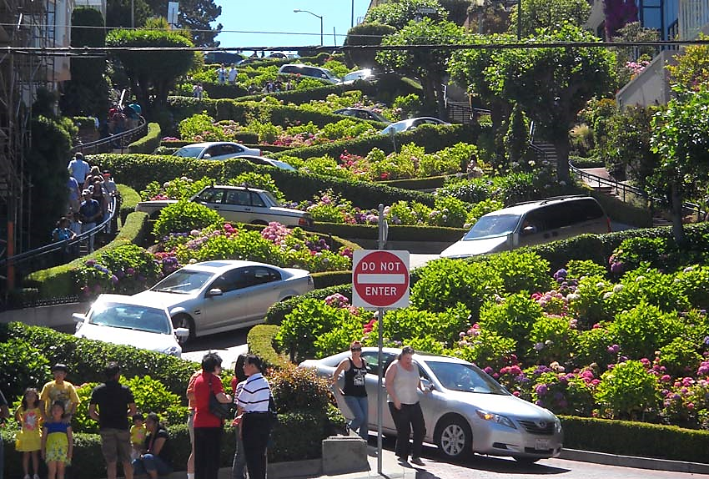
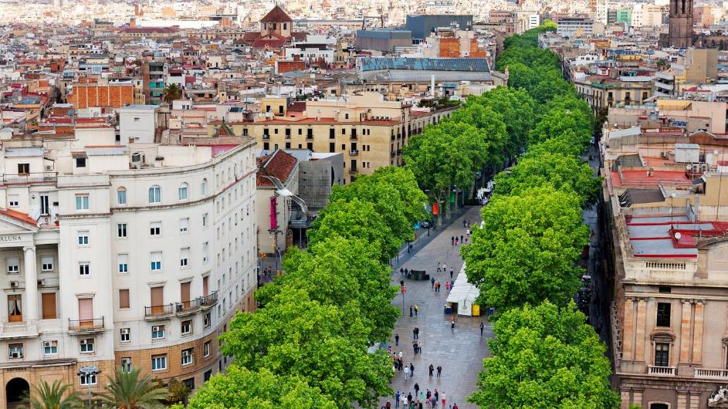
QUESTION # 16
NAME THE ROADS

Slide 41

LOMBARD STREET
SAN FRANCISCO, CALIFORNIA

Slide 42
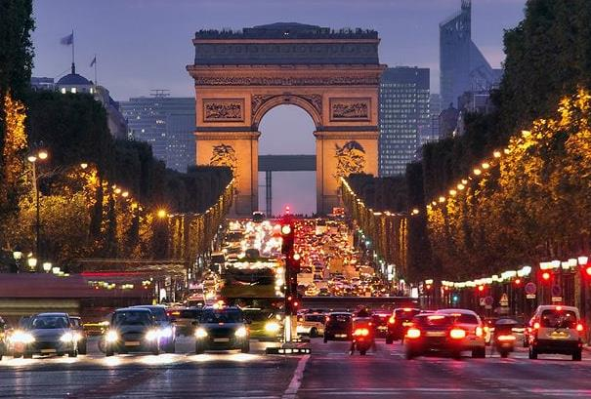
CHAMPS-ÉLYSÉES
PARIS, FRANCE

Slide 43

ORCHARD ROAD
SINGAPORE

Slide 44

ABBEY ROAD
LONDON, ENGLAND

Slide 45
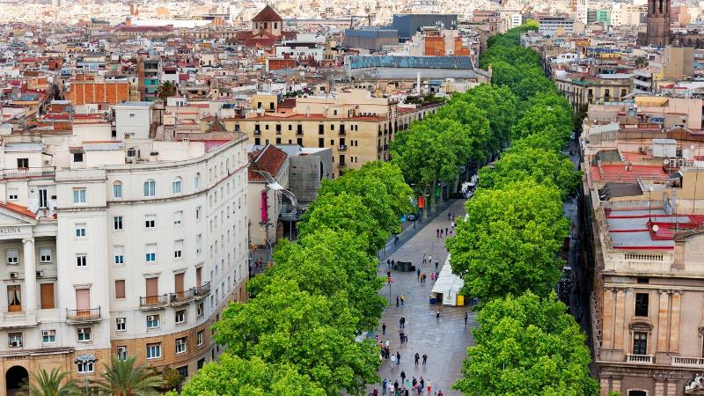
LA RAMBLA
BARCELONA, SPAIN

Slide 46
QUESTION # 17
FASHION
THE WENDY AND THE WALLY ARE VARIATIONS OF WHAT SHOE BRAND WITH NO-TIE LACES THAT WAS INTRODUCED IN 2008?

Slide 47

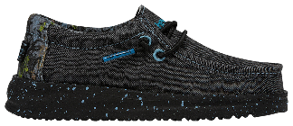
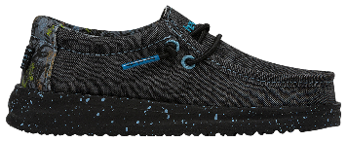
ANSWER # 17

Slide 48
QUESTION # 18
MUSIC
2-PARTER
WHAT TWO AFRICAN AMERICAN WOMEN WON THE GRAMMY FOR ALBUM OF THE YEAR IN THE 1990s FOR NON-SOUNDTRACK ALBUMS?

Slide 49


ANSWER # 18
NATALIE COLE
LAURYN HILL

Slide 50
QUESTION # 19
WORD ORIGINS
CONSIDERED TO BE THE PROTECTOR OF BOUNDARY MARKERS, WHAT ROMAN GOD LENT HIS NAME TO A MODERN-DAY ENGLISH WORD DEFINED AS THE END POINT OF A TRANSPORTATION ROUTE?

Slide 51
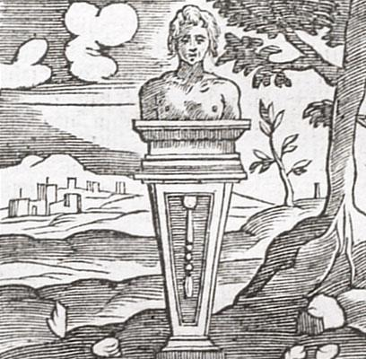
ANSWER # 19
TERMINUS

Slide 52
QUESTION # 20
BET UP TO 15 POINTS
U.S. STATES
  LOCATED EAST OF THE MISSISSIPPI RIVER, WHICH U.S. STATE HAS A POPULATION OF ABOUT 1.8 MILLION DESPITE THE FACT THAT ITS MOST POPULOUS CITY HAS FEWER THAN 50,000 RESIDENTS?

Slide 53
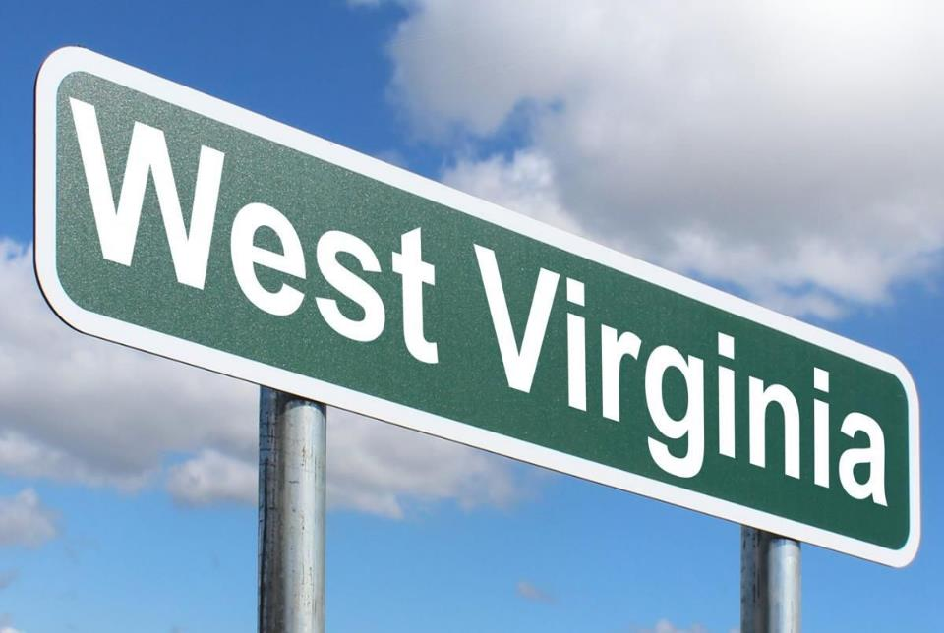
ANSWER # 20

Slide 54
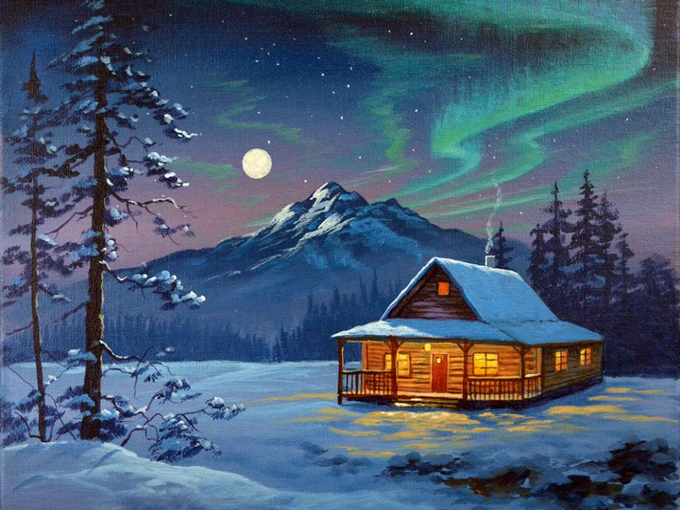


TRIVIAMARYLAND
triviamaryland.com @triviamaryland

Slide 55
TIEBREAKER QUESTION
  HOW MANY TOTAL MISSIONS HAVE BEEN FLOWN BY NASA’S SPACE SHUTTLE FLEET?

Slide 56
TIEBREAKER ANSWER
135

