Slide 1
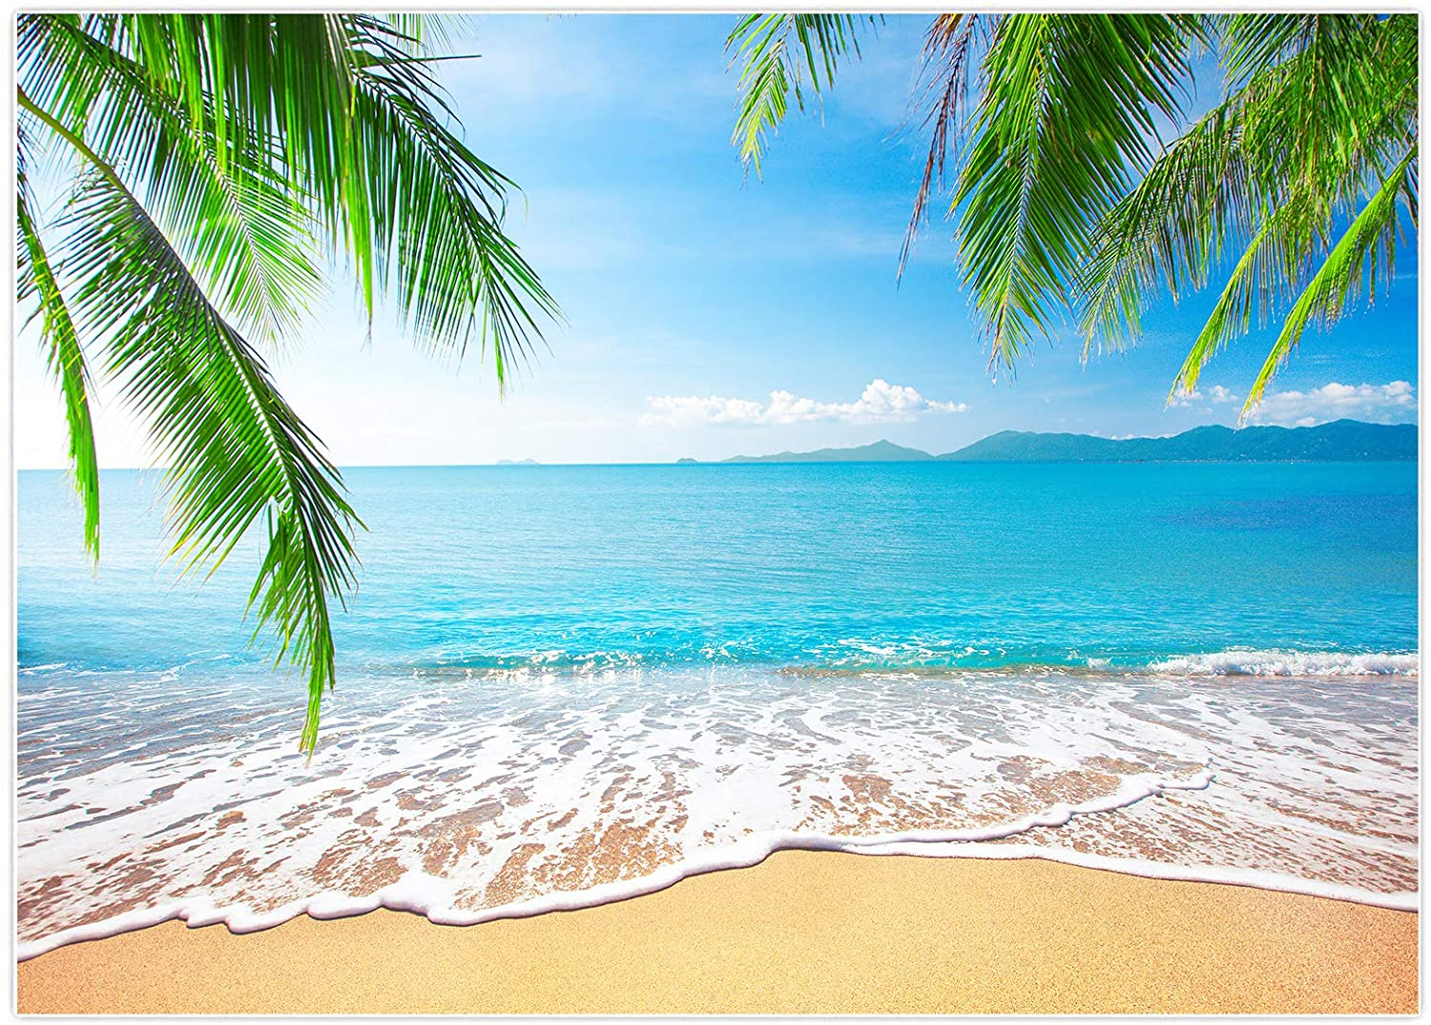
⬜🟨⬜⬜⬜
⬜⬜⬜🟨🟨
🟨🟨🟨⬜⬜
🟨⬜🟩🟩⬜
🟩🟩🟩🟩🟩
T
R
I
V
I
A
M
A
R
Y
L
A
N
D
W
O
R
L
D
S
E
R
I
E
S

Slide 2
FAMOUS GIRAFFES | RHYMES WITH ORANGE | PEOPLE NAMED ARSENIO | NUMBERS BETWEEN 3 AND 5 | AFTER AND BEFORE
KISS ME, I’M VAXXED | LET’S GO BRANDON | SENIOR MOMENTS | BAY CITY ROLLERS CLUB | JEFFREYS
MASTER DEBATERS | 2.5 NUT | WUBBA DUB LUB | FLEETWOOD MAC & CHEESE | HERPE THE LOVE BUG
JUST US | A HARD MAYBE | DINK ROW | ALL OR NOTHING | JOPPATOWN CHRISTIAN CHURCH FIGHTING COMMUNION WAFERS
MORE LIKE 5AM | MARKSMEN | THE ISLANDERS | PARTIAL RECALL
100% | PHONES DOWN | SWEEP THE LEG | INFINITY

Slide 3

NO CELL PHONES DURING THE GAME
MAXIMUM OF 10 PLAYERS PER TEAM
1ST PLACE - $500 / TROPHY
2ND PLACE - $300
3RD PLACE - $150
4TH PLACE - $50
5TH PLACE - $50 IN HOUSE CASH
6TH PLACE - $25 IN HOUSE CASH
7TH PLACE - $15 IN HOUSE CASH

Slide 4
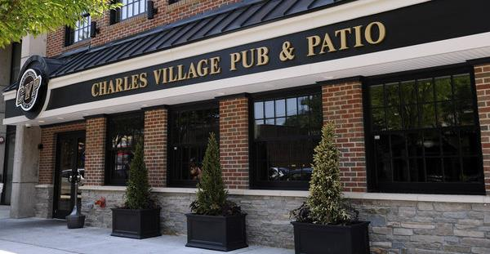
WE PLAY TRIVIA HERE EVERY SUNDAY AT 6:00 PM!

Slide 5
QUESTION # 1
AUTOMOBILES
TWO YEARS AFTER THE TOYOTA PRIUS BECAME THE FIRST MASS-MARKETED HYBRID AUTOMOBILE IN THE WORLD, WHAT MAKE AND MODEL FROM A DIFFERENT COMPANY BECAME THE FIRST HYBRID AVAILABLE IN NORTH AMERICA?

Slide 6
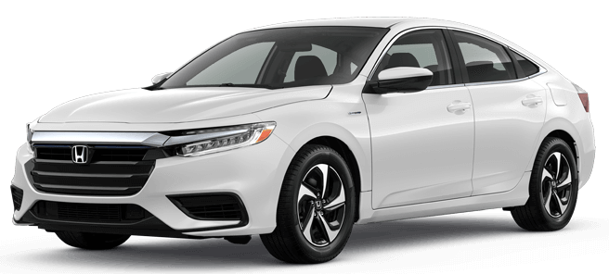
ANSWER # 1
HONDA INSIGHT

Slide 7
QUESTION # 2
U.S. GEOGRAPHY
3-PARTER
WHAT THREE U.S. STATES BORDER MORE THAN ONE GREAT LAKE?

Slide 8
ANSWER # 2
MICHIGAN
(MICHIGAN, HURON, ERIE, SUPERIOR)
NEW YORK
(ONTARIO, ERIE)
WISCONSIN
(MICHIGAN, SUPERIOR)

Slide 9
QUESTION # 3
THERE’S AN APP FOR THAT
LAUNCHED IN MARCH 2020, WHAT INVITE-ONLY SOCIAL MEDIA APP CONSISTS OF AUDIO-ONLY CHAT ROOMS?

Slide 10


ANSWER # 3

Slide 11

QUESTION # 4
6-4-2
THIS WAS THE ONLY DRAMA TO LEAD THE NIELSEN RATINGS FOR MORE THAN ONE SEASON IN THE 1980s
A REVIVAL OF THIS SHOW AIRED ON TNT FROM 2012-2014
SOME OF THE MAIN CHARACTERS INCLUDED J.R. EWING, RAY KREBBS, AND MISS ELLIE

Slide 12
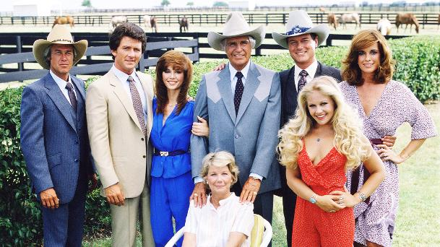
ANSWER # 4
DALLAS

Slide 13
QUESTION # 5
THE CONSTITUTION
TAKING MORE THAN 200 YEARS FOR RATIFICATION, THE 27TH AND MOST RECENT AMENDMENT CONCERNS WHAT CONCEPT?

Slide 14
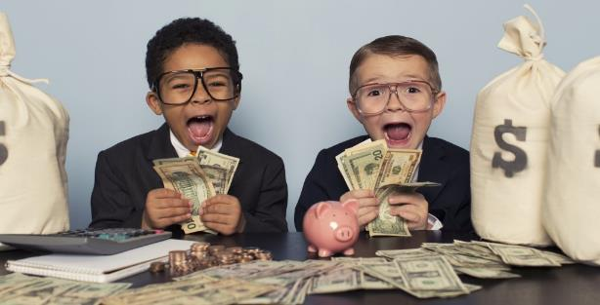
ANSWER # 5
CONGRESSIONAL PAY RAISES

Slide 15
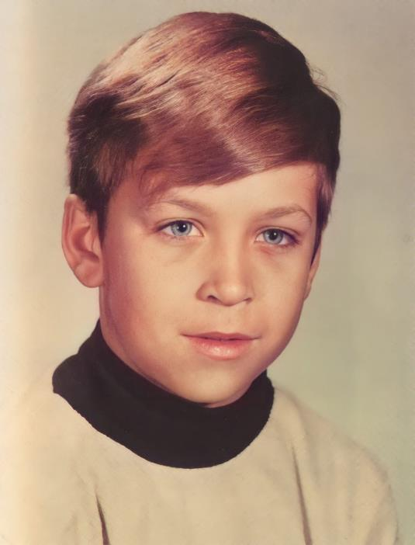
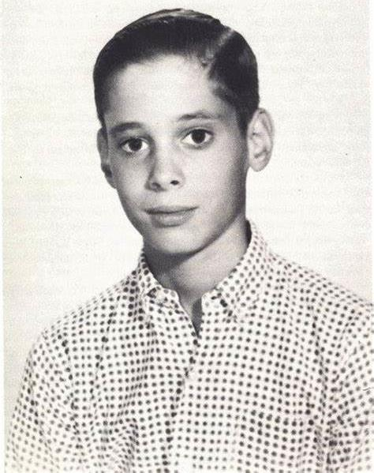
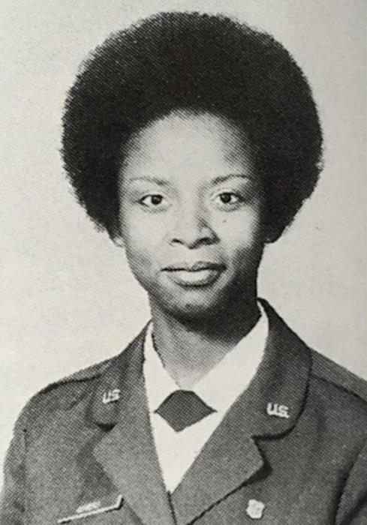
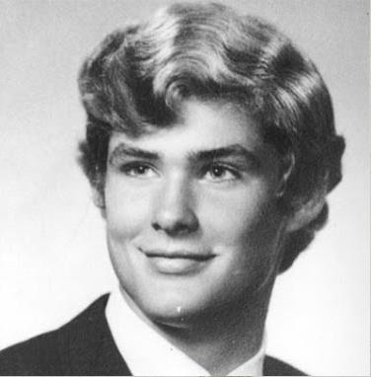
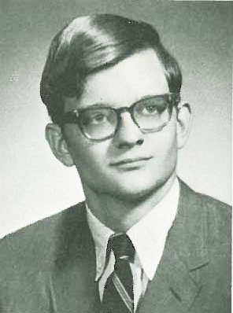
QUESTION # 6
NAME THE MARYLANDERS

Slide 16
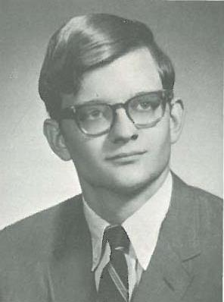
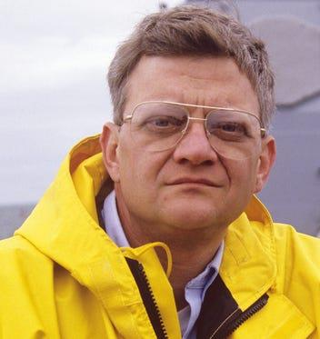
ANSWER #6
TOM CLANCY

Slide 17
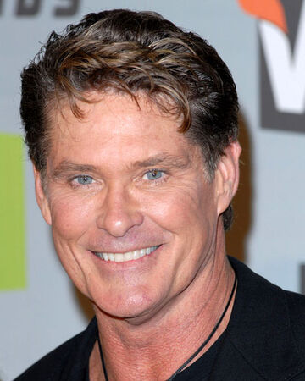
DAVID HASSELHOFF

Slide 18

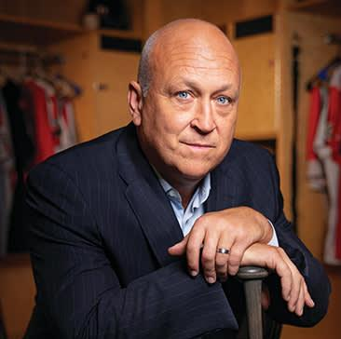
CAL RIPKEN, JR.

Slide 19

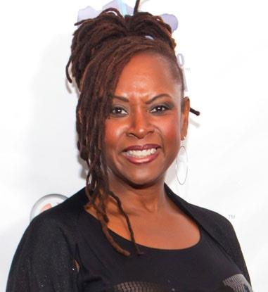
ROBIN QUIVERS

Slide 20
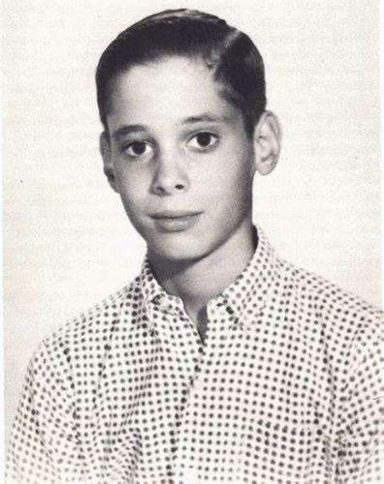
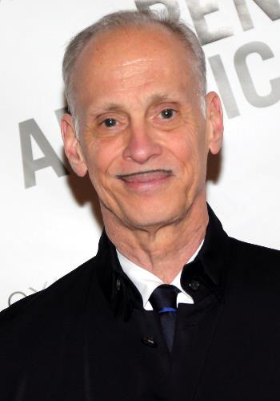
JOHN WATERS

Slide 21
QUESTION # 7
MATH TERMS
WHAT WORD FOR A PROCESS THAT LEADS TO THE SOLUTION TO A PROBLEM COMES FROM THE ARABIC NAME OF A 9TH CENTURY MATHEMATICIAN?

Slide 22
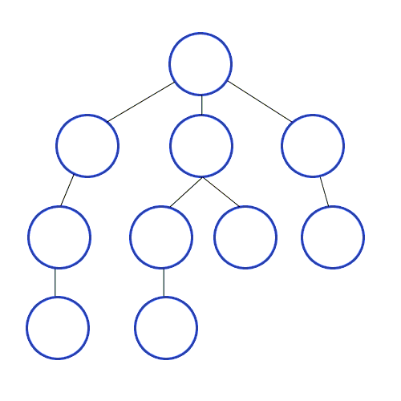
ANSWER # 7
ALGORITHM

Slide 23
QUESTION # 8
MOVIES
2- PARTER
WHAT TWO MOVIES NOMINATED FOR ‘BEST PICTURE’ AT TOMORROW NIGHT’S OSCARS CEREMONY ARE CONSIDERED REMAKES?

Slide 24


ANSWER # 8

Slide 25
QUESTION # 9
BUSINESS
KIRKLAND SIGNATURE IS THE PRIVATE LABEL BRAND OF WHAT CHAIN OF RETAIL STORES?

Slide 26

ANSWER # 9

Slide 27

QUESTION # 10
MUSIC
3-PARTER
NAME THE TITLE, ORIGINAL ARTIST, AND COVER GROUP FOR THE FOLLOWING SONG:

Slide 28
ANSWER # 10
TITLE:
“LIKE A ROLLING STONE”
ORIGINAL ARTIST:
BOB DYLAN
COVER GROUP:
GREEN DAY

Slide 29

HALFTIME
TRIVIAMARYLAND.COM
FACEBOOK.COM/TRIVIAMARYLAND

Slide 30
QUESTION # 11
LANGUAGES
ORIGINATING IN 1817, WHAT IS THE MOST-STUDIED LANGUAGE IN THE U.S. AFTER ENGLISH, SPANISH, AND FRENCH?

Slide 31

ANSWER # 11
AMERICAN SIGN LANGUAGE

Slide 32
QUESTION # 12
SCIENCE
3-PARTER
ALPHABETICALLY, WHAT ARE THE FIRST THREE HALOGENS ON THE PERIODIC TABLE?

Slide 33
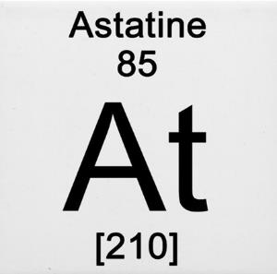
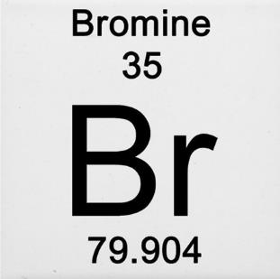
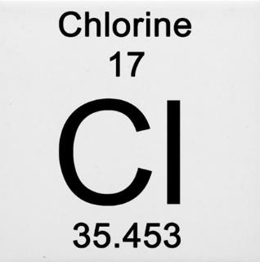
ANSWER # 12

Slide 34
QUESTION # 13
LITERATURE
  “WHO IS JOHN GALT?” IS A QUESTION REPEATED IN WHAT 1957 NOVEL WRITTEN BY THE FOUNDER OF THE PHILOSOPHICAL SYSTEM KNOWN AS OBJECTIVISM?

Slide 35

ANSWER # 13

Slide 36
QUESTION # 14
FOOTBALL
4-PARTER
WHICH FOUR NFC TEAMS WILL HAVE NEW HEAD COACHES FOR THE 2022 SEASON?

Slide 37

ANSWER # 14
CHICAGO BEARS
MINNESOTA VIKINGS
NEW ORLEANS SAINTS
NEW YORK GIANTS

Slide 38
QUESTION # 15
COMPUTERS
    SINCE 2007, WHAT HAS BEEN THE DEFAULT FONT FOR MICROSOFT’S PROGRAMS, INCLUDING WORD, POWERPOINT, EXCEL, OUTLOOK, AND OTHERS?

Slide 39

ANSWER # 15
CALIBRI

Slide 40
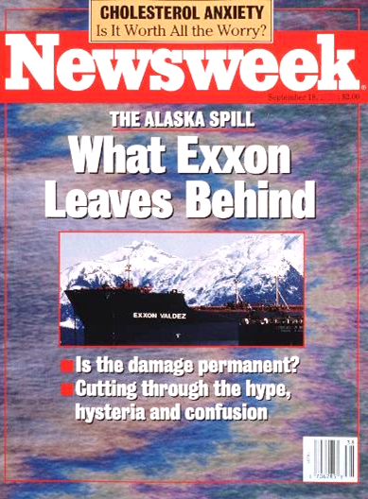

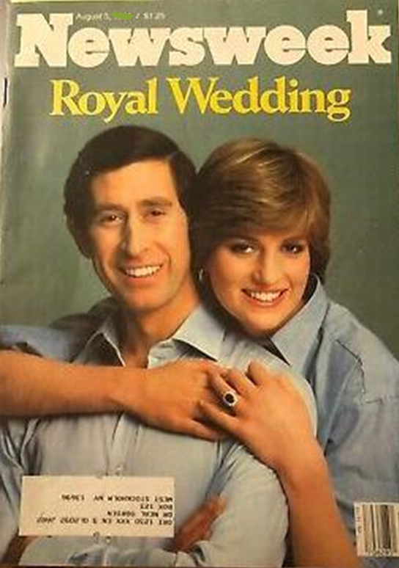
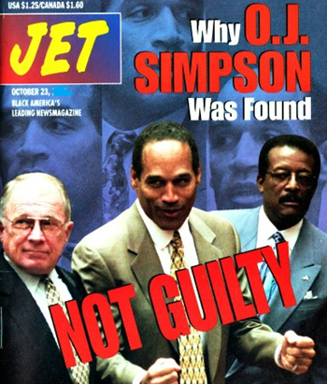
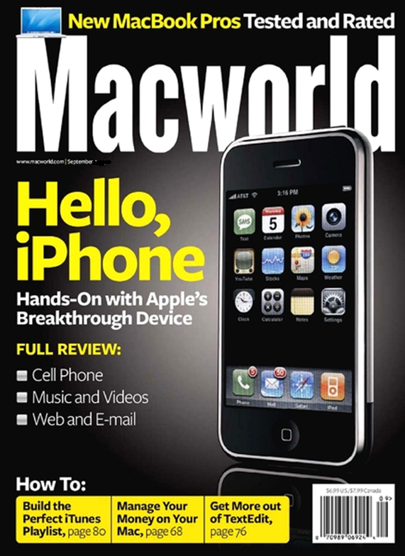
QUESTION # 16
NAME THE YEARS

Slide 41
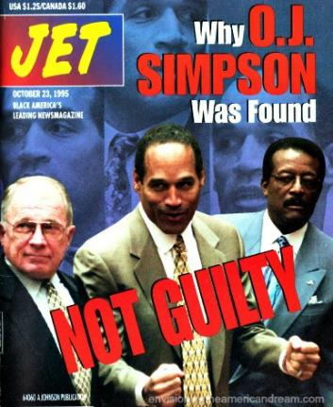
ANSWER #16
1995

Slide 42

2007

Slide 43
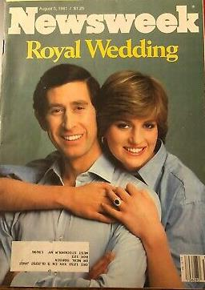
1981

Slide 44
1969

Slide 45
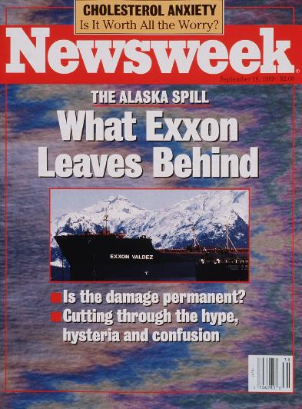
1989

Slide 46
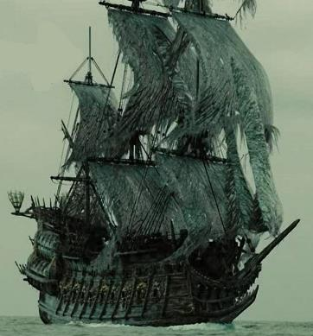
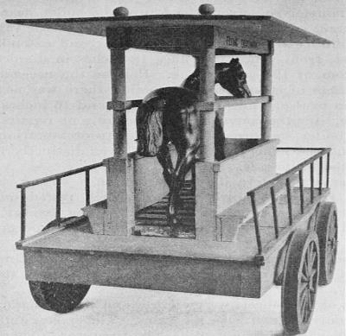
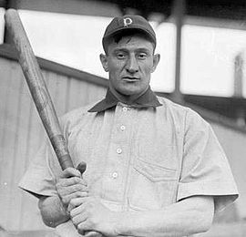
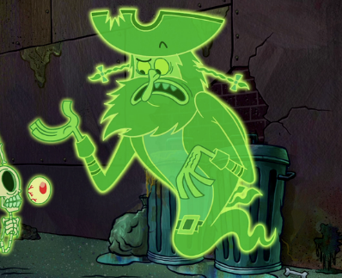
QUESTION # 17
COMMON BONDS
WHAT NAME/NICKNAME IS SHARED BY THESE FOUR PICTURES?

Slide 47
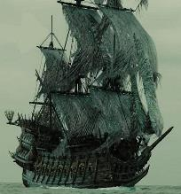
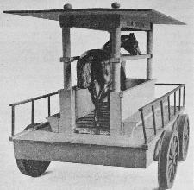
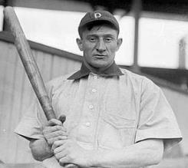

ANSWER # 17
THE FLYING DUTCHMAN
(SHIP FROM PIRATES OF THE CARIBBEAN, HORSE-POWERED LOCOMOTIVE, HONUS WAGNER, CHARACTER FROM SPONGEBOB SQUAREPANTS)

Slide 48
QUESTION # 18
TOYS & GAMES
4-PARTER
    EXCLUDING HANDHELD SYSTEMS AND ADD-ONS, WHAT WERE THE FOUR VIDEO GAME CONSOLES RELEASED BY SEGA IN NORTH AMERICA?

Slide 49

ANSWER # 18
MASTER SYSTEM
GENESIS
SATURN
DREAMCAST

Slide 50
QUESTION # 19
IN THE NEWS
SUPREME COURT CONFIRMATION HEARINGS OPENED THIS WEEK FOR KETANJI BROWN JACKSON, WHO WORKED AS A LAW CLERK FOR WHICH SUPREME COURT JUSTICE FROM 1999-2000?

Slide 51
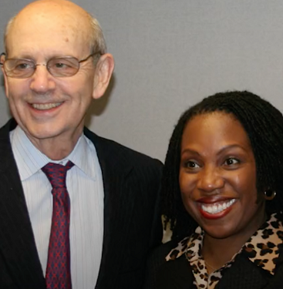
ANSWER # 19
STEPHEN BREYER

Slide 52
QUESTION # 20
BET UP TO 15 POINTS
NAMES
  WHEN THIS MAN IN THE FILM INDUSTRY WAS BORN IN 1944, HIS FIRST NAME WAS THE 14TH-MOST POPULAR BABY NAME FOR BOYS. IN 2020, HIS LAST NAME WAS THE 8TH-MOST POPULAR BABY NAME FOR BOYS. WHO IS IT?

Slide 53
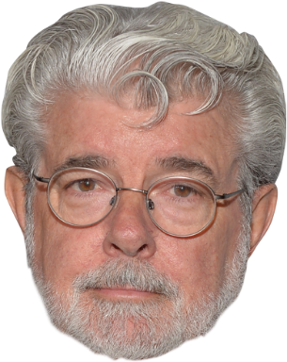
ANSWER # 20
GEORGE LUCAS

Slide 54
TRIVIAMARYLAND
TRIVIAMARYLAND.COM FACEBOOK.COM/TRIVIAMARYLAND

Slide 55
TIEBREAKER QUESTION
AS OF YESTERDAY, FOR HOW MANY PERFORMANCES HAS THE LION KING RUN ON BROADWAY?

Slide 56
TIEBREAKER ANSWER
9,504

