Slide 1
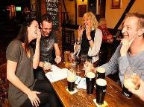
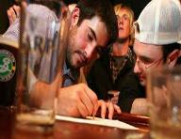
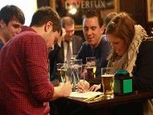
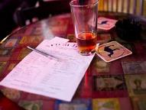
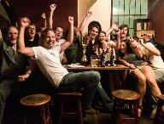
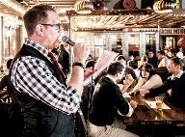
TRIVIA MARYLAND
WORLD SERIES

Slide 2
WORLD SERIES TEAMS
pub crawl liechtenstein
Du crew
Master debators
Birthday bros
Fresh pricks of bel air
clueless
Land of misfit toys
Fear the crab
Moist towelettes
Mostly skraelings
The cruisers
Donner party
infinity
Run over by a puffin
I’m so hungry
Meet us at the bar
marksmen
All or nothing
Missoula trivia theatre
Looking for denim chicken
Whiskey tango foxtrot
Livin la vida yoda
Notes:
North, Central, West, South

Slide 3
QUESTION # 1 LAWS
PASSED BY CONGRESS IN 1856, WHAT FEDERAL ACT ENABLES U.S. CITIZENS TO TAKE POSSESSION, IN THE NAME OF THE UNITED STATES, OF UNCLAIMED ISLANDS?

Slide 4
ANSWER # 1
GUANO ISLANDS ACT

Slide 5
QUESTION # 2 ROYALTY 3-PARTER
AFTER QUEEN ELIZABETH II, WHO ARE THE NEXT THREE FEMALES IN THE LINE OF SUCCESSION TO THE BRITISH THRONE?

Slide 6
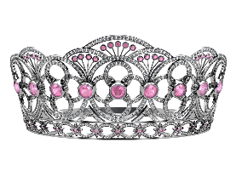
ANSWER # 2
PRINCESS CHARLOTTE
PRINCESS BEATRICE
PRINCESS EUGENIE

Slide 7
QUESTION # 3 WHO AM I?
WHAT COMEDIAN, BORN SCOTT THOMPSON IN 1965, HAD MINOR ROLES IN SO I MARRIED AN AXE MURDERER AND THE HANGOVER AND CURRENTLY HEADLINES A SHOW AT THE LUXOR IN LAS VEGAS?

Slide 8
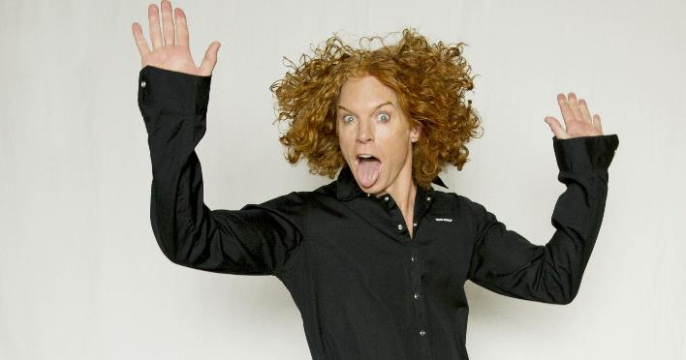
ANSWER # 3
CARROT TOP

Slide 9
QUESTION # 4 HOCKEY 2-PARTER
OF THE TEAMS THAT JOINED THE NHL IN THE 1990s, WHICH TWO HAVE WON A STANLEY CUP?

Slide 10
ANSWER # 4

Slide 11
QUESTION # 5 U.S. GEOGRAPHY
WHAT IS THE ONLY STATE EAST OF THE MISSISSIPPI RIVER THAT BORDERS CANADA BUT NOT THE ATLANTIC OCEAN OR A GREAT LAKE?

Slide 12
ANSWER # 5

Slide 13
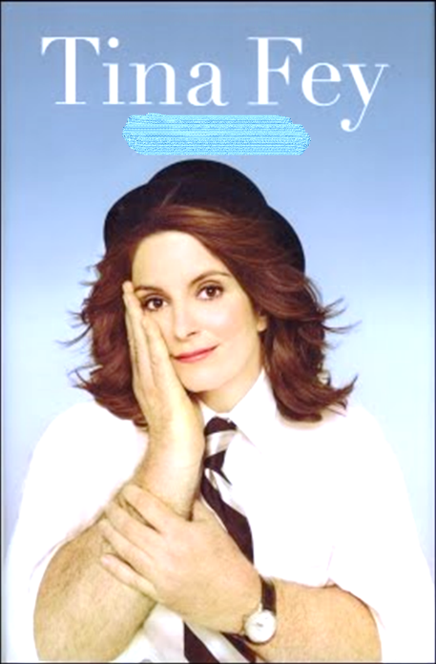
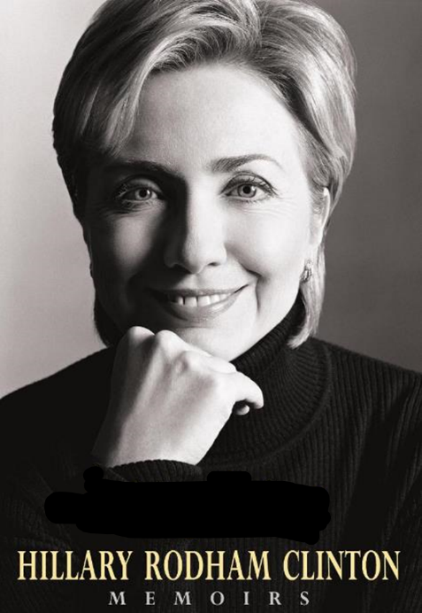
QUESTION # 6
NAME THE AUTOBIOGRAPHIES

Slide 14
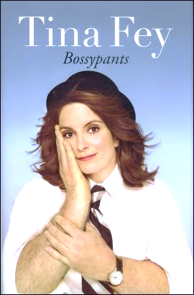
ANSWER #6

Slide 19
QUESTION # 7 COMPUTING
WHAT PROGRAMMING LANGUAGE, DEVELOPED BY IBM IN THE 1950s FOR SCIENTIFIC AND ENGINEERING APPLICATIONS, IS STILL IN USE TODAY?

Slide 20
ANSWER # 7

Slide 21
QUESTION # 8 TOYS & GAMES 3-PARTER
WHAT THREE NEW GAME PIECES WERE INCLUDED WITH MONOPOLY BEGINNING IN 2017?

Slide 22
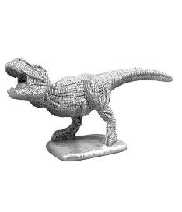
ANSWER # 8
RUBBER DUCK
T-REX
PENGUIN

Slide 23
QUESTION # 9 QUOTATIONS
ACCORDING TO SOCRATES, WHAT TYPE OF LIFE “IS NOT WORTH LIVING”?

Slide 24
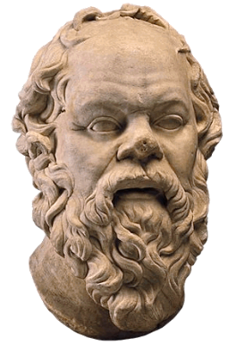
ANSWER # 9
UNEXAMINED

Slide 25
QUESTION # 10 ADVERTISING
3-PARTER
NAME THE PRODUCTS ADVERTISED IN THE FOLLOWING tv COMMERCIALS:

Slide 26
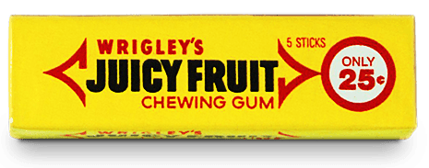
ANSWER # 10

Slide 27
HALFTIME
TRIVIAMARYLAND.COM FACEBOOK.COM/TRIVIAMARYLAND

Slide 28
QUESTION # 11 SCIENCE
WHILE THE RICHTER SCALE MEASURES THE ENERGY RELEASED BY EARTHQUAKES, WHAT SCALE MEASURES THE INTENSITY OF EARTHQUAKES?

Slide 29
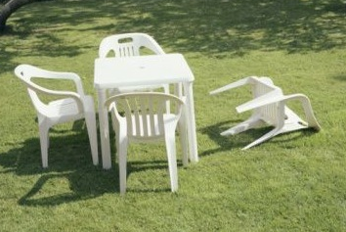
ANSWER # 11
MERCALLI SCALE

Slide 30
QUESTION # 12 WORLD CITIES 2-PARTER
OF THE MOST POPULOUS CITY ON EACH CONTINENT, WHICH TWO HAVE TWO-WORD NAMES?

Slide 31
ANSWER # 12
MEXICO CITY, MEXICO
SÃO PAULO, BRAZIL

Slide 32
QUESTION # 13 SPORTS
SINCE 2006, WHAT IS THE ONLY TEAM IN THE FOUR MAJOR SPORTS TO NOT HAVE A MANAGER/HEAD COACH LAST FOR MORE THAN THREE FULL SEASONS?

Slide 33
ANSWER # 13

Slide 34
QUESTION # 14 MUSIC 2-PARTER
“OLD TOWN ROAD” WAS #1 ON THE BILLBOARD CHART FOR 19 WEEKS, BREAKING THE RECORD HELD BY WHAT TWO SONGS THAT EACH STAYED AT #1 FOR 16 WEEKS? (1995/96, 2017)

Slide 35
ANSWER # 14
“ONE SWEET DAY” (MARIAH CAREY/BOYZ II MEN)
“DESPACITO” (LUIS FONSI/DADDY YANKEE/JUSTIN BIEBER)

Slide 36
QUESTION # 15 RELIGION
THE ‘PRIMATE OF ALL ENGLAND’ IS ANOTHER NAME FOR THE PERSON WHO HOLDS WHAT TITLE?

Slide 37
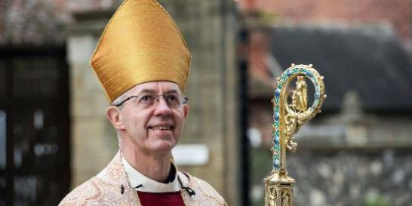
ANSWER # 15
ARCHBISHOP OF CANTERBURY

Slide 38
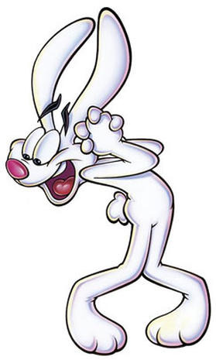
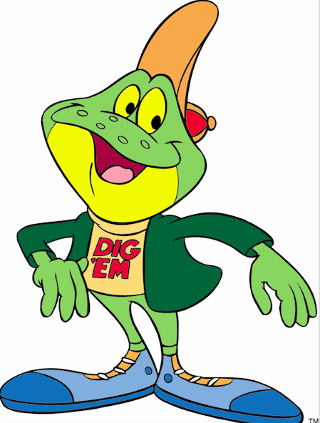
QUESTION # 16
NAME THE CEREALS

Slide 39
ANSWER #16

Slide 43
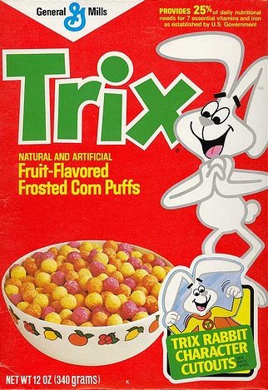

Slide 44
QUESTION # 17 FOREIGN WORDS & PHRASES
MEANING ‘FORCE OF THE COUNTY’ IN LATIN, WHAT TWO-WORD TERM REFERS TO A GROUP OF CITIZENS ASSEMBLED TO AID LAW ENFORCEMENT?

Slide 45
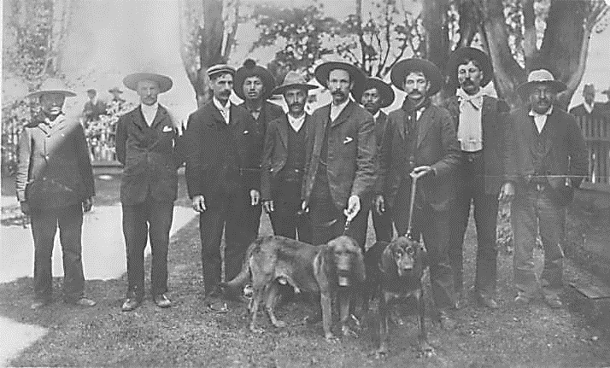
ANSWER # 17
POSSE COMITATUS

Slide 46
QUESTION # 18 MOVIES 4-PARTER
ACCORDING TO BOX OFFICE MOJO, WHAT FOUR MOVIES RELEASED IN 2019 MADE AT LEAST $100 MILLION AT THE DOMESTIC BOX OFFICE IN THEIR OPENING WEEKEND?

Slide 47
ANSWER # 18
AVENGERS: ENDGAME
THE LION KING
CAPTAIN MARVEL
TOY STORY 4

Slide 48
QUESTION # 19 NAME THE DECADE
THE EMPIRE STATE BUILDING IS COMPLETED
BEER IS FIRST SOLD IN CANS
THE STAR SPANGLED BANNER BECOMES THE U.S. NATIONAL ANTHEM
GIANT OPENS ITS FIRST SUPERMARKET

Slide 49
ANSWER # 19
1930s

Slide 50
QUESTION # 20 BET UP TO 15 POINTS THEATRE
OF THE FIVE CITIES MENTIONED IN THE TITLES OF PLAYS BY WILLIAM SHAKESPEARE, WHICH IS THE ONLY ONE NOT FOUND IN EUROPE?

Slide 51
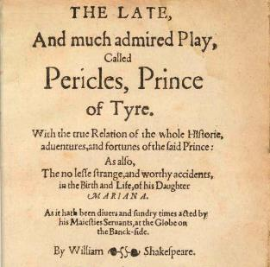
ANSWER # 20
TYRE

Slide 52
TRIVIAMARYLAND
TRIVIAMARYLAND.COM FACEBOOK.COM/TRIVIAMARYLAND

Slide 53
TIEBREAKER
WHAT IS THE CURRENT SALARY FOR THE U.S. SPEAKER OF THE HOUSE?

Slide 54
TIEBREAKER ANSWER
$223,500

