Slide 1


TRIVIAMARYLAND
WORLD SERIES
triviamaryland.com
@triviamaryland

Slide 2

DEEP FRIED GOODNESS
QUIZANTINE EMPIRE
MULVA CLAIBORNE
AROUSED EXPECTATIONS
WE DON’T KNOW JACK
CALL ME OLD FASHIONED
SENIOR MOMENTS
SWEEP THE LEG
NORFOLK & WAY
M AS IN MANCY
PARTIAL RECALL
JOPPATOWN CHRISTIAN CHURCH FIGHTING COMMUNION WAFERS
FEAR THE CRAB
BACONATORS
FAT KIDS
SCHOOL’S OUT
SOD SQUAD
50/50/90
GOING BATTY
NO IDEA
LITE
JUST US
MARKSMEN

Slide 3
QUESTION # 1
VICE PRESIDENTS
WHO WAS THE FIRST U.S. VICE PRESIDENT TO SERVE UNDER TWO DIFFERENT PRESIDENTS?

Slide 4
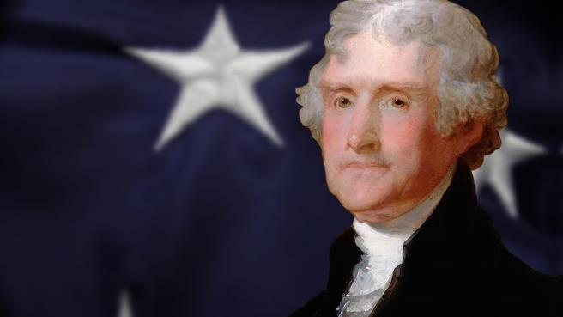
ANSWER # 1
GEORGE CLINTON
(THOMAS JEFFERSON, JAMES MADISON)

Slide 5
QUESTION # 2
FOOTBALL
2-PARTER
WHAT TWO STADIUMS IN NEW ORLEANS HAVE HOSTED THE SUPER BOWL?

Slide 6
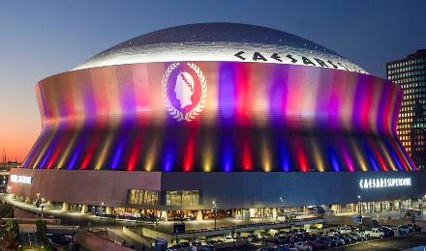
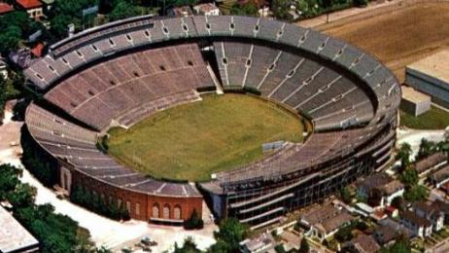
ANSWER # 2
SUPERDOME
TULANE STADIUM

Slide 7
QUESTION # 3
TELEVISION
WHAT TIKTOK STAR WITH OVER 45 MILLION FOLLOWERS WAS THE FIRST PERSON TO APPEAR ON DANCING WITH THE STARS AS PART OF A SAME-SEX PARTNERSHIP?

Slide 8
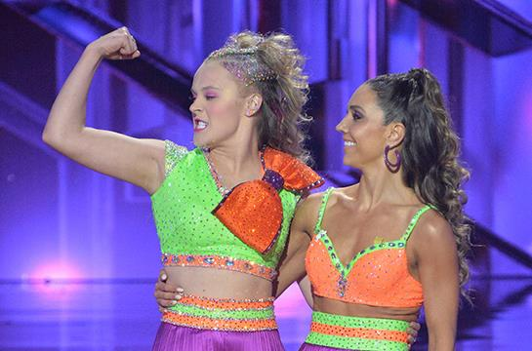
ANSWER # 3
JOJO SIWA

Slide 9
QUESTION # 4
MONEY
3-PARTER
BESIDES THE UNITED STATES, WHAT THREE MAINLAND COUNTRIES IN THE AMERICAS USE THE
U.S. DOLLAR AS THEIR OFFICIAL CURRENCY?

Slide 10

ANSWER # 4
EL SALVADOR
ECUADOR
PANAMA

Slide 11
QUESTION # 5
PHYSICS
WHAT TWO-WORD PHRASE STATES THAT ALL OBJECTS IN THE UNIVERSE ARE MADE OF VIBRATING FILAMENTS OF ENERGY?

Slide 12
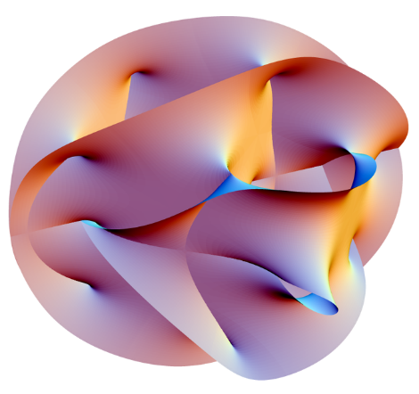
ANSWER # 5
STRING THEORY

Slide 13
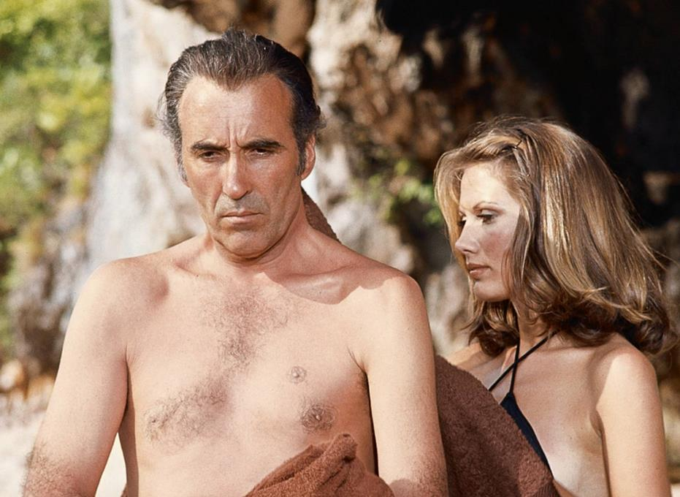
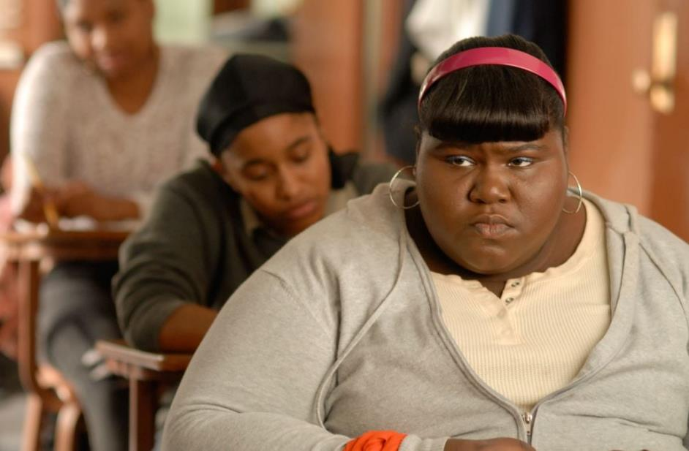
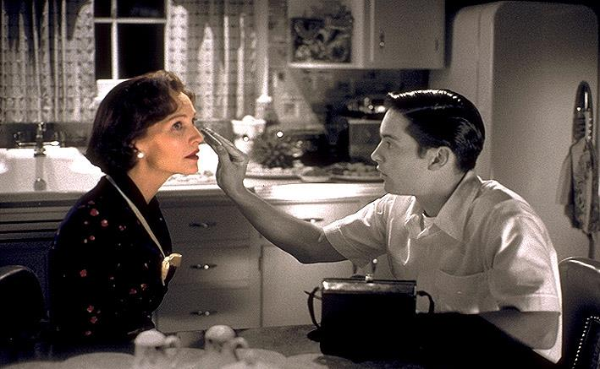
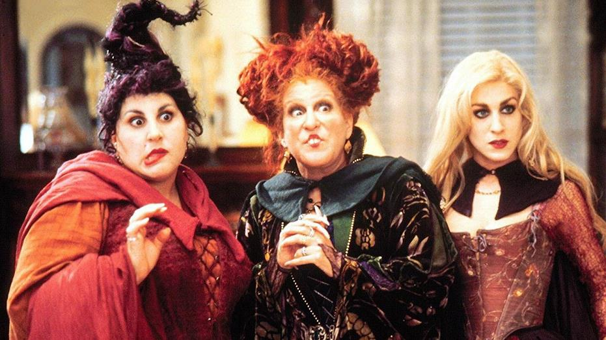
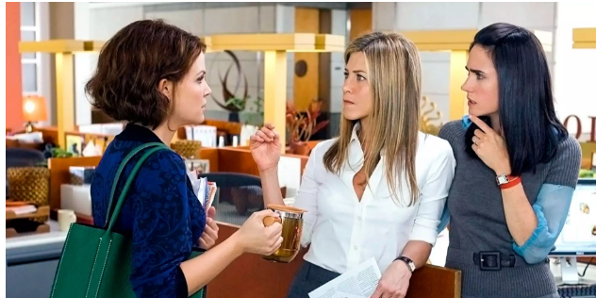
QUESTION # 6
NAME THE MOVIES AND THE THEME

Slide 14

HOCUS POCUS

Slide 15

PRECIOUS

Slide 16

THE MAN WITH THE GOLDEN GUN

Slide 17
PLEASANTVILLE

Slide 18
HE’S JUST NOT THAT INTO YOU

Slide 19
THEME
ALL OF THE MOVIES FEATURE A LEAD CHARACTER NAMED MARY

Slide 20
QUESTION # 7
MATHEMATICS
THE OBELUS IS A SYMBOL USED IN MATH TO INDICATE WHAT FUNCTION?

Slide 21

ANSWER # 7
DIVISION

Slide 22
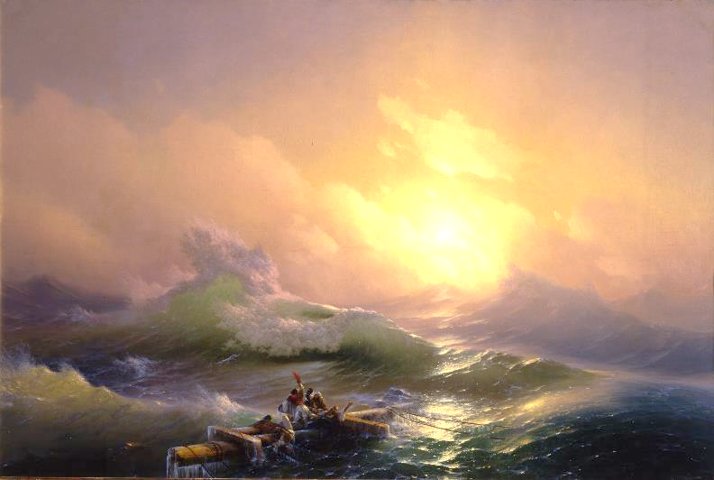
QUESTION # 8
NAME THE ART & ARTIST
2-PARTER

Slide 23
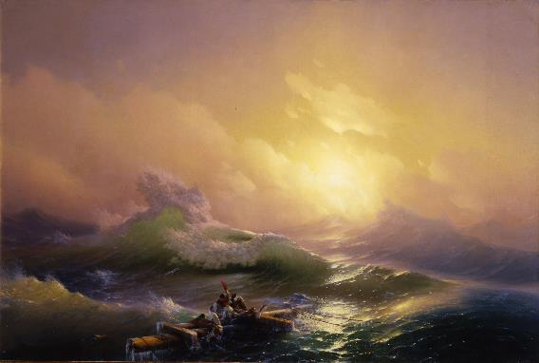
ANSWER # 8
ART: ‘THE NINTH WAVE’
ARTIST: IVAN AIVAZOVSKY

Slide 24
QUESTION # 9
ANNUAL EVENTS
ATTRACTING OVER 500,000 PEOPLE EACH YEAR TO SOUTH DAKOTA, WHAT IS THE NAME OF THE BIGGEST MOTORCYCLE RALLY IN THE WORLD?

Slide 25
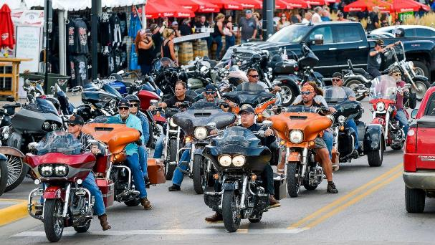
ANSWER # 9
STURGIS

Slide 26

QUESTION # 10
MUSIC
3-PARTER
NAME THE TITLE, ORIGINAL ARTIST, AND COVER GROUP FOR THE FOLLOWING SONG

Slide 27

ANSWER # 10
TITLE
“HAND IN MY POCKET”
ORIGINAL ARTIST
ALANIS MORISSETTE
COVER GROUP
IMAGINE DRAGONS

Slide 28
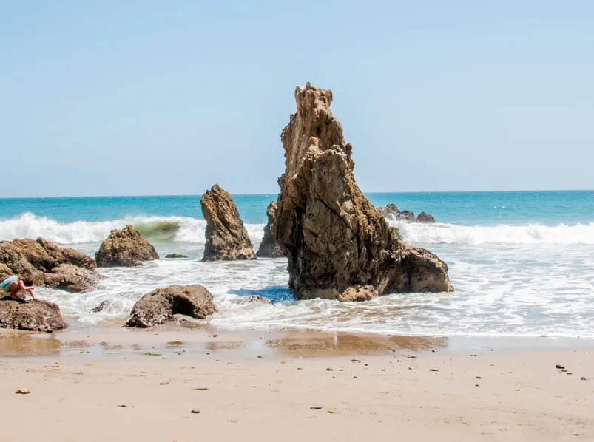

HALFTIME
triviamaryland.com
@triviamaryland

Slide 29
QUESTION # 11
FOOD & DRINK
WITH ITS FLAVOR AND PACKAGING DESIGNED BY ARTIFICIAL INTELLIGENCE, WHAT IS THE ALPHANUMERIC NAME OF COCA-COLA’S NEW ‘FUTURISTIC’ FLAVOR?

Slide 30
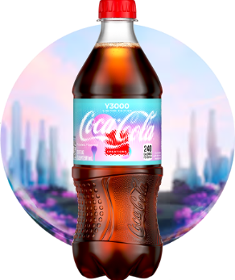
ANSWER # 11
Y3000

Slide 31
QUESTION # 12
WORLD FLAGS
3-PARTER
WHAT THREE SAINTS ARE THE NAMESAKES FOR THE HERALDIC CROSSES ON THE UNION JACK FLAG OF THE UNITED KINGDOM?

Slide 32

ANSWER # 12
PATRICK
ANDREW
GEORGE

Slide 33
QUESTION # 13
AWARDS
PRESENTED ANNUALLY SINCE 1979, THE PRITZKER PRIZE IS AN AWARD GIVEN FOR EXCELLENCE IN
WHAT FIELD?

Slide 34

ANSWER # 13
ARCHITECTURE

Slide 35
QUESTION # 14
VIDEO GAMES
2-PARTER
BOTH RELEASED IN 2017, WHAT ARE THE SUBTITLES OF THE FIRST TWO COMPETITIVE GAMES IN
THE FORTNITE SERIES?

Slide 36
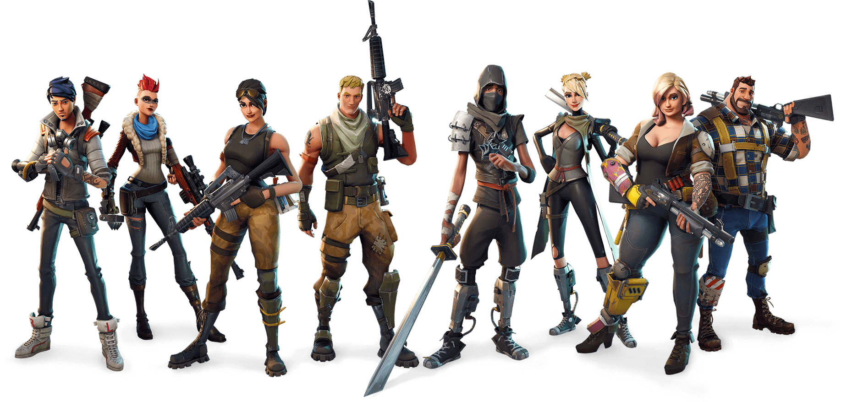
ANSWER # 14
BATTLE ROYALE
SAVE THE WORLD

Slide 37
QUESTION # 15
FASHION
IN 2009, BRITISH DESIGNER ALEXANDER McQUEEN CREATED A
12-INCH PLATFORM SHOE NAMED FOR WHAT TYPE OF MAMMAL?

Slide 38
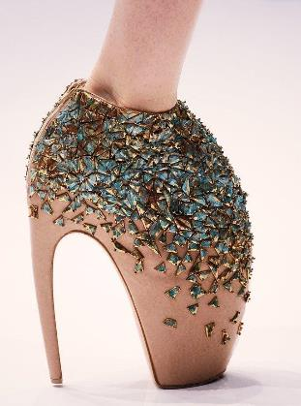
ANSWER # 15
ARMADILLO

Slide 39
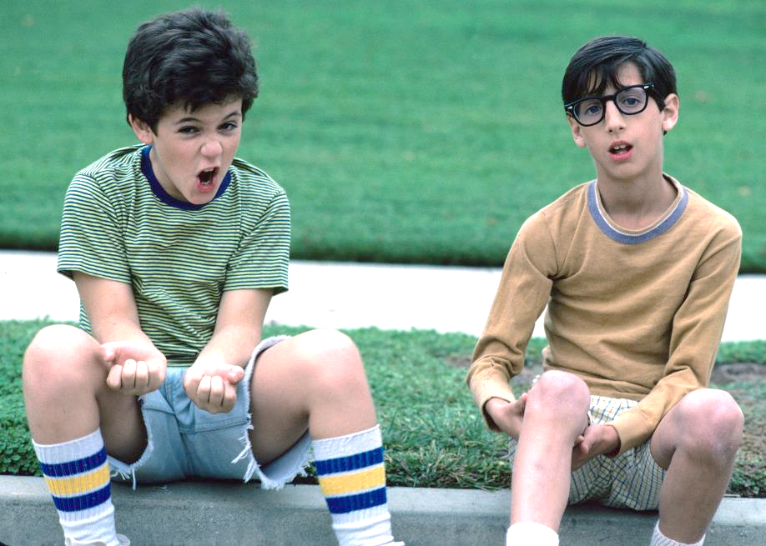
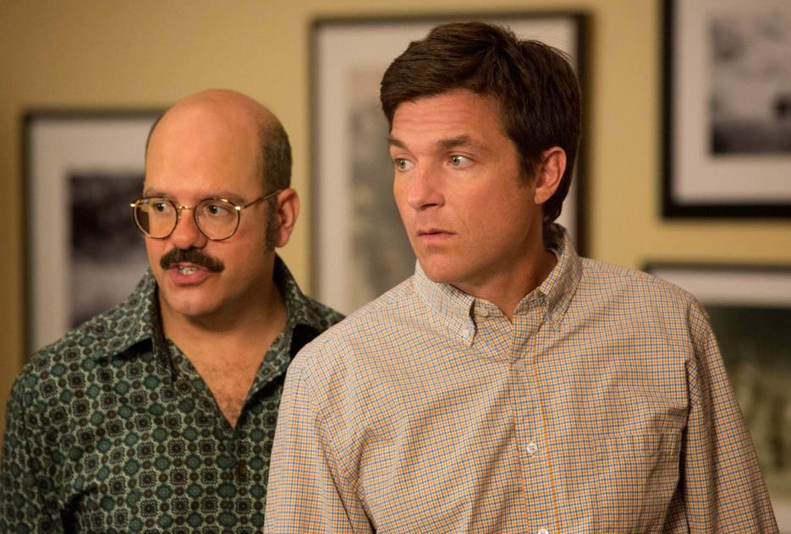
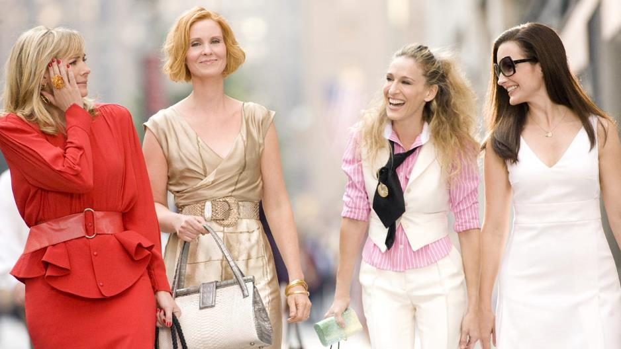
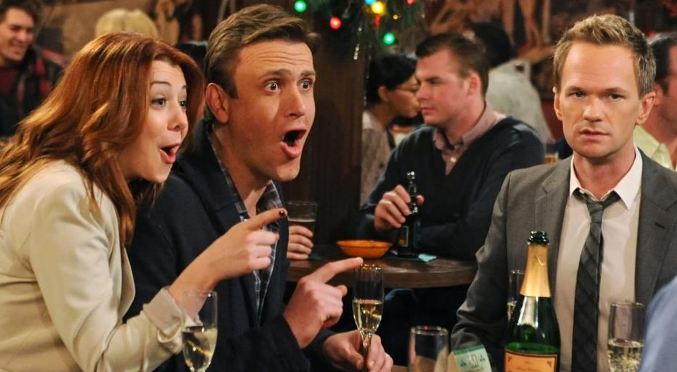
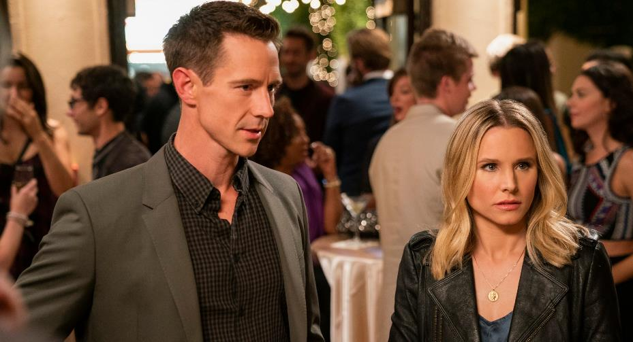
QUESTION # 16
NAME THE ACTORS/ACTRESSES WHO NARRATED THESE TV SHOWS

Slide 40

DANIEL STERN
THE WONDER YEARS

Slide 41

KRISTEN BELL
VERONICA MARS

Slide 42
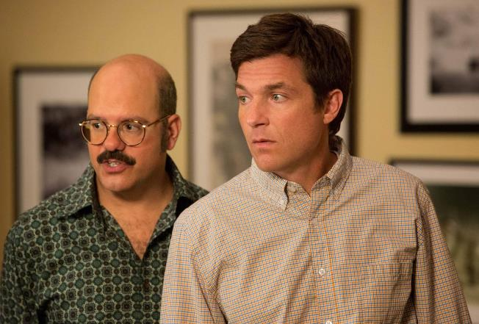
RON HOWARD
ARRESTED DEVELOPMENT

Slide 43
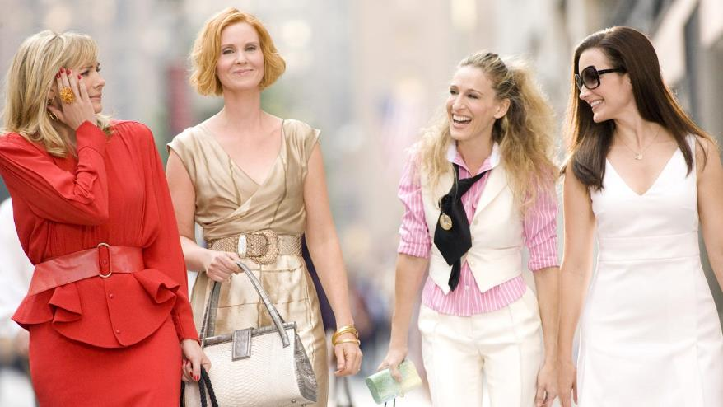
SARAH JESSICA PARKER
SEX AND THE CITY

Slide 44

BOB SAGET
HOW I MET YOUR MOTHER

Slide 45
QUESTION # 17
BUSINESS
WHAT TWO-WORD BUSINESS TERM DESCRIBES A FIRM WHOSE PRIMARY PURPOSE IS TO BUY AND SELL OTHER FIRMS?

Slide 46

ANSWER # 17
HOLDING COMPANY

Slide 47
QUESTION # 18
U.S. STATES
4-PARTER
ACCORDING TO THE 2020 CENSUS, WHAT ARE THE FOUR MOST POPULOUS CITIES IN THE EASTERN TIME ZONE?

Slide 48
ANSWER # 18
NEW YORK, NY
PHILADELPHIA, PA
JACKSONVILLE, FL
COLUMBUS, OH

Slide 49
QUESTION # 19
LITERATURE
LATER ADAPTED FOR TV, FILM, AND THEATRE, WHAT 1856 NOVEL BY GUSTAVE FLAUBERT LED TO AN OBSCENITY TRIAL?

Slide 50

ANSWER # 19

Slide 51
QUESTION # 20
BET UP TO 15 POINTS
ENTERTAINMENT
  WHEN WHAT CHILDREN’S FRANCHISE DEBUTED IN THE UK, ONE OF THE WORDS IN ITS NAME WAS CONSIDERED TOO VIOLENT, SO IT WAS REPLACED WITH THE WORD ‘HERO’?

Slide 52

ANSWER # 20

Slide 53
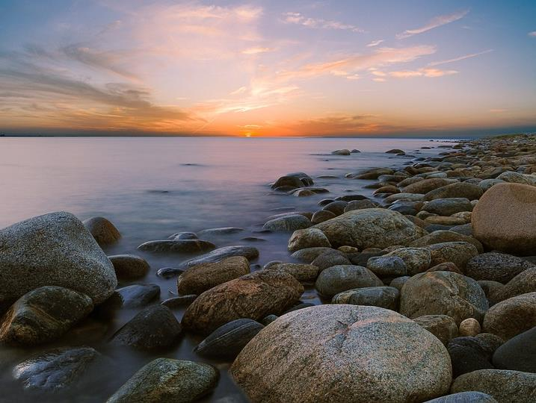

TRIVIAMARYLAND
triviamaryland.com @triviamaryland

Slide 54
TIEBREAKER QUESTION
HOW MANY LETTER SPACES ARE THERE ON THE WHEEL OF FORTUNE BOARD?

Slide 55
TIEBREAKER ANSWER
52

