Slide 1
TRIVIAMARYLAND WORLD SERIES
triviamaryland.com @triviamaryland

Slide 2
QUESTION # 1 THE HUMAN BODY
WHAT IS THE MEDICAL TERM USED WHEN FOOD “GOES DOWN THE WRONG PIPE”?

Slide 3
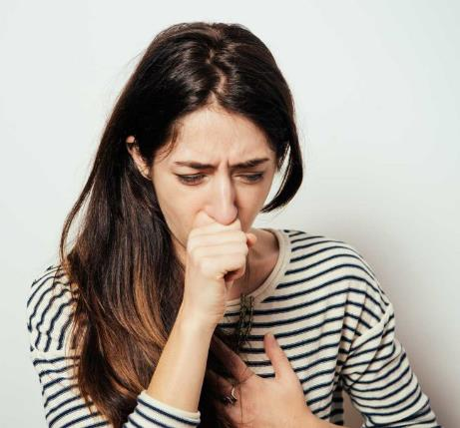
ANSWER # 1
ASPIRATION

Slide 4
QUESTION # 2 MOVIES 2-PARTER
WHAT ARE THE OLDEST AND MOST RECENT FILMS FOR WHICH TOM HANKS HAS BEEN NOMINATED FOR AN ACTING OSCAR?

Slide 5
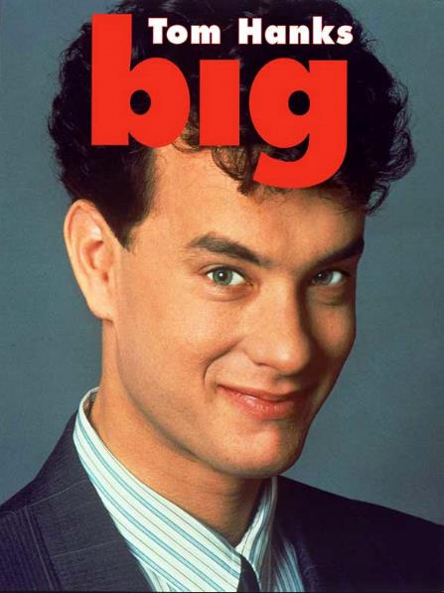
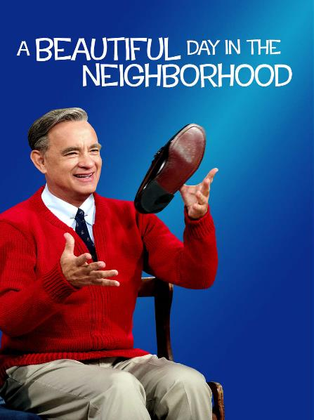
ANSWER # 2

Slide 6
QUESTION # 3 THE OLYMPICS
DEBUTING AS AN OFFICIAL MEDAL EVENT DURING THE 1988 GAMES, WHICH OLYMPIC SPORT FEATURES A PIECE OF EQUIPMENT THAT MEASURES FIVE FEET BY NINE FEET AND IS TWO-AND-A-HALF FEET HIGH?

Slide 7
ANSWER # 3
TABLE TENNIS

Slide 8
QUESTION # 4 U.S. STATES 3-PARTER
OF THE THIRTEEN ORIGINAL COLONIES, WHICH THREE HAVE CAPITALS THAT ALSO SERVE AS THEIR MOST POPULOUS CITIES?

Slide 9
ANSWER # 4
MASSACHUSETTS (BOSTON)
GEORGIA
(ATLANTA)
RHODE ISLAND
(PROVIDENCE)

Slide 10
QUESTION # 5 HISTORY
NAMED FOR AN ILLINOIS REPRESENTATIVE, THE WHITE-SLAVE TRAFFIC ACT OF 1910 IS BETTER KNOWN AS WHAT “ACT”?

Slide 11
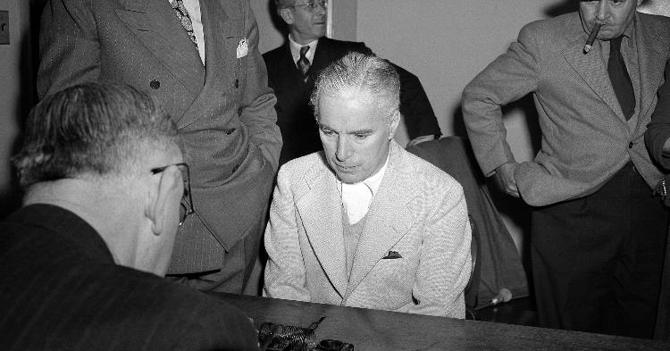
ANSWER # 5
MANN ACT

Slide 12
QUESTION # 6
NAME THE CLOTHING BRANDS

Slide 13
ANSWER #6

Slide 18
QUESTION # 7 PODCASTING
IN 2020, WHOSE PODCAST DID SPOTIFY PURCHASE FOR A RECORD $200 MILLION?

Slide 19
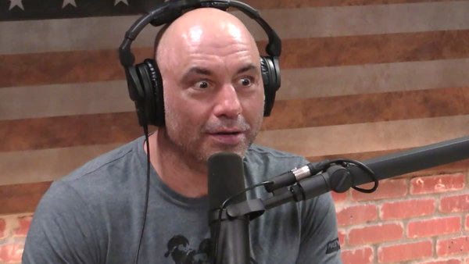
ANSWER # 7
JOE ROGAN

Slide 20
QUESTION # 8 U.S. PRESIDENTS 2-PARTER
WHICH TWO U.S. PRESIDENTS WERE BORN IN A STATE THAT BEGINS WITH THE LETTER ‘I’?

Slide 21
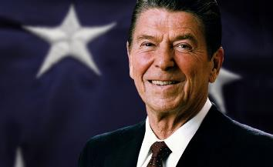
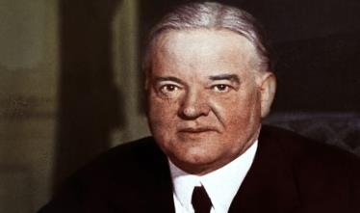
ANSWER # 8
RONALD REAGAN
(ILLINOIS)
HERBERT HOOVER
(IOWA)

Slide 22
QUESTION # 9 FICTIONAL CHARACTERS
WHAT FICTIONAL CHARACTER’S LIKENESS HAS BEEN USED FOR A COOKIE SOLD BY KEEBLER AND A DOG TREAT SOLD BY SNAUSAGES?

Slide 23
ANSWER # 9
SCOOBY-DOO

Slide 24
QUESTION # 10 MUSIC
3-PARTER
NAME THE TITLE, ORIGINAL GROUP, AND COVER ARTIST FOR THE FOLLOWING SONG:

Slide 25
ANSWER # 10
TITLE
“FIX YOU”
ORIGINAL GROUP
COLDPLAY
COVER ARTIST
CARRIE UNDERWOOD

Slide 26
HALFTIME

Slide 27
QUESTION # 11
SCIENCE
THE MEDICAL CONDITION GOITER, WHICH IS AN ABNORMAL ENLARGEMENT OF THE THYROID GLAND, IS MOST OFTEN CAUSED BY A DIETARY LACK OF WHAT?

Slide 28
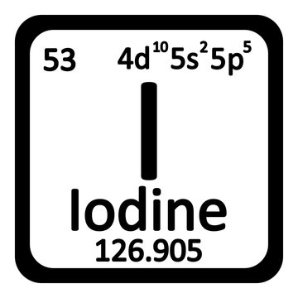
ANSWER # 11

Slide 29
QUESTION # 12 COMEDY 3-PARTER
IN ABBOTT AND COSTELLO’S “WHO’S ON FIRST” ROUTINE, WHAT ARE THE NAMES OF THE OTHER THREE INFIELDERS?

Slide 30
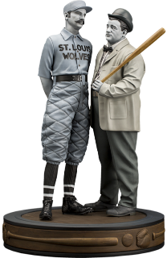
ANSWER # 12
I DON’T KNOW
I DON’T CARE!
WHAT

Slide 31
QUESTION # 13 LITERATURE
WHAT IS THE LAST NAME OF THE FICTIONAL PERSONA CREATED BY WASHINGTON IRVING TO NARRATE HIS 1809 PARODY A HISTORY OF NEW YORK, WHICH LATER BECAME A NICKNAME FOR ANY NEW YORKER?

Slide 32
ANSWER # 13
KNICKERBOCKER

Slide 33
QUESTION # 14 MONEY
2-PARTER
WHICH TWO SIGNERS OF THE DECLARATION OF INDEPENDENCE APPEAR ON CURRENTLY PRINTED U.S. PAPER CURRENCY?

Slide 34
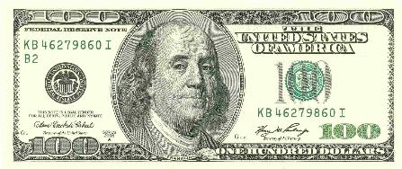
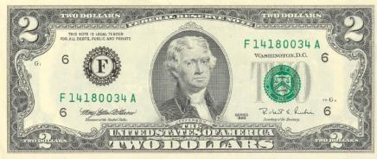
ANSWER # 14
BENJAMIN FRANKLIN
THOMAS JEFFERSON

Slide 35
QUESTION # 15 FOOD & DRINK
IN 2004, WHAT FAST FOOD CHAIN BECAME THE FIRST TO ADVERTISE AN R-RATED FILM ON ITS CONTAINERS?

Slide 36
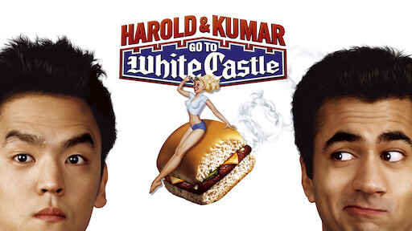
ANSWER # 15
WHITE CASTLE

Slide 37
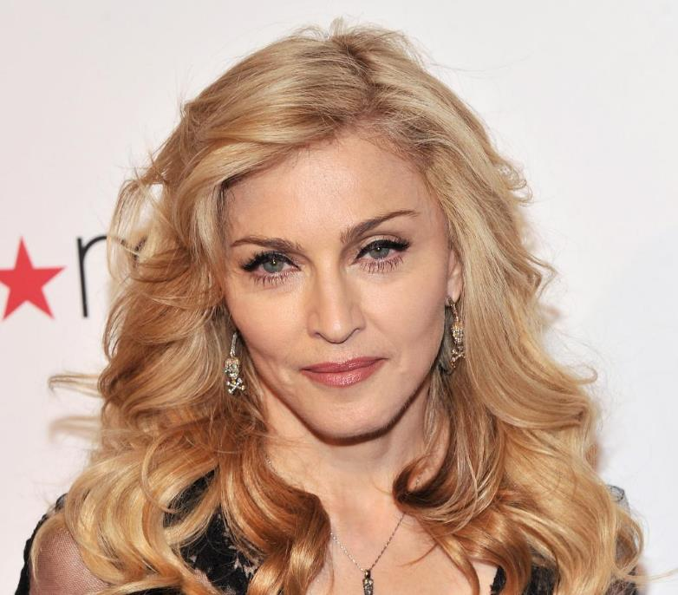
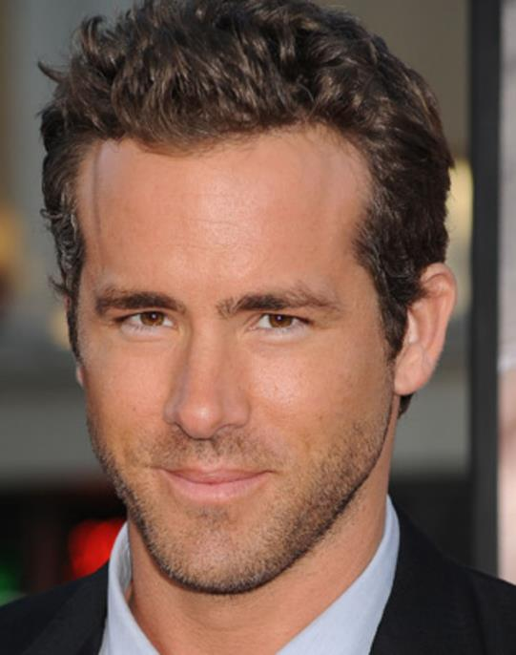
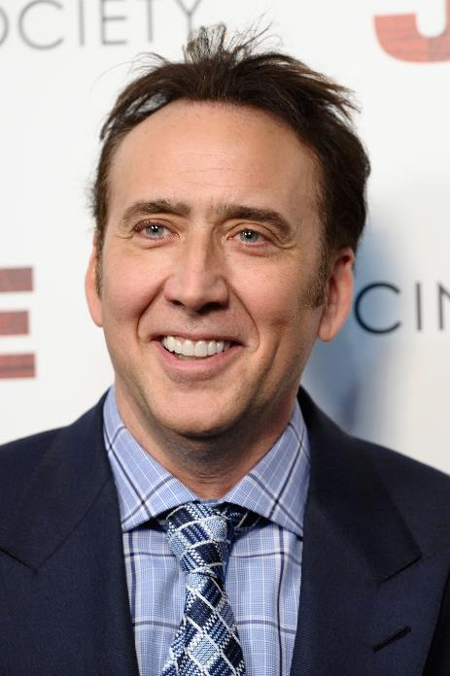
QUESTION # 16
NAME THEIR FIRST SPOUSES

Slide 38
ANSWER #16
TOMMY LEE
(PAMELA ANDERSON)

Slide 39
PATRICIA ARQUETTE
(NICOLAS CAGE)

Slide 40
SEAN PENN
(MADONNA)

Slide 41
SCARLETT JOHANSSON
(RYAN REYNOLDS)

Slide 42
PETE WENTZ
(ASHLEE SIMPSON)

Slide 43
QUESTION # 17 MARYLAND
THE ONLY SURVIVING SHIP FROM THE CIVIL WAR ERA, WHAT VESSEL HAS BEEN DOCKED AT THE INNER HARBOR SINCE 1968?

Slide 44
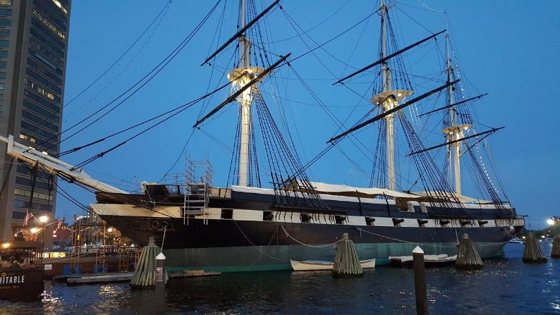
ANSWER # 17
U.S.S. CONSTELLATION

Slide 45
QUESTION # 18 6-4-2
IN 1936, ORSON WELLES ADAPTED AND DIRECTED AN ALL-BLACK PRODUCTION OF THIS PLAY, REFERRED TO AS THE “VOODOO” PRODUCTION
THE TITLE CHARACTER OF THIS SHAKESPEARE PLAY WAS PORTRAYED IN A 2021 FILM BY DENZEL WASHINGTON
THIS PLAY IS FREQUENTLY REFERRED TO AS “THE SCOTTISH PLAY” AND FEATURES THE LINE “DOUBLE, DOUBLE TOIL AND TROUBLE; FIRE BURN AND CAULDRON BUBBLE”

Slide 46
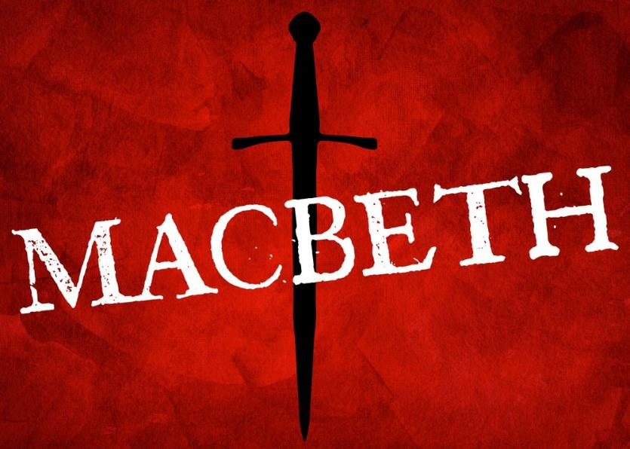
ANSWER # 18

Slide 47
QUESTION # 19 UP IN THE AIR
IN ADDITION TO THEIR ALPHANUMERIC CODES, THE BOEING B-29 AND B-50 BOMBERS ALSO INCLUDE WHAT COMPOUND WORD IN THEIR FULL NAMES?

Slide 48
ANSWER # 19
SUPERFORTRESS

Slide 49
QUESTION # 20 BET UP TO 15 POINTS ENTERTAINMENT
DEBUTING IN THE 1950s AND AIRING FOR 19 SEASONS, WHAT IS THE LONGEST-RUNNING AMERICAN TV SHOW IN HISTORY THAT WAS ADAPTED FROM A NOVEL?

Slide 50
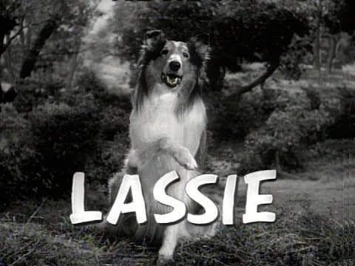
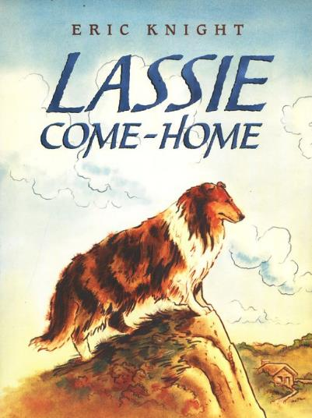
ANSWER # 20

Slide 51
TRIVIAMARYLAND

Slide 52
TIEBREAKER
HOW MUCH DID TOM HANKS EARN FOR HIS ROLE IN BIG?

Slide 53
TIEBREAKER ANSWER
$1,750,000

