Slide 1
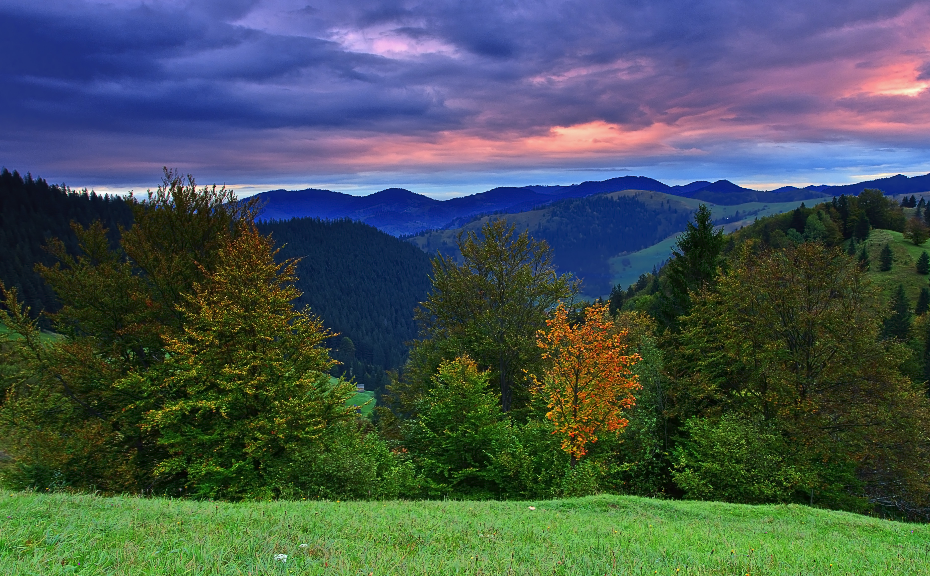
TRIVIAMARYLAND
WORLD SERIES
TRIVIAMARYLAND.COM FACEBOOK.COM/TRIVIAMARYLAND

Slide 2
QUESTION # 1
BOTANY
AN EPIPHYTE IS A PLANT THAT DOES WHAT?

Slide 3

ANSWER # 1
GROWS ON OTHER PLANTS

Slide 4
QUESTION # 2
WORLD COUNTRIES
3-PARTER
WHAT ARE THE THREE EUROPEAN COUNTRIES THAT SHARE A BORDER WITH RUSSIA THAT WERE NOT PART OF THE USSR?

Slide 5
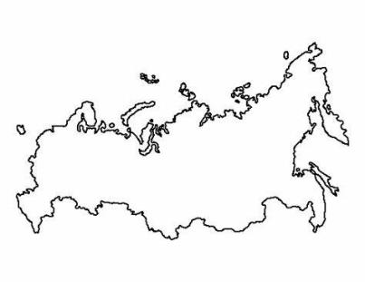
ANSWER # 2
FINLAND
POLAND
NORWAY

Slide 6
QUESTION # 3
TECHNOLOGY
ACTIVE FROM APRIL 2020 - DECEMBER 2020, WHAT IS THE NAME OF THE STREAMING SERVICE THAT FEATURED ORIGINAL CONTENT IN SHORT-FORM EPISODES OF TEN MINUTES OR LESS?

Slide 7

ANSWER # 3

Slide 8
QUESTION # 4
BASKETBALL
3-PARTER
OF THE TEN WINNINGEST COACHES IN NBA HISTORY, WHICH THREE ARE NOT MEMBERS OF THE BASKETBALL HALL OF FAME AS COACHES?

Slide 9

ANSWER # 4
GREGG POPOVICH
GEORGE KARL
DOC RIVERS

Slide 10
QUESTION # 5
HISTORY
IN 1786, WHAT ARMED UPRISING TOOK PLACE IN WESTERN MASSACHUSETTS WHEN A REBEL ARMY MARCHED ON THE SPRINGFIELD ARMORY IN AN ATTEMPT TO OVERTHROW THE GOVERNMENT?

Slide 11
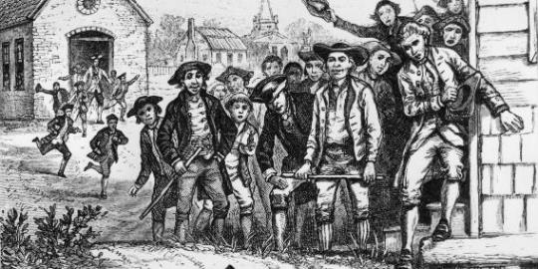
ANSWER # 5
SHAYS’ REBELLION

Slide 12
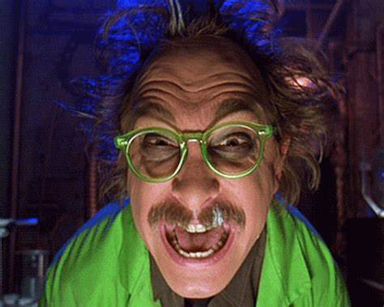
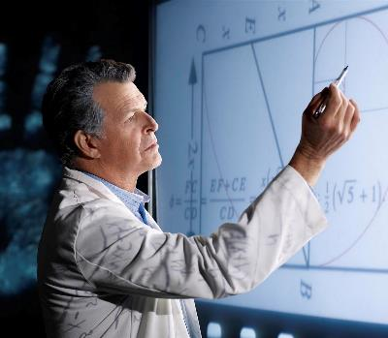
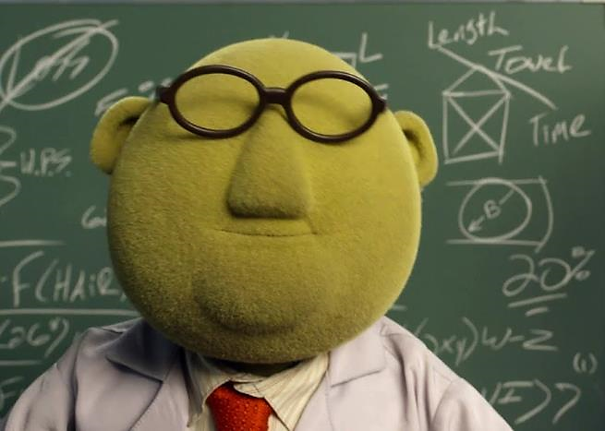
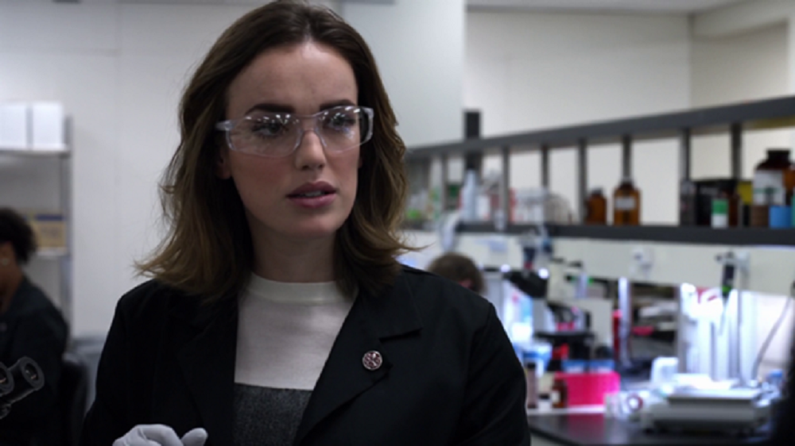
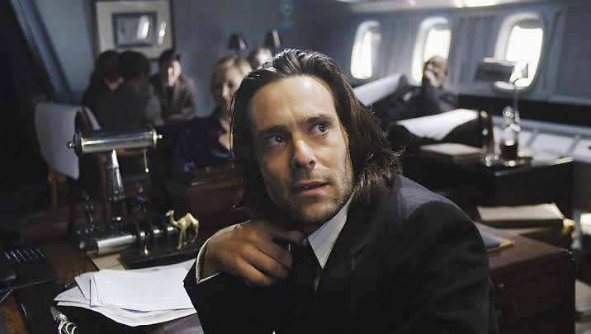
QUESTION # 6
NAME THE TV SCIENTISTS

Slide 13
ANSWER #6
WALTER BISHOP
FRINGE

Slide 14

BUNSEN HONEYDEW
THE MUPPET SHOW

Slide 15
CLAYTON FORRESTER
MYSTERY SCIENCE THEATER 3000

Slide 16
GAIUS BALTAR
BATTLESTAR GALACTICA

Slide 17
JEMMA SIMMONS
AGENTS OF S.H.I.E.L.D.

Slide 18
QUESTION # 7
RELIGION
THE INDIAN REGION OF PUNJAB IS HOME TO ABOUT 19 MILLION OF THE WORLD’S 25 MILLION PRACTITIONERS OF WHAT RELIGION?

Slide 19

ANSWER # 7
SIKHISM

Slide 20
QUESTION # 8
MOVIES
2-PARTER
WHAT HUSBAND AND WIFE ARE THE ONLY TWO SPANISH ACTORS TO WIN ACADEMY AWARDS FOR ACTING?

Slide 21
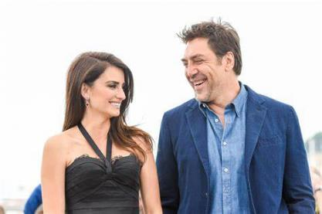
ANSWER # 8
PENÉLOPE CRUZ
JAVIER BARDEM

Slide 22
QUESTION # 9
WEIGHTS & MEASUREMENTS
WHAT WORD MOST COMMONLY USED AS A PEJORATIVE IS ALSO THE NAME OF A PHYSICS UNIT THAT MEASURES THE RATE AT WHICH ACCELERATION CHANGES?

Slide 23
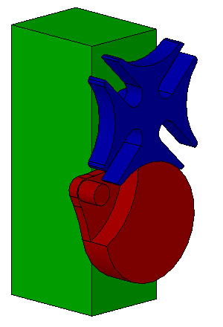
ANSWER # 9
JERK

Slide 24


QUESTION # 10
MUSIC
4-PARTER
NAME THE SONG AND THE THREE SINGERS PERFORMING IT

Slide 25
ANSWER # 10
SONG:
“ONE”
SINGERS:
JOHNNY CASH
MARY J. BLIGE
MICHAEL STIPE

Slide 26

HALFTIME
TRIVIAMARYLAND.COM FACEBOOK.COM/TRIVIAMARYLAND

Slide 27
QUESTION # 11
THE HUMAN BODY
SINGULTUS IS THE MEDICAL TERM FOR WHAT COMMON MINOR MEDICAL AILMENT?

Slide 28
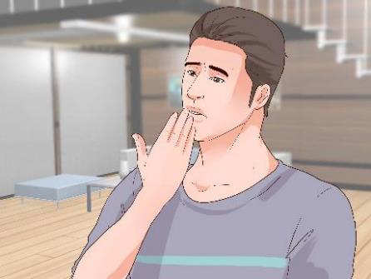
ANSWER # 11
HICCUPS

Slide 29
QUESTION # 12
MARYLAND
2-PARTER
WHAT TWO DEMOCRATS CURRENTLY REPRESENT MARYLAND IN THE U.S. SENATE?

Slide 30
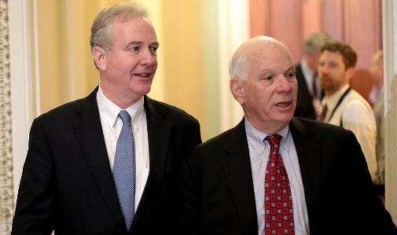
ANSWER # 12
BEN CARDIN
CHRIS VAN HOLLEN

Slide 31
QUESTION # 13
THEATRE
WHAT ANDREW LLOYD WEBBER MUSICAL THAT DEBUTED IN 2010 IS A SEQUEL TO THE PHANTOM OF THE OPERA?

Slide 32

ANSWER # 13

Slide 33
QUESTION # 14
MAGAZINES
4-PARTER
WHAT FOUR WORLD LEADERS REPRESENTED “THE PEACEMAKERS” AS TIME MAGAZINE’S ‘MAN OF THE YEAR’ IN 1993?

Slide 34
ANSWER # 14
YASSER ARAFAT
F.W. DE KLERK
NELSON MANDELA
YITZHAK RABIN

Slide 35
QUESTION # 15
BUSINESS
WHAT PERSONAL CARE COMPANY HAS USED THE SLOGAN “DOES SHE… OR DOESN’T SHE?”

Slide 36


ANSWER # 15

Slide 37
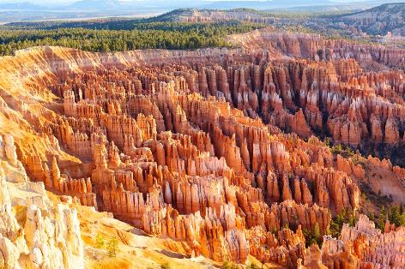
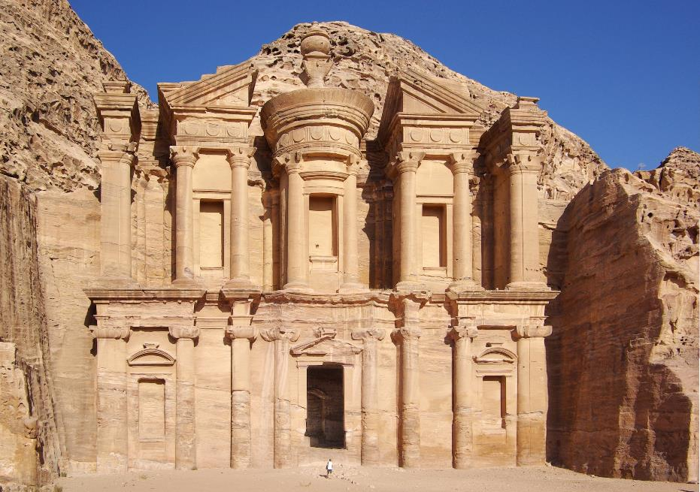
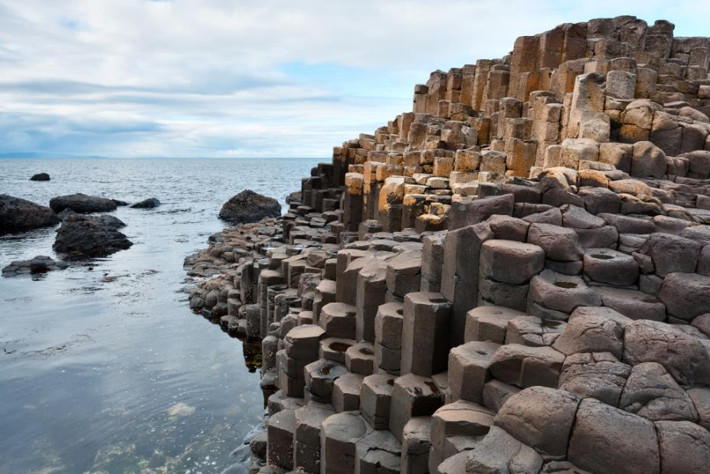
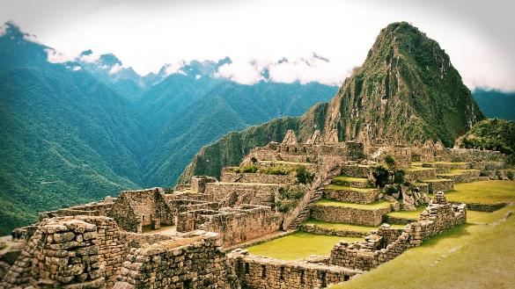
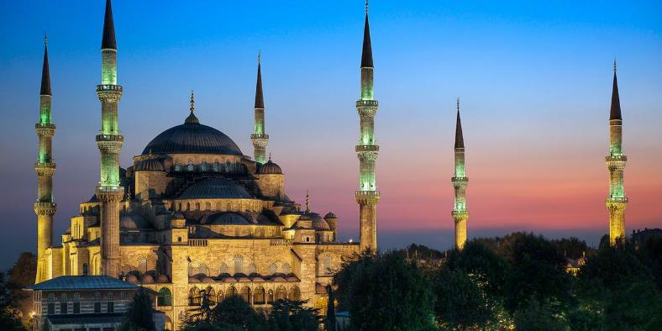
QUESTION # 16
NAME THE LANDMARKS

Slide 38
ANSWER #16
MACHU PICCHU
PERU

Slide 39

GIANT’S CAUSEWAY
IRELAND

Slide 40

PETRA
JORDAN

Slide 41
BLUE MOSQUE
TURKEY

Slide 42
BRYCE CANYON NATIONAL PARK
UNITED STATES

Slide 43
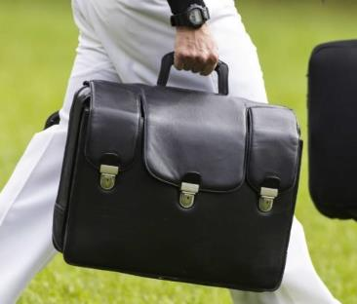
QUESTION # 17
TERMINOLOGY
WHAT IS THE TWO-WORD, SPORTS-RELATED NAME OF THIS MILITARILY IMPORTANT BRIEFCASE, WHICH ALWAYS ACCOMPANIES THE PRESIDENT OF THE UNITED STATES?

Slide 44

ANSWER # 17
NUCLEAR FOOTBALL

Slide 45
QUESTION # 18
MOVIE MUSIC
2-PARTER
IN THE 1990s, WHAT TWO SONGS THAT WON THE OSCAR FOR BEST ORIGINAL SONG HAVE THE MOVIE’S TITLE CONTAINED IN THE SONG’S TITLE?

Slide 46
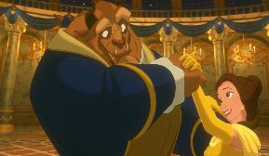
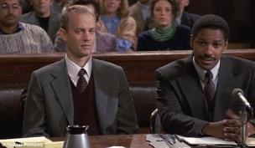
ANSWER # 18
‘BEAUTY AND THE BEAST’
‘STREETS OF PHILADELPHIA’

Slide 47
QUESTION # 19
FOREIGN WORDS & PHRASES
FROM THE FRENCH FOR ‘LOOSENING’, WHAT WORD REFERS TO THE LOOSENING OF TENSIONS BETWEEN THE U.S. AND THE SOVIET UNION IN THE 1970s?

Slide 48

ANSWER # 19
DÉTENTE

Slide 49
QUESTION # 20
BET UP TO 15 POINTS
TELEVISION
WHAT TV GAME SHOW, ON THE AIR SINCE 2009, ORIGINALLY DEBUTED IN 1963 AND SAW U.S. REVIVALS IN 1980, 1984, 1990, AND 2003?

Slide 50
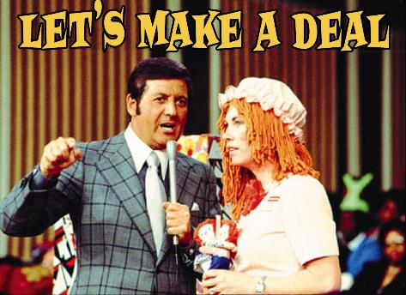
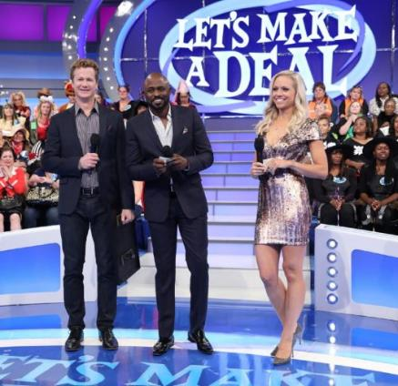
ANSWER # 20

Slide 51

TRIVIAMARYLAND
TRIVIAMARYLAND.COM FACEBOOK.COM/TRIVIAMARYLAND

Slide 52
TIEBREAKER
IN WHAT YEAR DID ST. PATRICK’S DAY BECOME AN OFFICIAL PUBLIC HOLIDAY IN IRELAND?

Slide 53
TIEBREAKER ANSWER
1903

