Slide 1
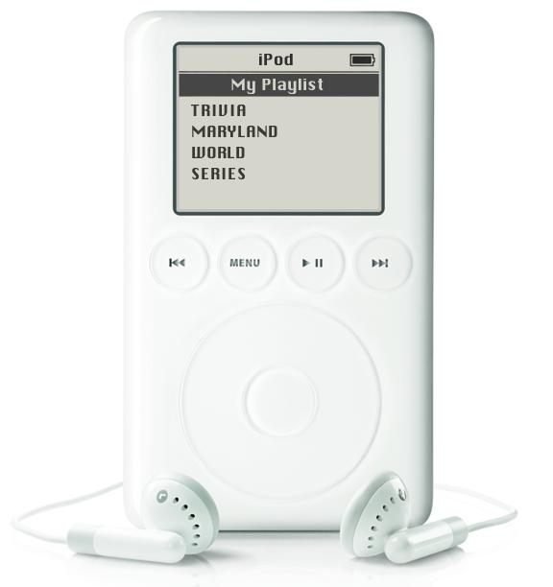


Slide 2

BEACH BUMS
CAFFEINATORS
DEBBIE & THE NITTIE GRITTIEST
DOT STRIKES BACK
FAB FOUR
FEAR THE CRAB
FRESH PRICKS OF BEL AIR
GUESSING GEEZERS
I’M SO HUNGRY
LOOKING FOR DENIM CHICKEN
MAKE UP YOUR MINDS
MARKSMEN
NEW MOFOS
PUB CRAWL LIECHTENSTEIN
RUN OVER BY A PUFFIN
SUCK IT TREBEK
SWEEP THE LEG
TRIVIA NEWTON JOHN
TRIVIA-HOLICS ANONYMOUS
TRIVIANATORS
TROUBLE IN TRIVIA TOWN
UNDECIDED
WAIT, WHAT?

Slide 3

UPCOMING EVENTS
THEME GAMES: NETFLIX, HARRY POTTER, STEPHEN KING, AND MORE!
6TH ANNUAL OCEAN CITY TOURNAMENT: MAY 4, 2019
FALL SEASON STARTS MONDAY

Slide 4
QUESTION # 1
DEFINITIONS
WHAT WORD FOR ONE WHO EATS FOOD GROWN OR PRODUCED NEARBY WAS THE 2007 OXFORD AMERICAN DICTIONARY WORD OF THE YEAR?

Slide 5
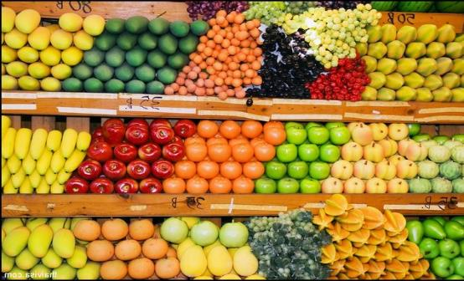
ANSWER # 1
LOCAVORE

Slide 6
QUESTION # 2
U.S. PRESIDENTS
3-PARTER
WHAT THREE CONSECUTIVE U.S. PRESIDENTS WERE REPUBLICANS, BORN IN OHIO, AND GENERALS IN THE UNION ARMY?

Slide 7

ANSWER # 2
ULYSSES S. GRANT
RUTHERFORD B. HAYES
JAMES GARFIELD

Slide 8
QUESTION # 3
TENNIS
WHAT WAS THE LAST NAME OF THE BROTHER-SISTER TEAM THAT WON THE WIMBLEDON MIXED DOUBLES TOURNAMENT IN 1980?

Slide 9
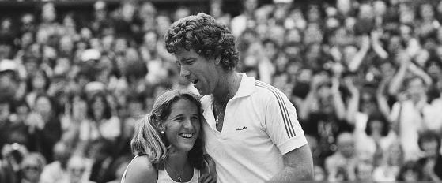
ANSWER # 3
AUSTIN
(TRACY & JOHN)

Slide 10

QUESTION # 4
TELEVISION
4-PARTER
WHAT FOUR PERFORMERS WERE AGE 20 OR YOUNGER WHEN THEY JOINED THE CAST OF SATURDAY NIGHT LIVE?

Slide 11
ANSWER # 4
ANTHONY MICHAEL HALL
EDDIE MURPHY
ROBERT DOWNEY, JR.
PETE DAVIDSON

Slide 12
QUESTION # 5
NAME’S THE SAME
THE FIRST NASA COMMUNICATIONS SATELLITE, LAUNCHED IN 1960, SHARES ITS NAME WITH WHAT NYMPH IN GREEK MYTHOLOGY?

Slide 13
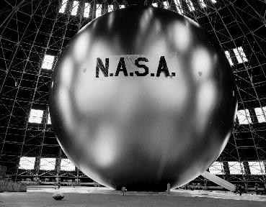

ANSWER # 5
ECHO

Slide 14
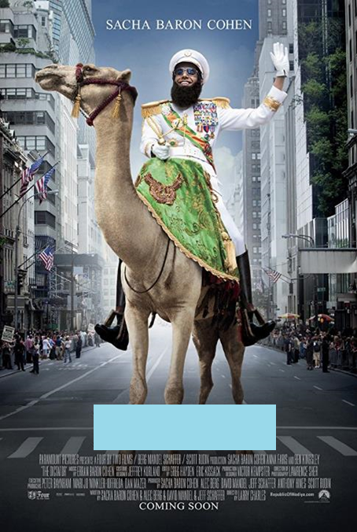
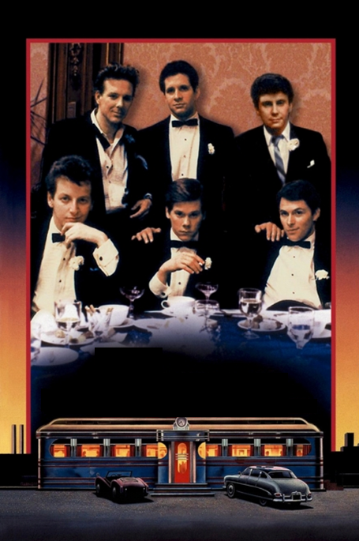
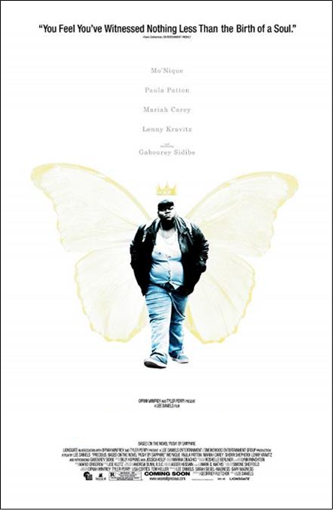
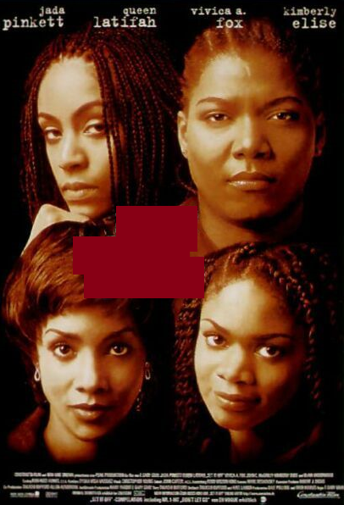
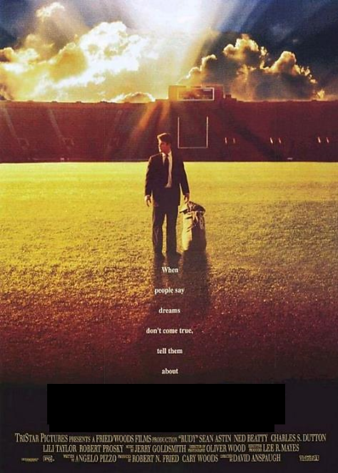
QUESTION # 6
NAME THE MOVIES AND THE THEME

Slide 15
ALL MOVIES FEATURE A MARYLAND NATIVE IN A LEAD ROLE
THEME

Slide 16
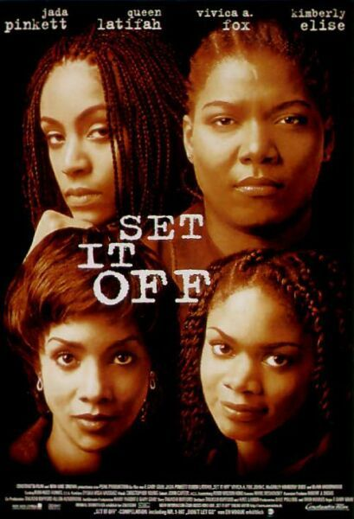
ANSWER #6
JADA PINKETT SMITH

Slide 17

MO’NIQUE

Slide 18
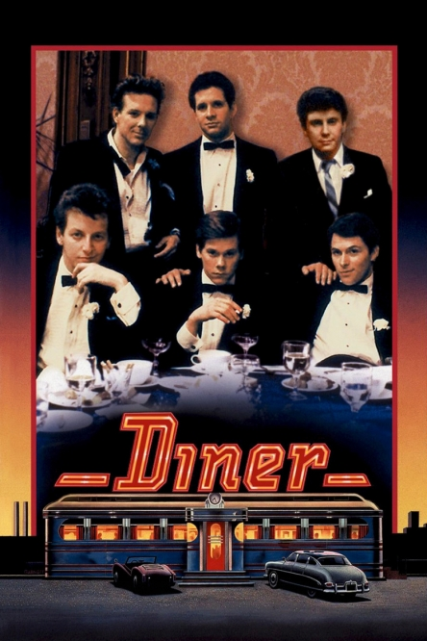
DANIEL STERN

Slide 19
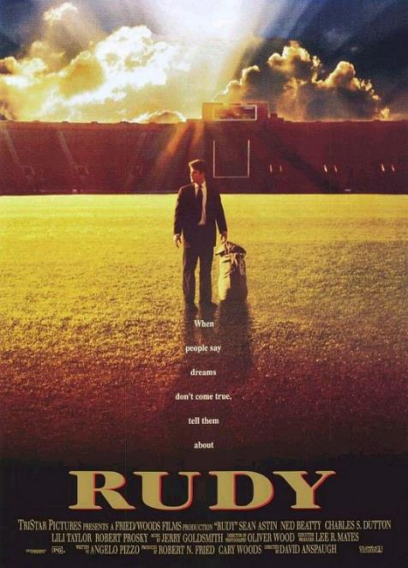
CHARLES DUTTON

Slide 20
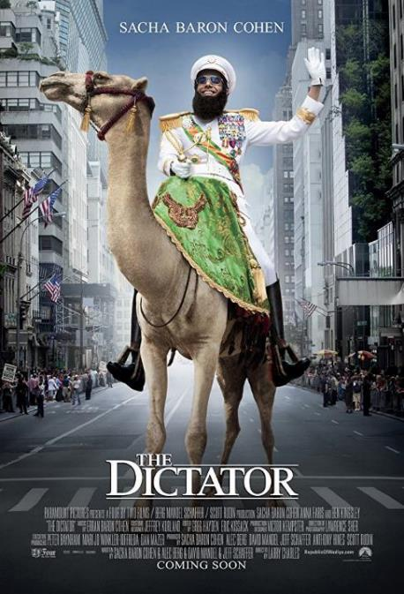
ANNA FARIS

Slide 21
QUESTION # 7
WORLD GEOGRAPHY
AT 3,572 SQUARE MILES, WHAT IS THE LARGEST ISLAND IN THE MEDITERRANEAN WHERE ITALIAN IS NOT AN OFFICIAL LANGUAGE?

Slide 22
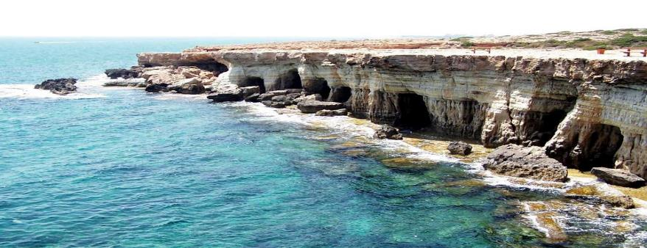
ANSWER # 7
CYPRUS

Slide 23
QUESTION # 8
SCIENCE
2-PARTER
WHAT TWO METALLIC ELEMENTS ARE THE MOST COMMON IN METEORITES?

Slide 24
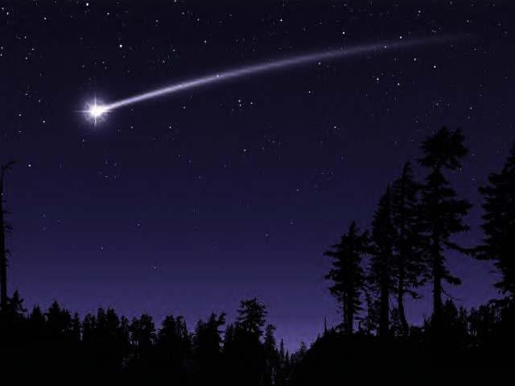
ANSWER # 8
IRON
NICKEL

Slide 25
QUESTION # 9
FOOD & DRINK
WHAT SHAPE WAS ADDED TO LUCKY CHARMS CEREAL EARLIER THIS YEAR?

Slide 26
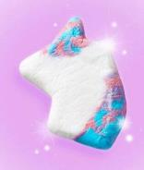
ANSWER # 9
UNICORN

Slide 27
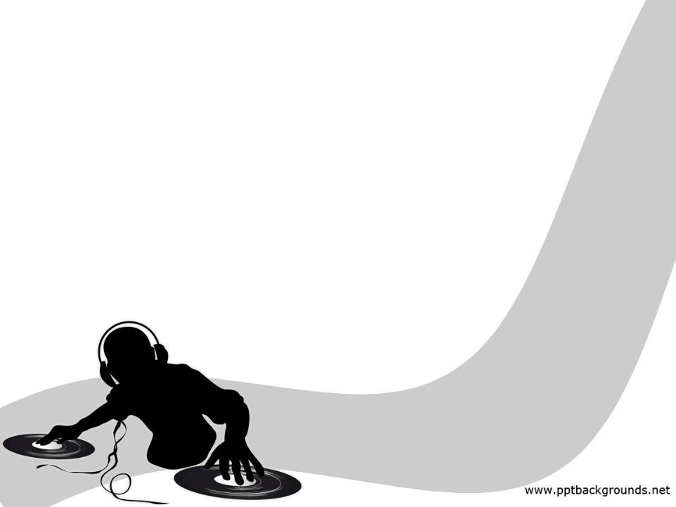

QUESTION # 10
MUSIC
4-PARTER
NAME THE SONG AND THE THREE ARTISTS performing IT

Slide 28
ANSWER # 10
SONG
“THE LONG AND WINDING ROAD”
ARTISTS
* GEORGE MICHAEL
* DIANA ROSS
* BARRY MANILOW

Slide 29

HALFTIME
TRIVIAMARYLAND.COM
FACEBOOK.COM/TRIVIAMARYLAND

Slide 30
QUESTION # 11
ORGANIZATIONS
“WE NEVER SLEEP” IS THE MOTTO OF WHAT PRIVATE DETECTIVE AGENCY FOUNDED IN 1850?

Slide 31

ANSWER # 11

Slide 32
QUESTION # 12
U.S. STATES
2-PARTER
WHAT ARE THE TWO SETS OF U.S. STATES THAT BORDER EACH OTHER GEOGRAPHICALLY AND ALPHABETICALLY?

Slide 33
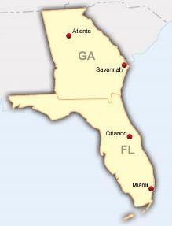
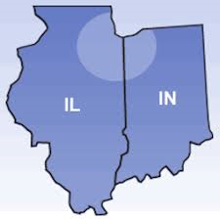
ANSWER # 12
FLORIDA/GEORGIA
ILLINOIS/INDIANA

Slide 34
QUESTION # 13
RADIO
  WHAT NICKNAME DOES DJ BARRY HANSEN USE FOR THE NOVELTY MUSIC SHOW HE’S BEEN BROADCASTING OR STREAMING WEEKLY SINCE 1970?

Slide 35
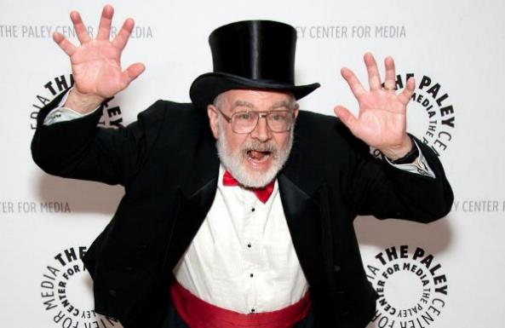
ANSWER # 13
DR. DEMENTO

Slide 36
QUESTION # 14
BASKETBALL
4-PARTER
    WHAT FOUR TEAMS JOINED THE NBA FOLLOWING THE MERGER WITH THE ABA IN 1976?

Slide 37

ANSWER # 14
DENVER NUGGETS
NEW JERSEY NETS
INDIANA PACERS
SAN ANTONIO SPURS

Slide 38
QUESTION # 15
HISTORY
    IN RESPONSE TO THE SOVIET UNION LAUNCHING SPUTNIK 1 AND 2, WHAT SATELLITE DID THE UNITED STATES LAUNCH IN JANUARY, 1958?

Slide 39
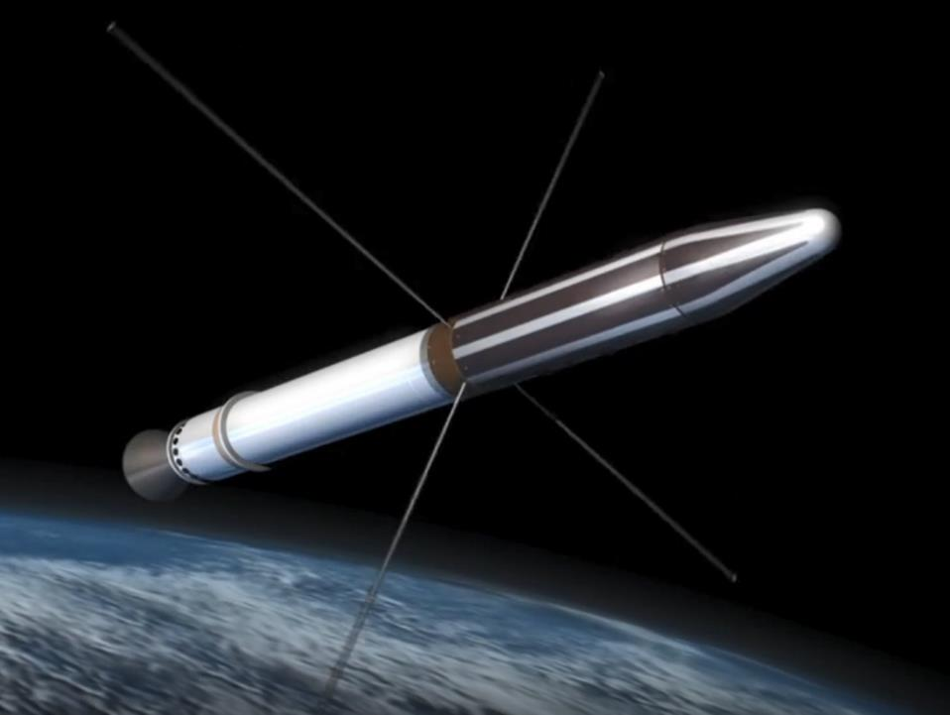
ANSWER # 15
EXPLORER 1

Slide 40
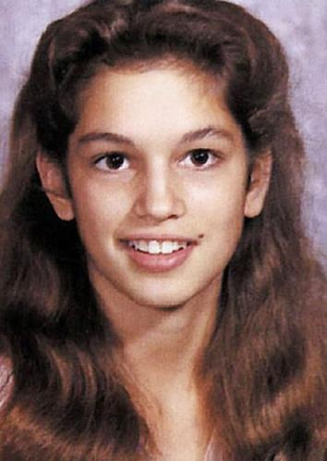
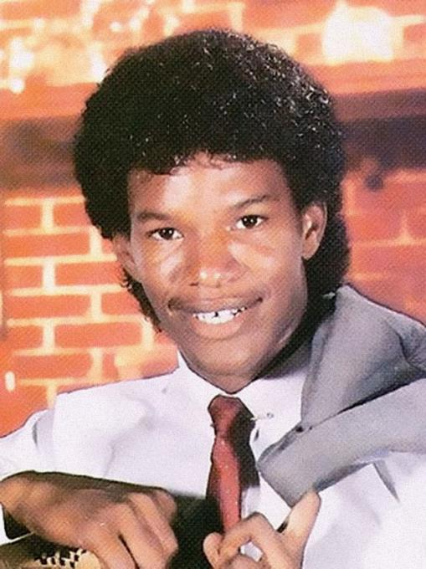
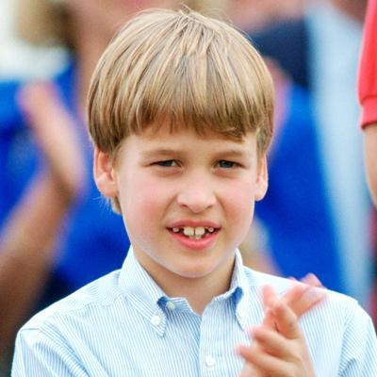
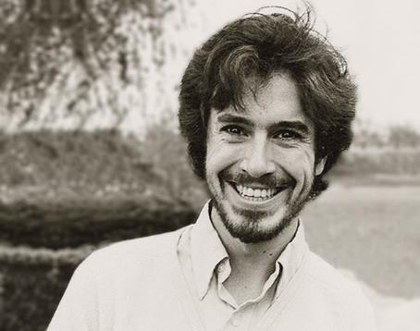
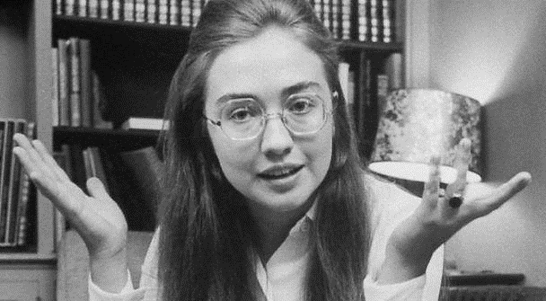
QUESTION # 16
WHO ARE WE?

Slide 41
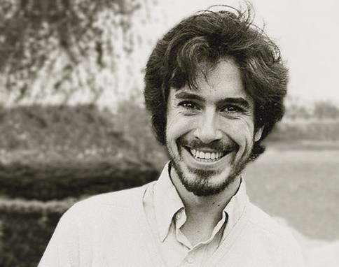
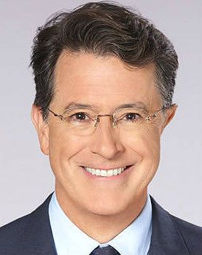
ANSWER #16
STEPHEN COLBERT

Slide 42
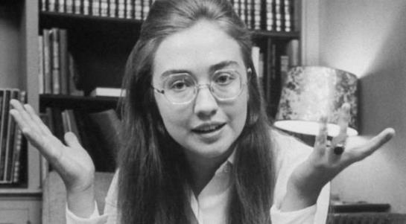
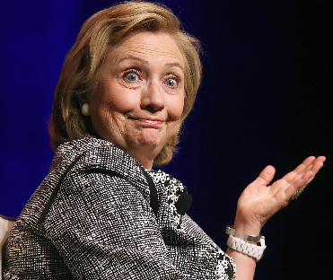
HILLARY CLINTON

Slide 43

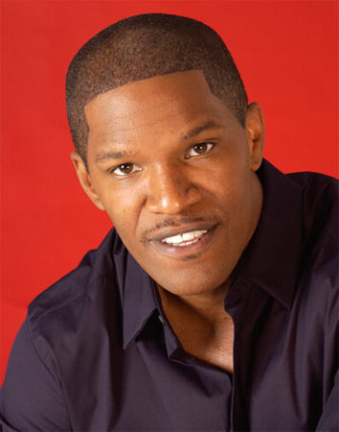
JAMIE FOXX

Slide 44

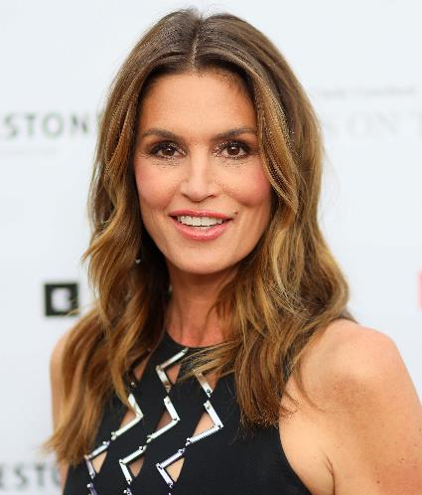
CINDY CRAWFORD

Slide 45
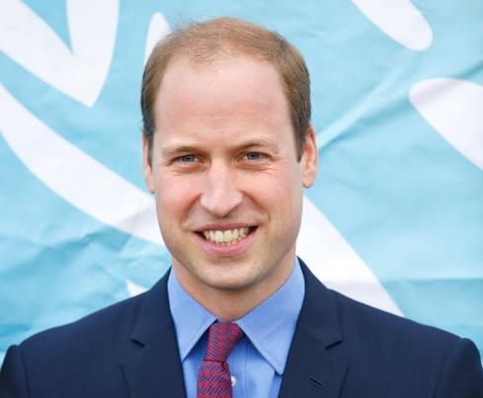
PRINCE WILLIAM

Slide 46
QUESTION # 17
MATHEMATICS
IN TRIGONOMETRY, WHAT PREFIX REPRESENTS AN INVERSE FUNCTION?

Slide 47

ANSWER # 17
ARC-

Slide 48
QUESTION # 18
MUSIC
3-PARTER
    WHAT THREE SONGS WITH THE WORD “ANOTHER” IN THE TITLE REACHED #1 ON THE U.S. BILLBOARD CHART IN THE 1980s?

Slide 49
ANSWER # 18
“ANOTHER BRICK IN THE WALL”
PINK FLOYD
“ANOTHER ONE BITES THE DUST”
QUEEN
“ANOTHER DAY IN PARADISE”
PHIL COLLINS

Slide 50
QUESTION # 19
IN THE NEWS
EARLIER THIS WEEK, PRESIDENT TRUMP DECLASSIFIED A SECRET FEDERAL COURT ORDER THAT APPROVED SURVEILLANCE OF WHAT FORMER TRUMP ASSOCIATE?

Slide 51
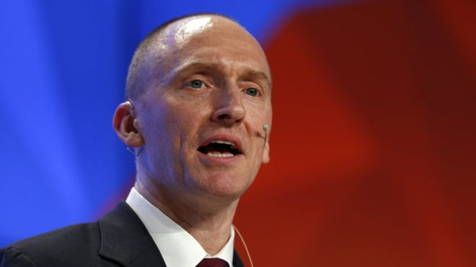
ANSWER # 19
CARTER PAGE

Slide 52
QUESTION # 20
BET UP TO 15 POINTS
FAMILIAR PHRASES
  WHAT PHRASE IS ASSOCIATED WITH UNRELATED EVENTS OF APRIL 19, 1775 AND OCTOBER 3, 1951?

Slide 53
ANSWER # 20
FIRST BATTLE OF THE REVOLUTIONARY WAR
BOBBY THOMSON’S HOME RUN TO WIN THE N.L. PENNANT
“SHOT HEARD ‘ROUND THE WORLD”

Slide 54

TRIVIAMARYLAND
TRIVIAMARYLAND.COM
FACEBOOK.COM/TRIVIAMARYLAND

Slide 55
TIEBREAKER
HOW MUCH MONEY DID KEN JENNINGS WIN DURING HIS INITIAL JEOPARDY! RUN?

Slide 56
TIEBREAKER ANSWER
$2,522,700

