Slide 1
TRIVIAMARYLAND WORLD SERIES
triviamaryland.com
@triviamaryland

Slide 2
B SQUAD
TEACHER’S PET
DONNER PARTY
QUIZANTINE EMPIRE
NORFOLK & WAY
COXSWAIN THE WIND
FEAR THE CRAB
SWEEP THE LEG
ALL OR NOTHING
MARKSMEN
LITE
JUNEBUGS
COUSIN EDDIE’S KIDS
DEEP FRIED GOODNESS
WE SAID THAT
BACONATORS
M AS IN MANCY
GOING BATTY
SENIOR MOMENTS
SMARTY PINTS
ANDY’S TOYS
TRIVIAHOLICS ANONYMOUS
JOPPATOWNE CHRISTIAN CHURCH FIGHTING COMMUNION WAFERS

Slide 3
QUESTION # 1 TELEVISION
WHAT IS THE CURRENT NAME OF THE STREAMING SERVICE OWNED BY AMAZON THAT WAS PREVIOUSLY KNOWN AS IMDB TV?

Slide 4
ANSWER # 1

Slide 5
QUESTION # 2 U.S. HISTORY 2-PARTER
BOTH LOCATED IN SOUTHERN U.S. STATES, WHAT TWO MOUNTAINS ARE NAMED IN MARTIN LUTHER KING JR.’S “I HAVE A DREAM” SPEECH?

Slide 6
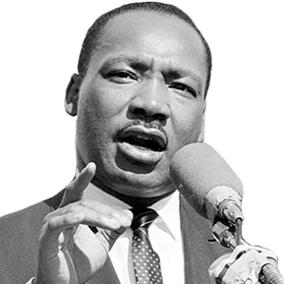
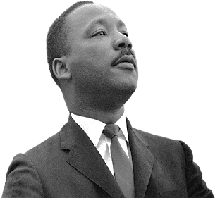
ANSWER # 2
STONE MOUNTAIN (GEORGIA)
LOOKOUT MOUNTAIN (TENNESSEE)

Slide 7
QUESTION # 3 THE HUMAN BODY
DEGLUTITION IS THE SCIENTIFIC TERM FOR WHAT COMMON BODILY FUNCTION THAT HUMANS DO HUNDREDS OF TIMES EVERY DAY?

Slide 8
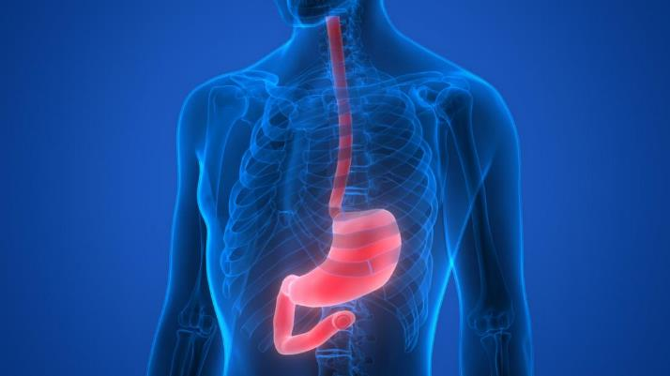
ANSWER # 3
SWALLOW

Slide 9
QUESTION # 4 TOYS & GAMES 4-PARTER
WHAT ARE THE FOUR VERSIONS OF CANDY CRUSH CURRENTLY AVAILABLE ON MOST PLATFORMS?

Slide 10
ANSWER # 4
SAGA
SODA
JELLY
FRIENDS

Slide 11
QUESTION # 5 IN THE NEWS
WHAT IS THE TITLE OF THE INAUGURAL POEM BY AMANDA GORMAN THAT WAS RECENTLY PLACED ON A RESTRICTED LIST BY A FLORIDA ELEMENTARY SCHOOL?

Slide 12
ANSWER # 5

Slide 13
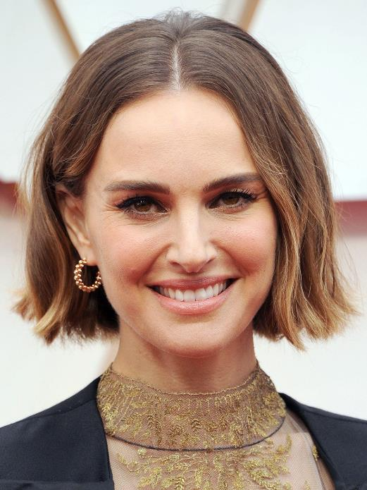
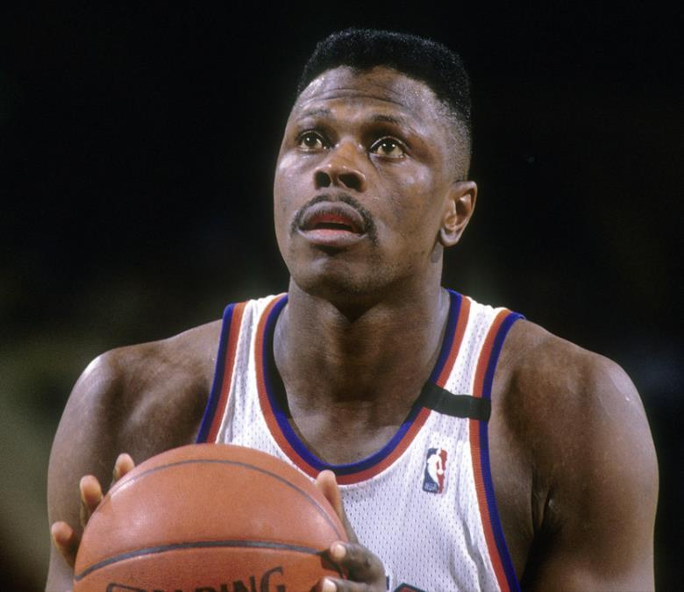
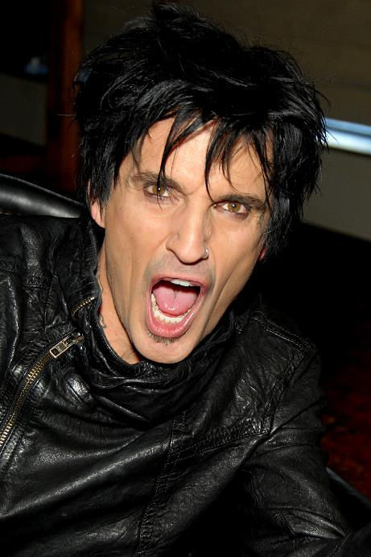
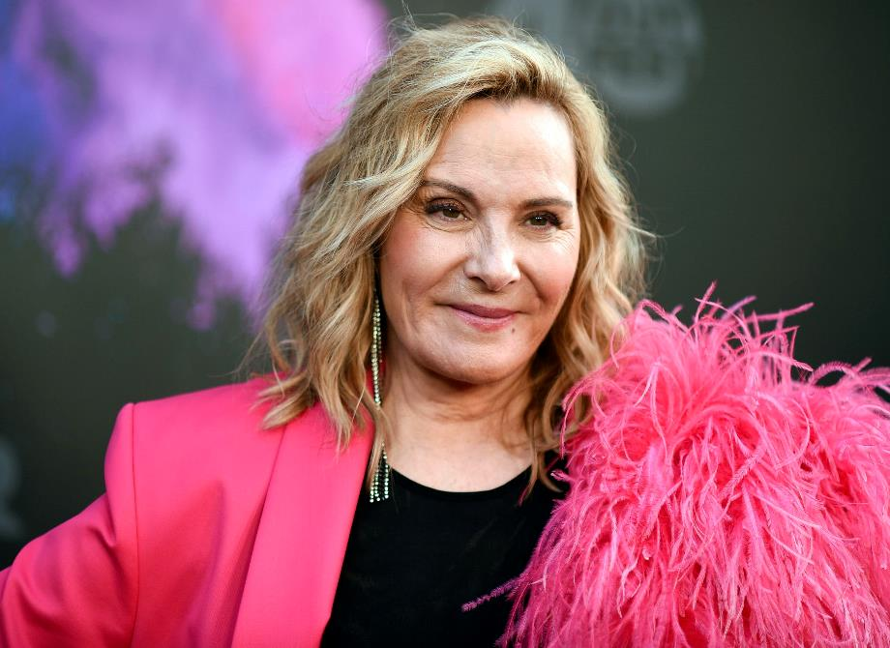
QUESTION # 6
IN WHAT COUNTRY WERE THEY BORN?

Slide 14
ISRAEL NATALIE PORTMAN

Slide 15
SOUTH AFRICA CHARLIZE THERON

Slide 16
GREECE TOMMY LEE

Slide 17
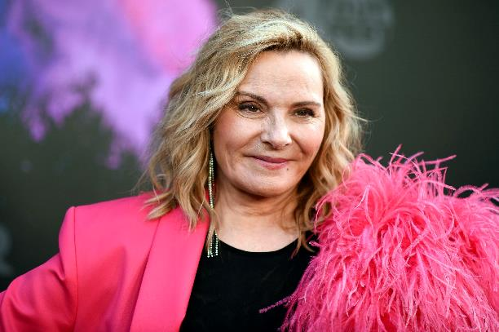
ENGLAND KIM CATTRALL

Slide 18
JAMAICA PATRICK EWING

Slide 19
QUESTION # 7 NAME’S THE SAME
WHAT ELEMENTARY PARTICLE THAT CARRIES A FRACTIONAL ELECTRONIC CHARGE SHARES ITS NAME WITH A DAIRY PRODUCT MADE BY WARMING SOUR MILK?

Slide 20
ANSWER # 7
QUARK

Slide 21
QUESTION # 8 TRANSPORTATION 4-PARTER
WHAT FOUR CITIES HAVE THE WORLD’S OLDEST METRO SYSTEMS, ALL COMPLETED BEFORE THE YEAR 1900?

Slide 22
ANSWER # 8
LONDON
CHICAGO
BUDAPEST
GLASGOW

Slide 23
QUESTION # 9 BOOKS & AUTHORS
WHAT AUTHOR WON PULITZER PRIZES FOR FICTION IN 1982 AND 1991 FOR BOOKS IN THE SAME SERIES?

Slide 24
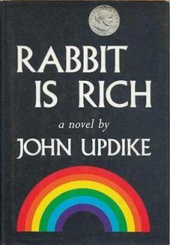
ANSWER # 9
JOHN UPDIKE

Slide 25
QUESTION # 10 MUSIC
3-PARTER
WHAT ARE THE NEXT THREE NAMES MENTIONED IN THE FOLLOWING SONG?

Slide 26
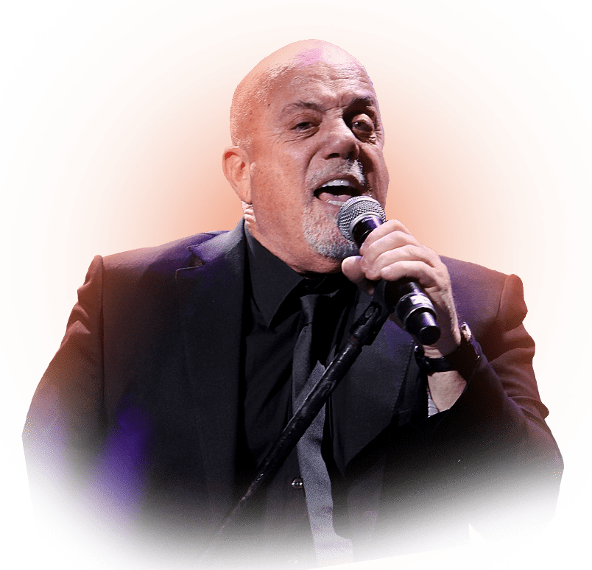
ANSWER # 10
ROCKY MARCIANO
LIBERACE
GEORGE SANTAYANA

Slide 27
HALFTIME
triviamaryland.com
@triviamaryland

Slide 28
QUESTION # 11 RELIGION
WHAT RELIGIOUS MOVEMENT TAKES ITS NAME FROM THE DAY WHEN THE HOLY SPIRIT DESCENDED ON THE APOSTLES?

Slide 29
ANSWER # 11
PENTECOSTALISM

Slide 30
QUESTION # 12 BASKETBALL 3-PARTER
BESIDES AN HONORARY ‘SIXTH MAN’, WHAT THREE NBA TEAMS HAVE NOT RETIRED ANY JERSEY NUMBERS?

Slide 31
ANSWER # 12

Slide 32
QUESTION # 13 PODCASTS
LAUNCHED IN 2020, WHAT WEEKLY PODCAST IS CO-HOSTED BY ACTORS JASON BATEMAN, WILL ARNETT, AND SEAN HAYES?

Slide 33
ANSWER # 13

Slide 34
QUESTION # 14 6-4-2
THIS DEPARTMENT STORE, WHICH ORIGINALLY HAD THE WORD ‘WALLIN’ IN ITS NAME, FIRST OPENED IN SEATTLE IN 1901
SEVERAL STORES FEATURE IN-HOUSE RESTAURANTS, SUCH AS BAZILLE, HABITANT, AND RUSCELLO
A DISCOUNT STORE CALLED RACK IS ATTACHED TO MANY OF THE FLAGSHIP STORES

Slide 35
ANSWER # 14

Slide 36
QUESTION # 15 FOREIGN WORDS & PHRASES
ONCE THE TITLE USED FOR THE JAPANESE EMPEROR, WHAT WORD TRANSLATES TO ENGLISH AS “THE HONORABLE GATE”?

Slide 37
ANSWER # 15
MIKADO

Slide 38
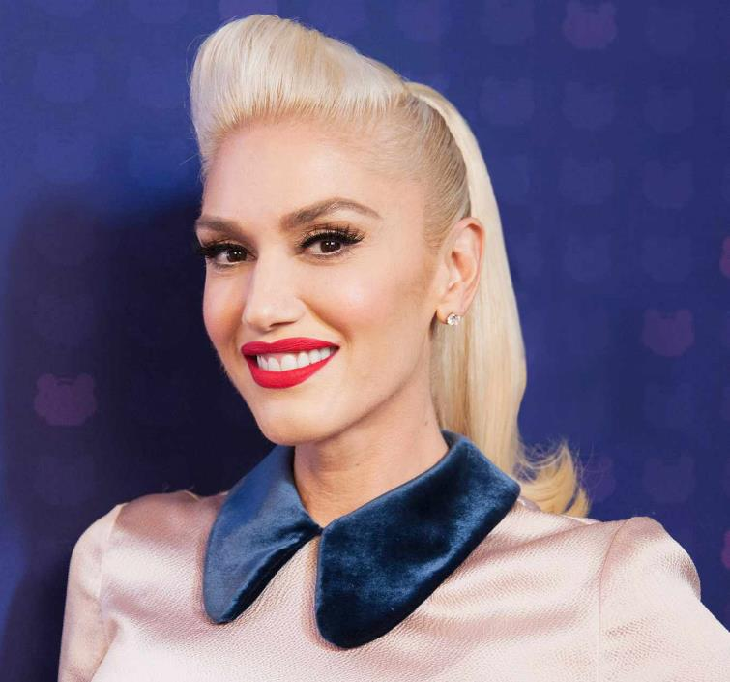
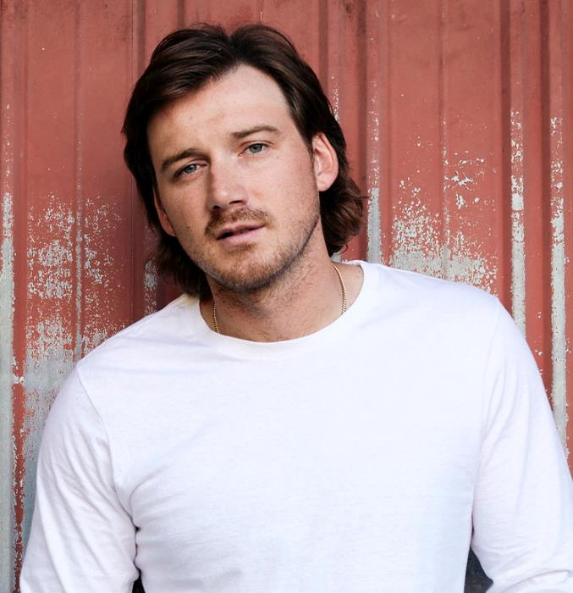
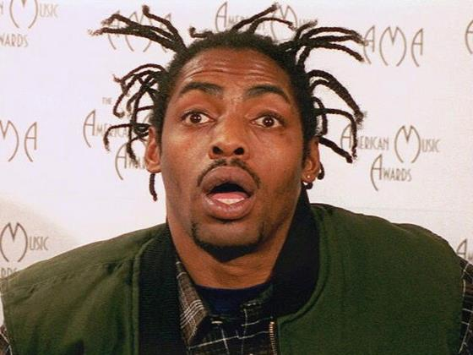
QUESTION # 16
WHAT IS THEIR ONLY #1 HIT?

Slide 39
SWEET CHILD O’ MINE GUNS N’ ROSES

Slide 40
HOLLABACK GIRL GWEN STEFANI

Slide 41
DANCING QUEEN ABBA

Slide 42
LAST NIGHT MORGAN WALLEN

Slide 43
GANGSTA’S PARADISE COOLIO

Slide 44
QUESTION # 17 ANIMALS
ALPHABETICALLY, WHAT SMALL DOG IS FIRST AMONG THOSE RECOGNIZED BY THE AMERICAN KENNEL CLUB?

Slide 45
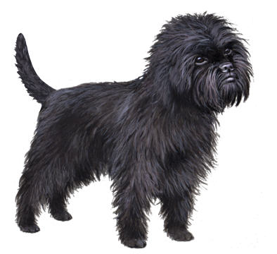
ANSWER # 17
AFFENPINSCHER

Slide 46
QUESTION # 18 COMEDY 2-PARTER
WHAT TWO COMEDIANS HAVE TOURED TOGETHER FREQUENTLY SINCE 2015, INCLUDING THE “AN EVENING YOU WILL FORGET FOR THE REST OF YOUR LIFE” SHOW WHICH WAS FILMED FOR NETFLIX?

Slide 47
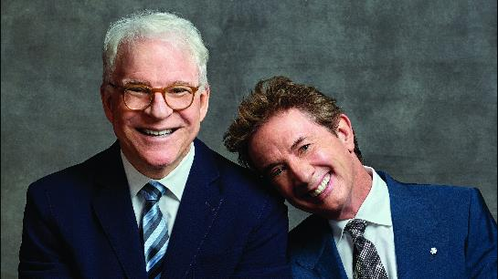
ANSWER # 18
STEVE MARTIN
MARTIN SHORT

Slide 48
QUESTION # 19
U.S. PRESIDENTS
FOLLOWING JOHN TYLER AND GROVER CLEVELAND, WOODROW WILSON IS THE THIRD AND MOST RECENT PRESIDENT TO DO WHAT WHILE IN OFFICE?

Slide 49
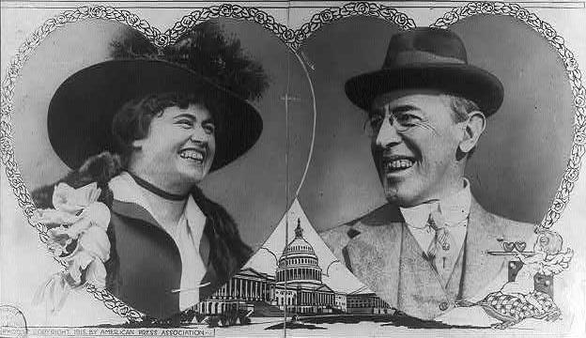
ANSWER # 19
GET MARRIED

Slide 50
QUESTION # 20 BET UP TO 15 POINTS MOVIES
WHAT 2018 FILM STARS THE THREE WOMEN WHO WON THE OSCARS FOR BEST SUPPORTING ACTRESS IN 2006, BEST ACTRESS IN 2017, AND BEST ACTRESS IN 2019?

Slide 51
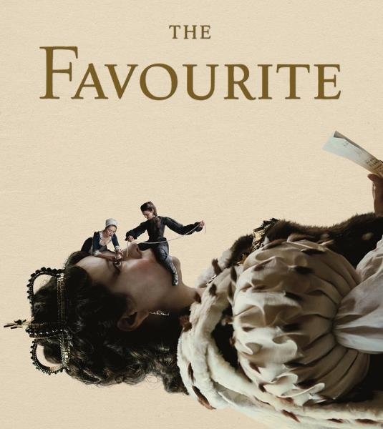
ANSWER # 20

Slide 52
TRIVIAMARYLAND
triviamaryland.com @triviamaryland

Slide 53
TIEBREAKER QUESTION
WHAT WAS THE POPULATION OF MARYLAND ACCORDING TO THE 2020 CENSUS?

Slide 54
TIEBREAKER ANSWER
6,177,224

