Slide 1
TRIVIAMARYLAND WORLD SERIES

Slide 2
QUESTION # 1 PEOPLE
WHAT SOCIETY WAS DIVIDED INTO THREE SOCIO-ECONOMIC CLASSES: JARLS, KARLS, AND THRALLS?

Slide 3
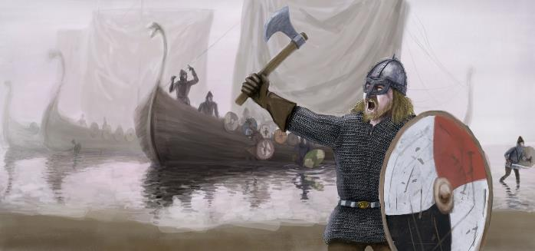
ANSWER # 1
VIKINGS

Slide 4
QUESTION # 2 U.S. STATES 2-PARTER
ALPHABETICALLY, WHAT WERE THE FIRST AND LAST STATES TO JOIN THE UNION IN THE 19TH CENTURY?

Slide 5
ANSWER # 2
ALABAMA
WYOMING

Slide 6
QUESTION # 3 TOYS & GAMES
WHAT VIDEO GAME, WHICH SHARES ITS NAME WITH A TYPE OF SHIP, WAS FIRST AVAILABLE TO PLAY ON MICROSOFT WINDOWS IN 1990?

Slide 7
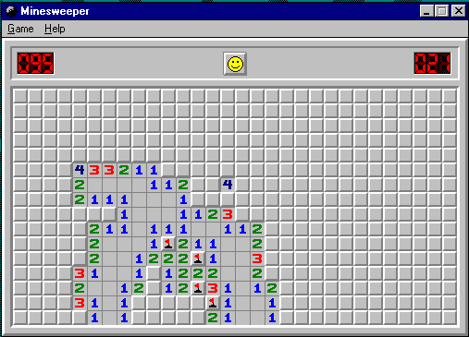
ANSWER # 3
MINESWEEPER

Slide 8
QUESTION # 4 MOVIES 5-PARTER
ACCORDING TO DOMESTIC BOX OFFICE, OF THE TEN HIGHEST-GROSSING MOVIES IN 2019, WHICH FIVE HAVE ONE-WORD TITLES?

Slide 9
ANSWER # 4
ALADDIN
US
SHAZAM!
DUMBO
GLASS

Slide 10
QUESTION # 5 BOTANY
DIATOMS, WHICH PRODUCE 20% OF THE EARTH’S OXYGEN, ARE A TYPE OF WHAT PLANT GROUP?

Slide 11
ANSWER # 5
ALGAE

Slide 12
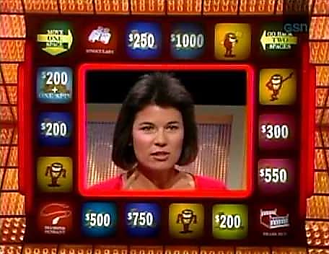
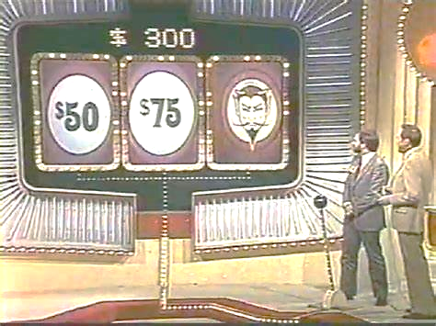
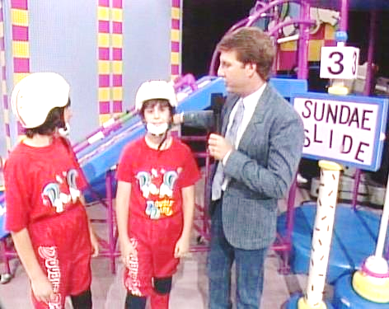
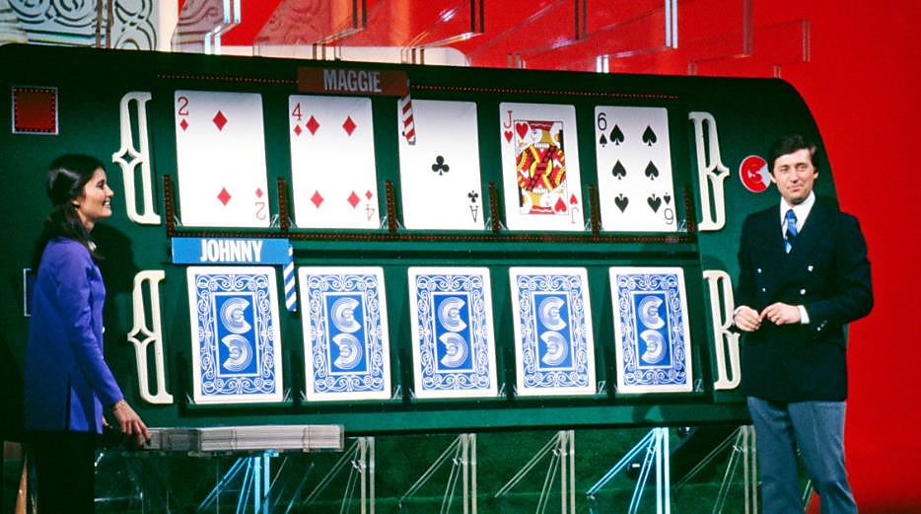
QUESTION # 6
NAME THE CURRENT HOSTS OF THE FOLLOWING GAME SHOWS

Slide 13
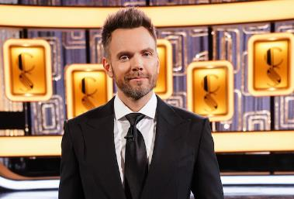
ANSWER #6
JOEL McHALE CARD SHARKS

Slide 14
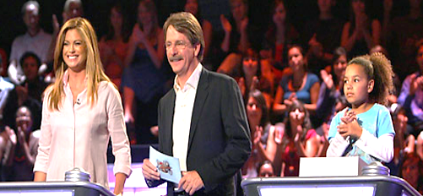
JOHN CENA ARE YOU SMARTER THAN A 5TH GRADER?

Slide 15
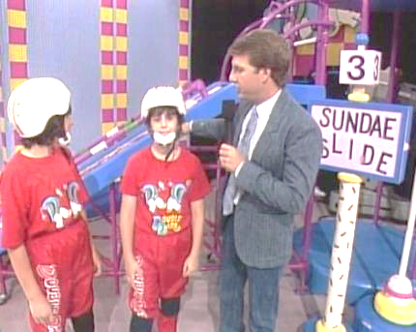
LIZA KOSHY DOUBLE DARE

Slide 16
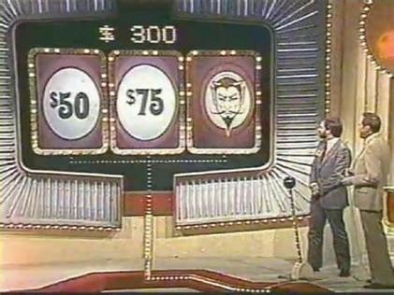
SNOOP DOGG THE JOKER’S WILD

Slide 17
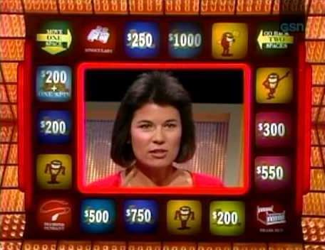
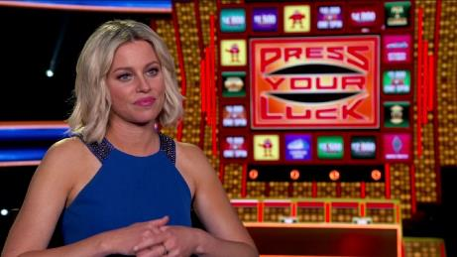
ELIZABETH BANKS PRESS YOUR LUCK

Slide 18
QUESTION # 7 ANIMALS
KOMODO DRAGONS ARE THE LARGEST OF WHAT TYPE OF LIZARD, SO NAMED BECAUSE THEY CAN STAND ON TWO LEGS TO WATCH THEIR SURROUNDINGS?

Slide 19
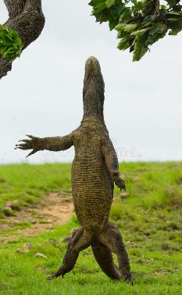
ANSWER # 7
MONITOR

Slide 20
QUESTION # 8 BASKETBALL 4-PARTER
WHO WERE THE LAST FOUR #1 PICKS IN THE NBA DRAFT ELECTED TO THE BASKETBALL HALL OF FAME?

Slide 21
ANSWER # 8
DAVID ROBINSON
SHAQUILLE O’NEAL
ALLEN IVERSON
YAO MING

Slide 22
QUESTION # 9 THE MILITARY
WHAT WAS THE ONLY U.S. NAVY SUBMARINE NAMED FOR A LIVING FORMER PRESIDENT?

Slide 23
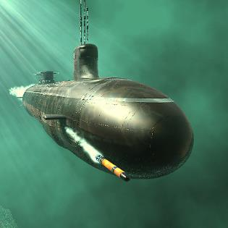
ANSWER # 9
USS JIMMY CARTER

Slide 24
QUESTION # 10 MUSIC
4-PARTER
NAME THE SONG AND THE THREE SINGERS PERFORMING IT

Slide 25
ANSWER # 10
SONG
“BLACKBIRD”
SINGERS
♪ DAVE GROHL
♪ CARLY SIMON
♪ NEIL DIAMOND

Slide 26
HALFTIME
TRIVIAMARYLAND.COM
FACEBOOK.COM/TRIVIAMARYLAND

Slide 27
QUESTION # 11 ???
ANNA O, WOLF MAN, DORA, AND LITTLE HANS ARE THE ALIASES OF PEOPLE KNOWN FOR THEIR ASSOCIATION WITH WHOM?

Slide 28
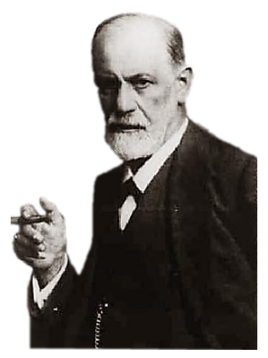
ANSWER # 11
SIGMUND FREUD

Slide 29
QUESTION # 12 WORLD HISTORY 3-PARTER
WHAT THREE BALTIC COUNTRIES WERE ANNEXED BY THE SOVIET UNION IN 1940?

Slide 30
ANSWER # 12
LITHUANIA
ESTONIA
LATVIA

Slide 31
QUESTION # 13 LITERATURE
IN THE TEXT OF A 20TH CENTURY NOVEL, WHAT TITLE PHRASE PRECEDES THE WORDS “WHICH HAD SWEPT THROUGH GEORGIA”?

Slide 32
ANSWER # 13

Slide 33
QUESTION # 14 TELEVISION 2-PARTER
WHAT TWO WORDS FROM THE NATO PHONETIC ALPHABET ARE ALSO THE NAMES OF NBC-OWNED CABLE NETWORKS?

Slide 34
ANSWER # 14

Slide 35
QUESTION # 15 BUSINESS
IN JULY 2002, WHAT COMPANY FILED FOR CHAPTER 11 BANKRUPTCY PROTECTION IN THE LARGEST FILING IN U.S. HISTORY AT THE TIME?

Slide 36
ANSWER # 15

Slide 37
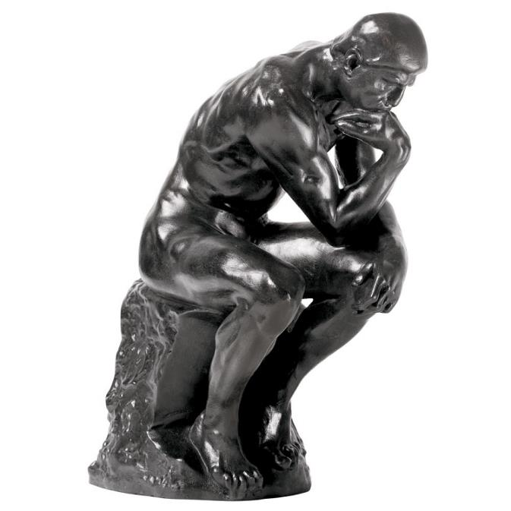
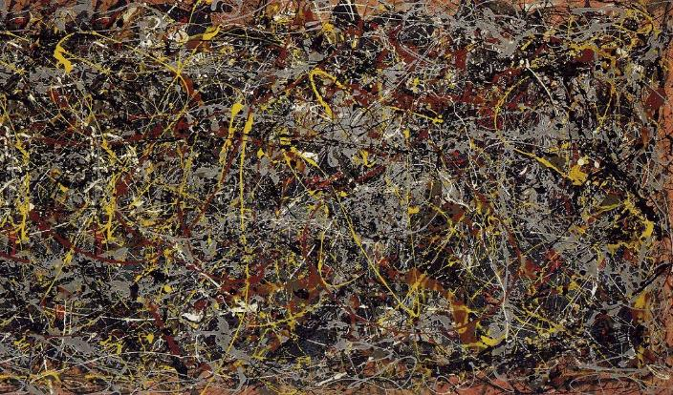
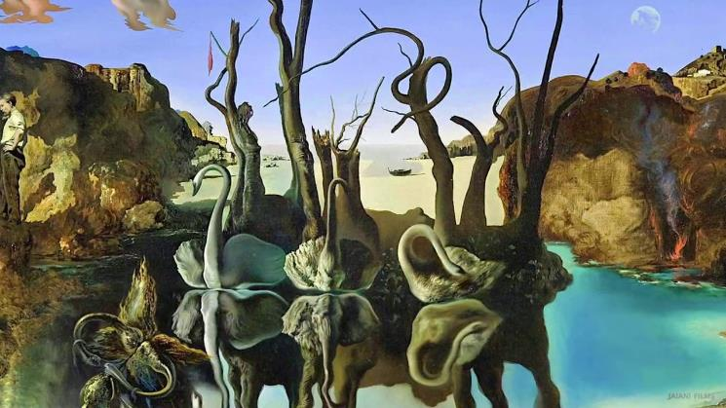
QUESTION # 16
NAME THE ARTISTS

Slide 38
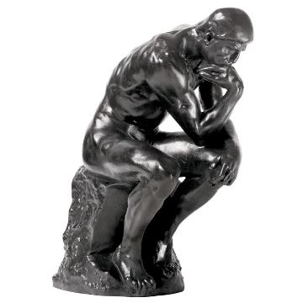
ANSWER #16
AUGUSTE RODIN THE THINKER

Slide 39
GEORGIA O’KEEFFE RED CANNA

Slide 40
JACKSON POLLOCK NUMBER 5

Slide 41
HENRI MATISSE WOMAN WITH A HAT

Slide 42
SALVADOR DALÍ SWANS REFLECTING ELEPHANTS

Slide 43
QUESTION # 17 MATHEMATICS
WHAT PUNCTUATION MARK IS USED TO REPRESENT A FACTORIAL OPERATION?

Slide 44
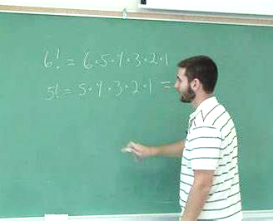
ANSWER # 17
EXCLAMATION MARK

Slide 45
QUESTION # 18 MUSIC 3-PARTER
WHAT THREE SONGS WITH THE WORD “AWAY” IN THE TITLE REACHED #1 ON THE BILLBOARD CHART IN THE 1980s?

Slide 46
ANSWER # 18
‘EVERY TIME YOU GO AWAY’ - PAUL YOUNG
‘TAKE MY BREATH AWAY’ - BERLIN
‘LOOK AWAY’ - CHICAGO

Slide 47
QUESTION # 19 CRIME
MEHMET ALI AGCA, WHO SHOT WHAT MAN IN 1981, WAS RELEASED FROM PRISON IN 2006 BUT SENT BACK A WEEK LATER?

Slide 48
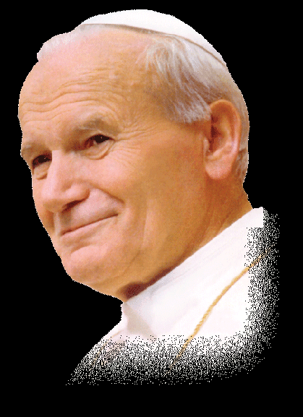
ANSWER # 19
POPE JOHN PAUL II

Slide 49
QUESTION # 20 BET UP TO 15 POINTS AWARDS
INCLUDING AN HONORARY AWARD FOR ONE PARENT, WHO IS THE ONLY OSCAR WINNER WHOSE PARENTS BOTH WON OSCARS?

Slide 50
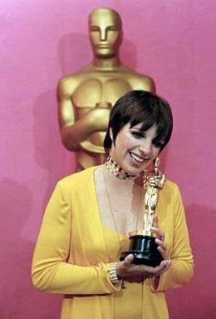
ANSWER # 20
LIZA MINNELLI

Slide 51
TRIVIAMARYLAND
TRIVIAMARYLAND.COM
FACEBOOK.COM/TRIVIAMARYLAND

Slide 52
TIEBREAKER
HOW MANY ACTORS WERE CAST TO PLAY MUNCHKINS IN THE WIZARD OF OZ?

Slide 53
TIEBREAKER ANSWER
124

