Slide 1

TRIVIAMARYLAND
WORLD SERIES
TRIVIAMARYLAND.COM
FACEBOOK.COM/TRIVIAMARYLAND

Slide 2
QUESTION # 1
U.S. STATES
WHAT WAS THE FIRST STATE ADMITTED TO THE UNION IN THE 20TH CENTURY?

Slide 3

ANSWER # 1

Slide 4
QUESTION # 2
AUTOMOBILES
3-PARTER
WHAT THREE SPECIALTY CONVERTIBLES DID GENERAL MOTORS ORIGINALLY INTRODUCE IN 1953?

Slide 5
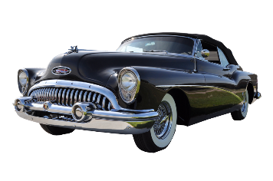
ANSWER # 2
BUICK SKYLARK
OLDSMOBILE FIESTA
CADILLAC ELDORADO

Slide 6
QUESTION # 3
COMEDY
WHOSE COMEDY ALBUM “RETALIATION” DEBUTED AT #4 ON THE BILLBOARD CHART IN 2005, THE HIGHEST-CHARTING ALBUM DEBUT BY A COMEDIAN SINCE STEVE MARTIN’S “A WILD AND CRAZY GUY” IN 1978?

Slide 7
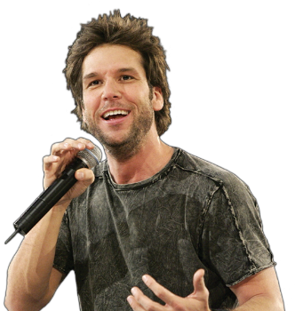
ANSWER # 3
DANE COOK

Slide 8

QUESTION # 4
MOVIES
4-PARTER
ACCORDING TO U.S. BOX OFFICE, WHAT ARE THE FOUR HIGHEST-GROSSING MOVIES DIRECTED BY ROBERT ZEMECKIS?

Slide 9
ANSWER # 4
FORREST GUMP
CAST AWAY
BACK TO THE FUTURE
THE POLAR EXPRESS

Slide 10
QUESTION # 5
NOTABLE WOMEN
THE FIRST NAME OF WHAT FILIPINO PRESIDENT, WHO SERVED FROM 1986 TO 1992, MEANS “HEART” IN SPANISH?

Slide 11
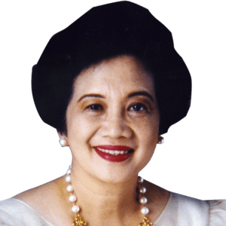
ANSWER # 5
CORAZON AQUINO

Slide 12

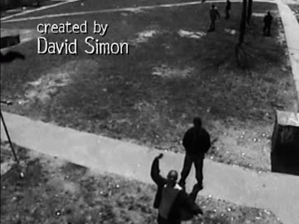
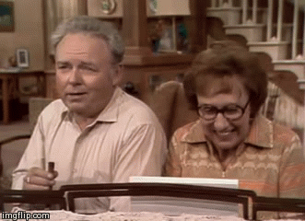


QUESTION # 6
NAME THE TV SHOWS

Slide 13
ANSWER #6
NEW GIRL

Slide 14
ALL IN THE FAMILY

Slide 15
FREAKS AND GEEKS

Slide 16
THE WIRE

Slide 17
BILL NYE THE SCIENCE GUY

Slide 18
QUESTION # 7
ANIMALS
ALPHABETICALLY, WHAT ANIMAL IS FIRST AMONG THE MEMBERS OF THE SOUTH AMERICAN CAMELIDS?

Slide 19
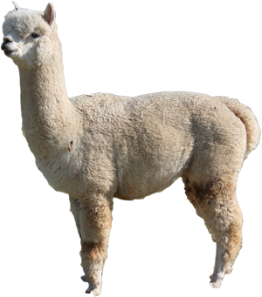
ANSWER # 7
ALPACA

Slide 20
QUESTION # 8
SOCCER
3-PARTER
SINCE 1970, WHAT THREE COUNTRIES HAVE WON THE WORLD CUP WHILE SERVING AS THE HOST COUNTRY?

Slide 21

ANSWER # 8
WEST GERMANY
ARGENTINA
FRANCE

Slide 22
QUESTION # 9
IN THE NEWS
VOTERS IN IRELAND RECENTLY SUCCEEDED IN REPEALING THE COUNTRY’S BAN ON WHAT?

Slide 23

ANSWER # 9
ABORTION

Slide 24

QUESTION # 10
MUSIC
4-PARTER
NAME THE SONG AND THE THREE ARTISTS/GROUPS PERFORMING IT

Slide 25
ANSWER # 10
SONG
“SPACE ODDITY”
ARTISTS/GROUPS
SMASHING PUMPKINS
NATALIE MERCHANT
JOHN WAITE

Slide 26

HALFTIME
TRIVIAMARYLAND.COM
FACEBOOK.COM/TRIVIAMARYLAND

Slide 27
QUESTION # 11
SCIENCE TERMS
WHAT TERM FOR THE LOWEST LEVEL OF THE OCEAN THAT THE SUN’S RAYS CAN REACH SHARES ITS NAME WITH A 1960s TV SHOW?

Slide 28

ANSWER # 11

Slide 29
QUESTION # 12
U.S. PRESIDENTS
3-PARTER
WHICH THREE U.S. PRESIDENTS ATTENDED MILITARY ACADEMIES?

Slide 30
ANSWER # 12
JIMMY CARTER (U.S. NAVAL ACADEMY)
DWIGHT EISENHOWER (WEST POINT)
ULYSSES GRANT (WEST POINT)

Slide 31
QUESTION # 13
FOOD & DRINK
  WHAT DOES A BEER’s IBU NUMBER MEASURE?

Slide 32

ANSWER # 13
BITTERNESS

Slide 33
QUESTION # 14
BOOKS
3-PARTER
    WHO ARE THE THREE MOST-MENTIONED CHARACTERS IN THE LORD OF THE RINGS TRILOGY?

Slide 34


ANSWER # 14
FRODO BAGGINS
SAMWISE GAMGEE
GANDALF

Slide 35
QUESTION # 15
NAME ORIGINS
    THE NAME OF WHAT FORMER BANK HONORED THE SETTLERS OF NORTH CAROLINA WHO CAME FROM A DANUBE VALLEY?

Slide 36

ANSWER # 15

Slide 37
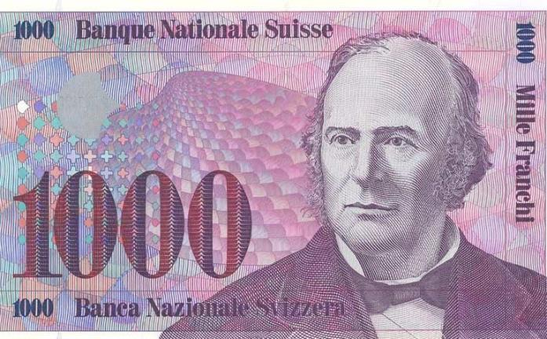
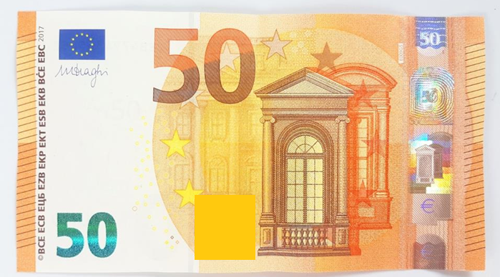
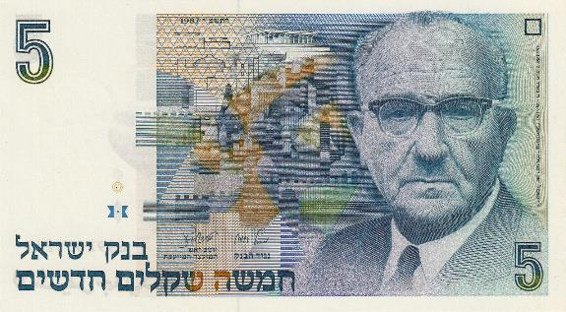
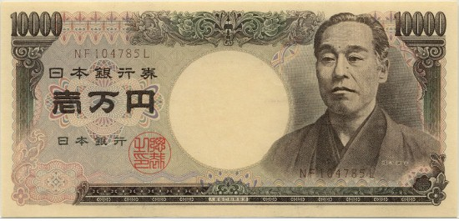
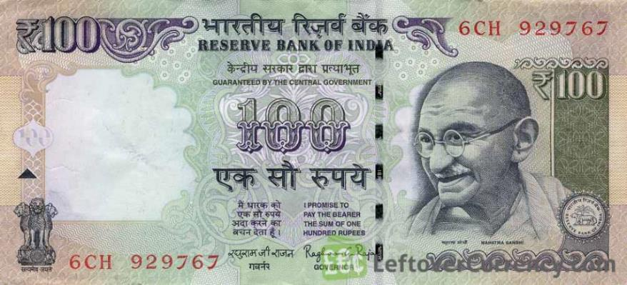
QUESTION # 16
NAME THE CURRENCY

Slide 38
ANSWER #16
SHEKEL

Slide 39
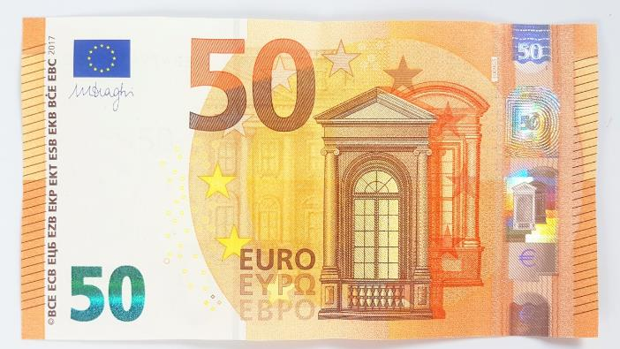
EURO

Slide 40

RUPEE

Slide 41
YEN

Slide 42
FRANC

Slide 43
QUESTION # 17
TECHNOLOGY
WHAT WORD FOR RELEASING SOMEONE’S PERSONAL INFORMATION ON THE INTERNET CAN BE SPELLED WITH ONE OR TWO “X”s IN THE MIDDLE?

Slide 44

ANSWER # 17
DOXXING

Slide 45
QUESTION # 18
MUSIC
2-PARTER
    WHAT TWO SONGS WITH THE WORD “ALWAYS” IN THE TITLE REACHED #1 ON THE U.S. BILLBOARD CHART IN THE 1990s?

Slide 46
ANSWER # 18
“I WILL ALWAYS LOVE YOU”
(WHITNEY HOUSTON)
“ALWAYS BE MY BABY”
(MARIAH CAREY)

Slide 47
QUESTION # 19
ON THE ROAD AGAIN
FOUNDED IN 1856, WHAT COMPANY INTRODUCED A NUMBERING SYSTEM FOR U.S. HIGHWAYS IN 1917?

Slide 48

ANSWER # 19

Slide 49
QUESTION # 20
BET UP TO 15 POINTS
AWARDS
  THE ONLY OSCAR WINNER ALSO TO WIN A NOBEL PRIZE, WHO WON THE OSCAR FOR ADAPTING HIS OWN WORK?

Slide 50
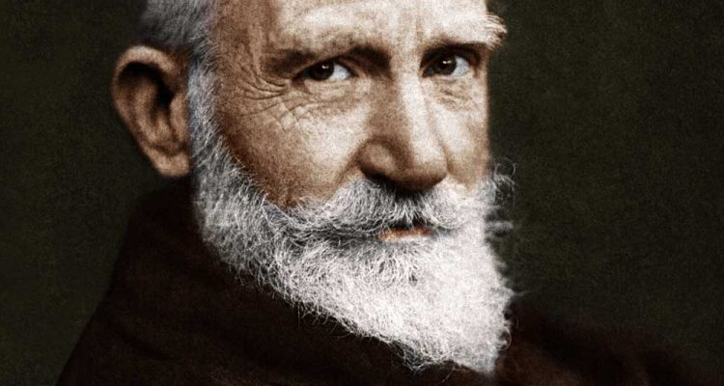
ANSWER # 20
GEORGE BERNARD SHAW

Slide 51

TRIVIAMARYLAND
TRIVIAMARYLAND.COM
FACEBOOK.COM/TRIVIAMARYLAND

Slide 52

TIEBREAKER
WHAT WAS THE ATTENDANCE OF THE 2018 PREAKNESS STAKES?

Slide 53
TIEBREAKER ANSWER
134,487

