Slide 1

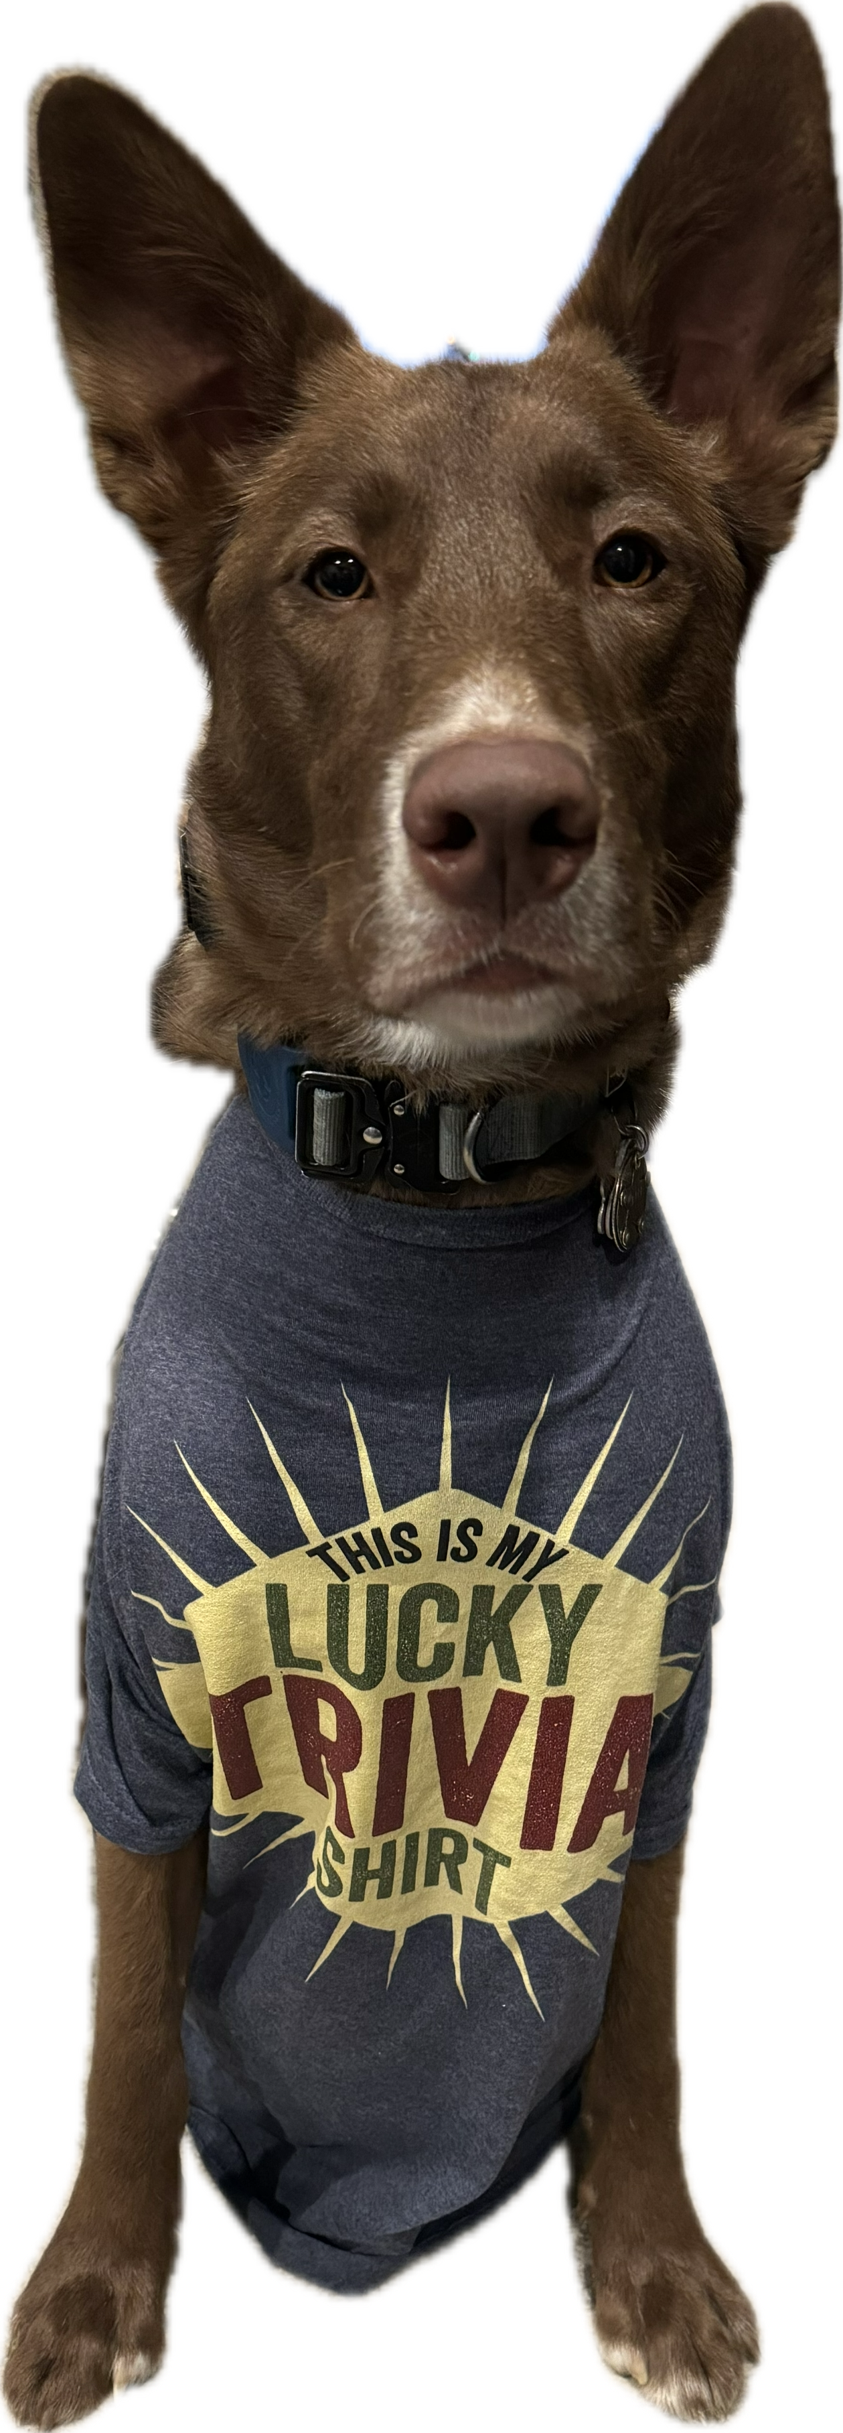
LXVIII

Slide 2
HERE ARE YOUR FALL 2024 WORLD SERIES TEAMS
NORTH REGION
• COUSIN EDDIE’S KIDS
• FEAR THE CRAB (11 TIME)
• I’M WITH STUPID
• LINCOLN LOVES ZJ’S
• MASTER DEBATORS
• REBEL ALLIANCE
• SMOKEY & SISSY
WEST REGION
• 50/50/90
• ALL OR NOTHING
• LITE
• MARKSMEN (18 TIME)
• RUNNING ERINS
SOUTH REGION
• CULT CLASSIC
• MAXIMUM SPARKLE
• NO IDEA
• QUIZ KHALIFA
• PIKACHUPABRAS
* PREVIOUS TRIVIA MARYLAND WORLD SERIES CHAMPION

Slide 3
QUESTION # 1
POLITICS
WHO WAS THE MOST RECENT VICE PRESIDENT TO HAVE HIS LAST NAME START WITH A VOWEL?

Slide 4
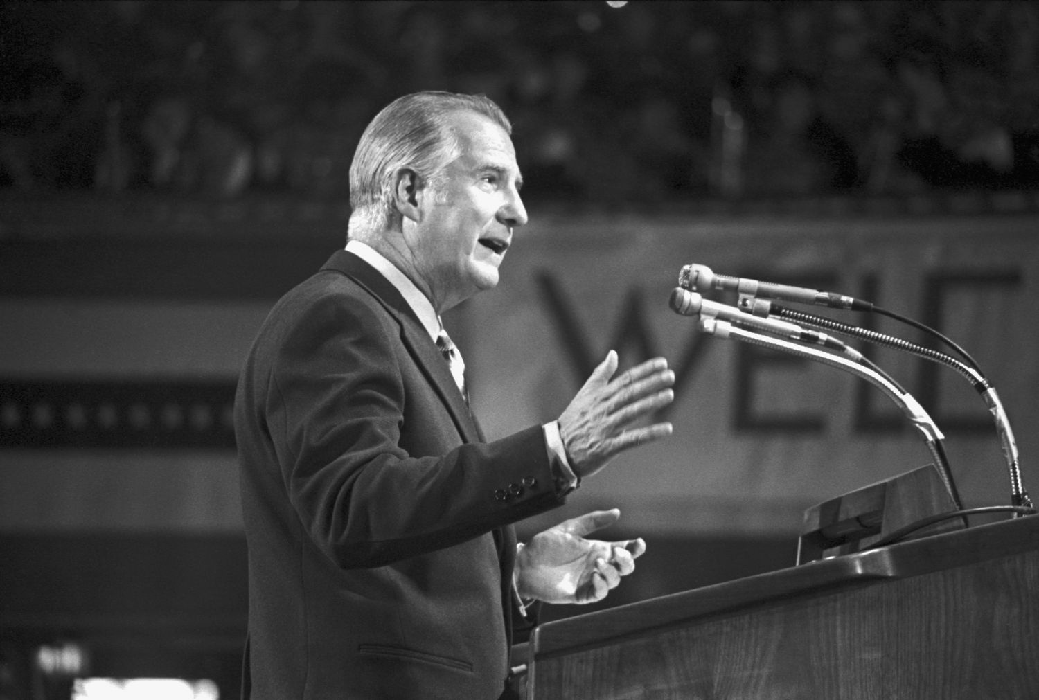
ANSWER # 1
SPIRO AGNEW

Slide 5
QUESTION # 2
ENTERTAINMENT
2 - PART
OF ALL SONGS ON THE ORIGINAL GUITAR HERO IN 2005, WHICH EDGAR WINTER SONG AND JOAN JETT COVER WERE THE ONLY TWO TO REACH # 1 ON THE BILLBOARD HOT 100 CHARTS?

Slide 6
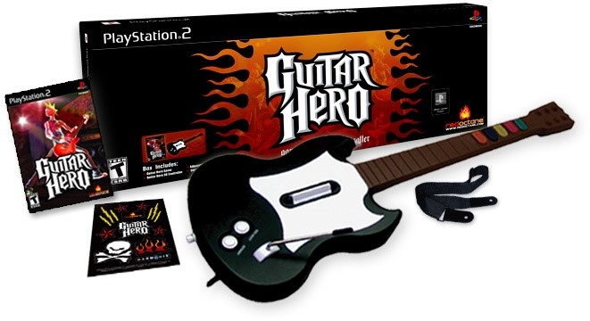
ANSWER # 2
• “FRANKENSTEIN”
• “I LOVE ROCK ‘N ROLL”

Slide 7
QUESTION # 3
FOOD AND DRINK
IN TERMS OF COOKING, “BARDING” MEANS TO MOST COMMONLY WRAP MEAT WITH WHAT OTHER TYPE OF MEAT?

Slide 8
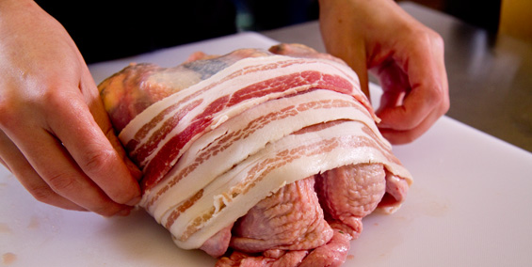
ANSWER # 3
BACON

Slide 9
QUESTION # 4
THE MEDIA
3 - PART
COINED “THE BIG THREE,” WHICH THREE MEN ANCHORED THE NIGHTLY NEWS BROADCAST ON EACH OF THE THREE MAJOR NETWORKS FROM THE EARLY 1980’s INTO THE 2000’s?

Slide 10
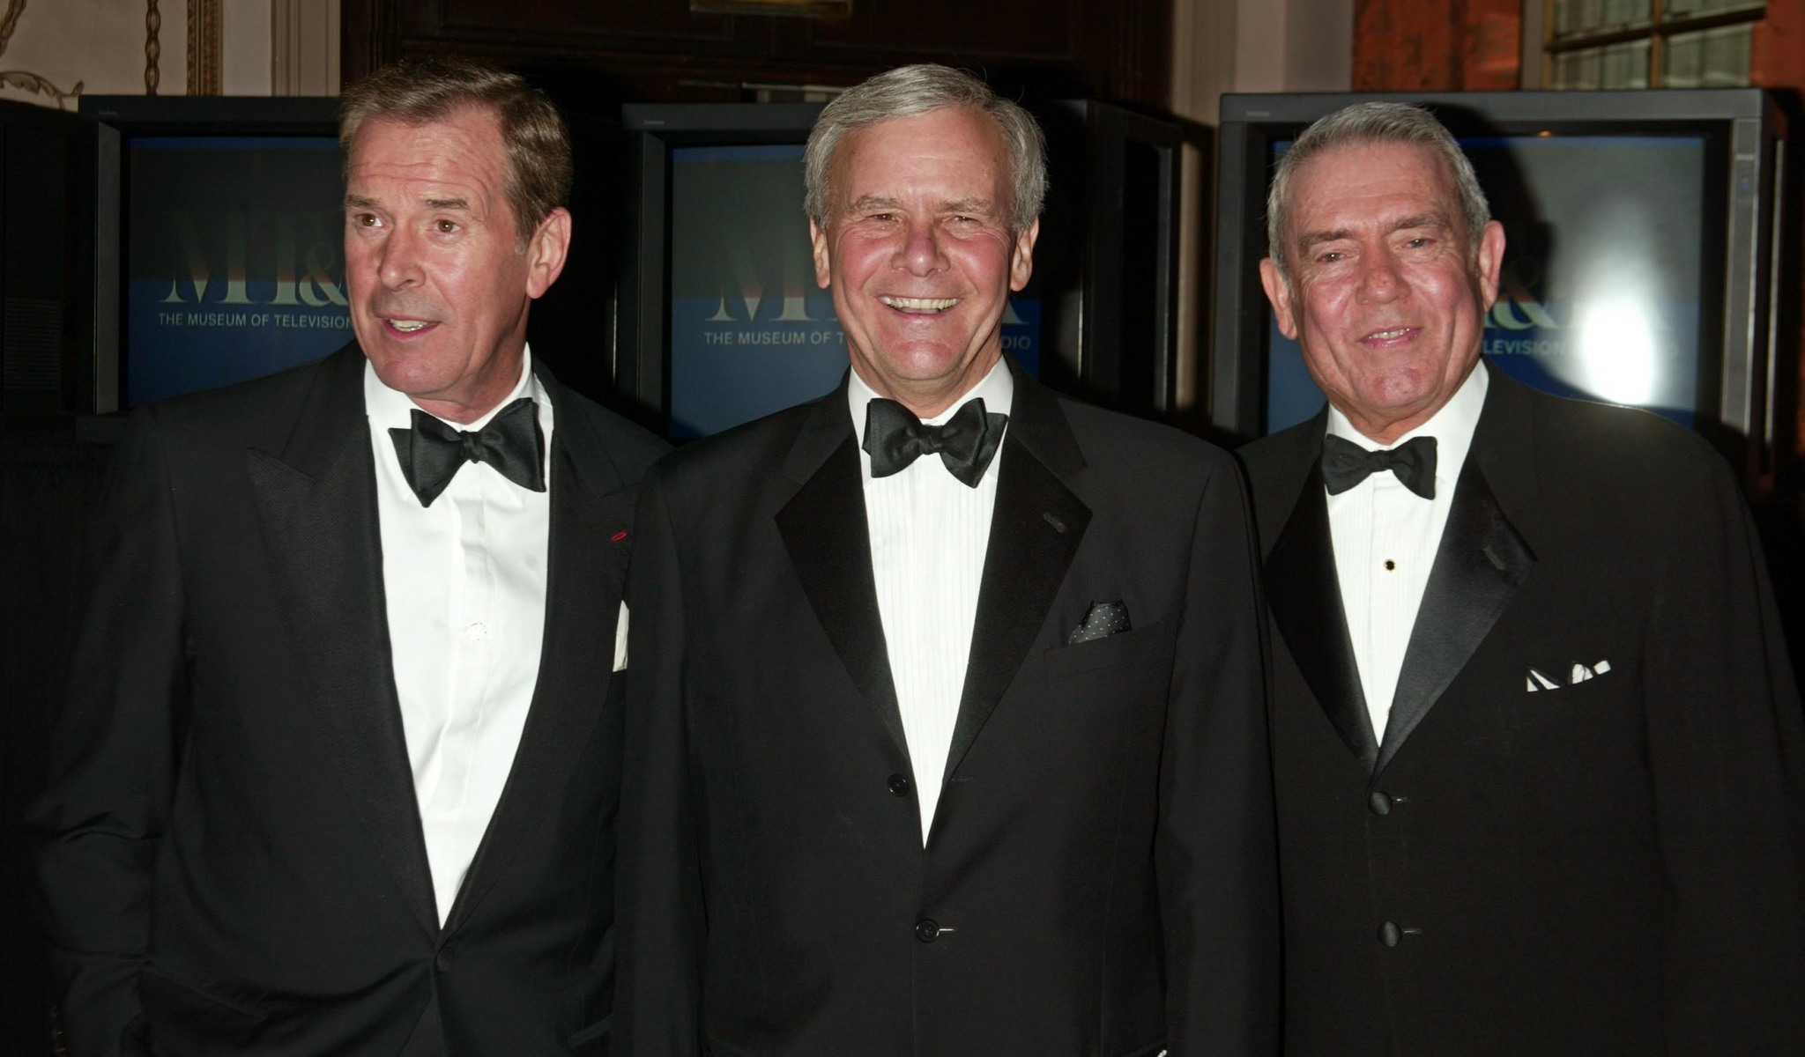
ANSWER # 4
• PETER JENNINGS
• DAN RATHER
• TOM BROKAW

Slide 11
QUESTION # 5
THE WORLD
BASED ON AREA, WHAT IS THE LARGEST LANDLOCKED COUNTRY THAT IS NOT IN AFRICA OR ASIA?

Slide 12
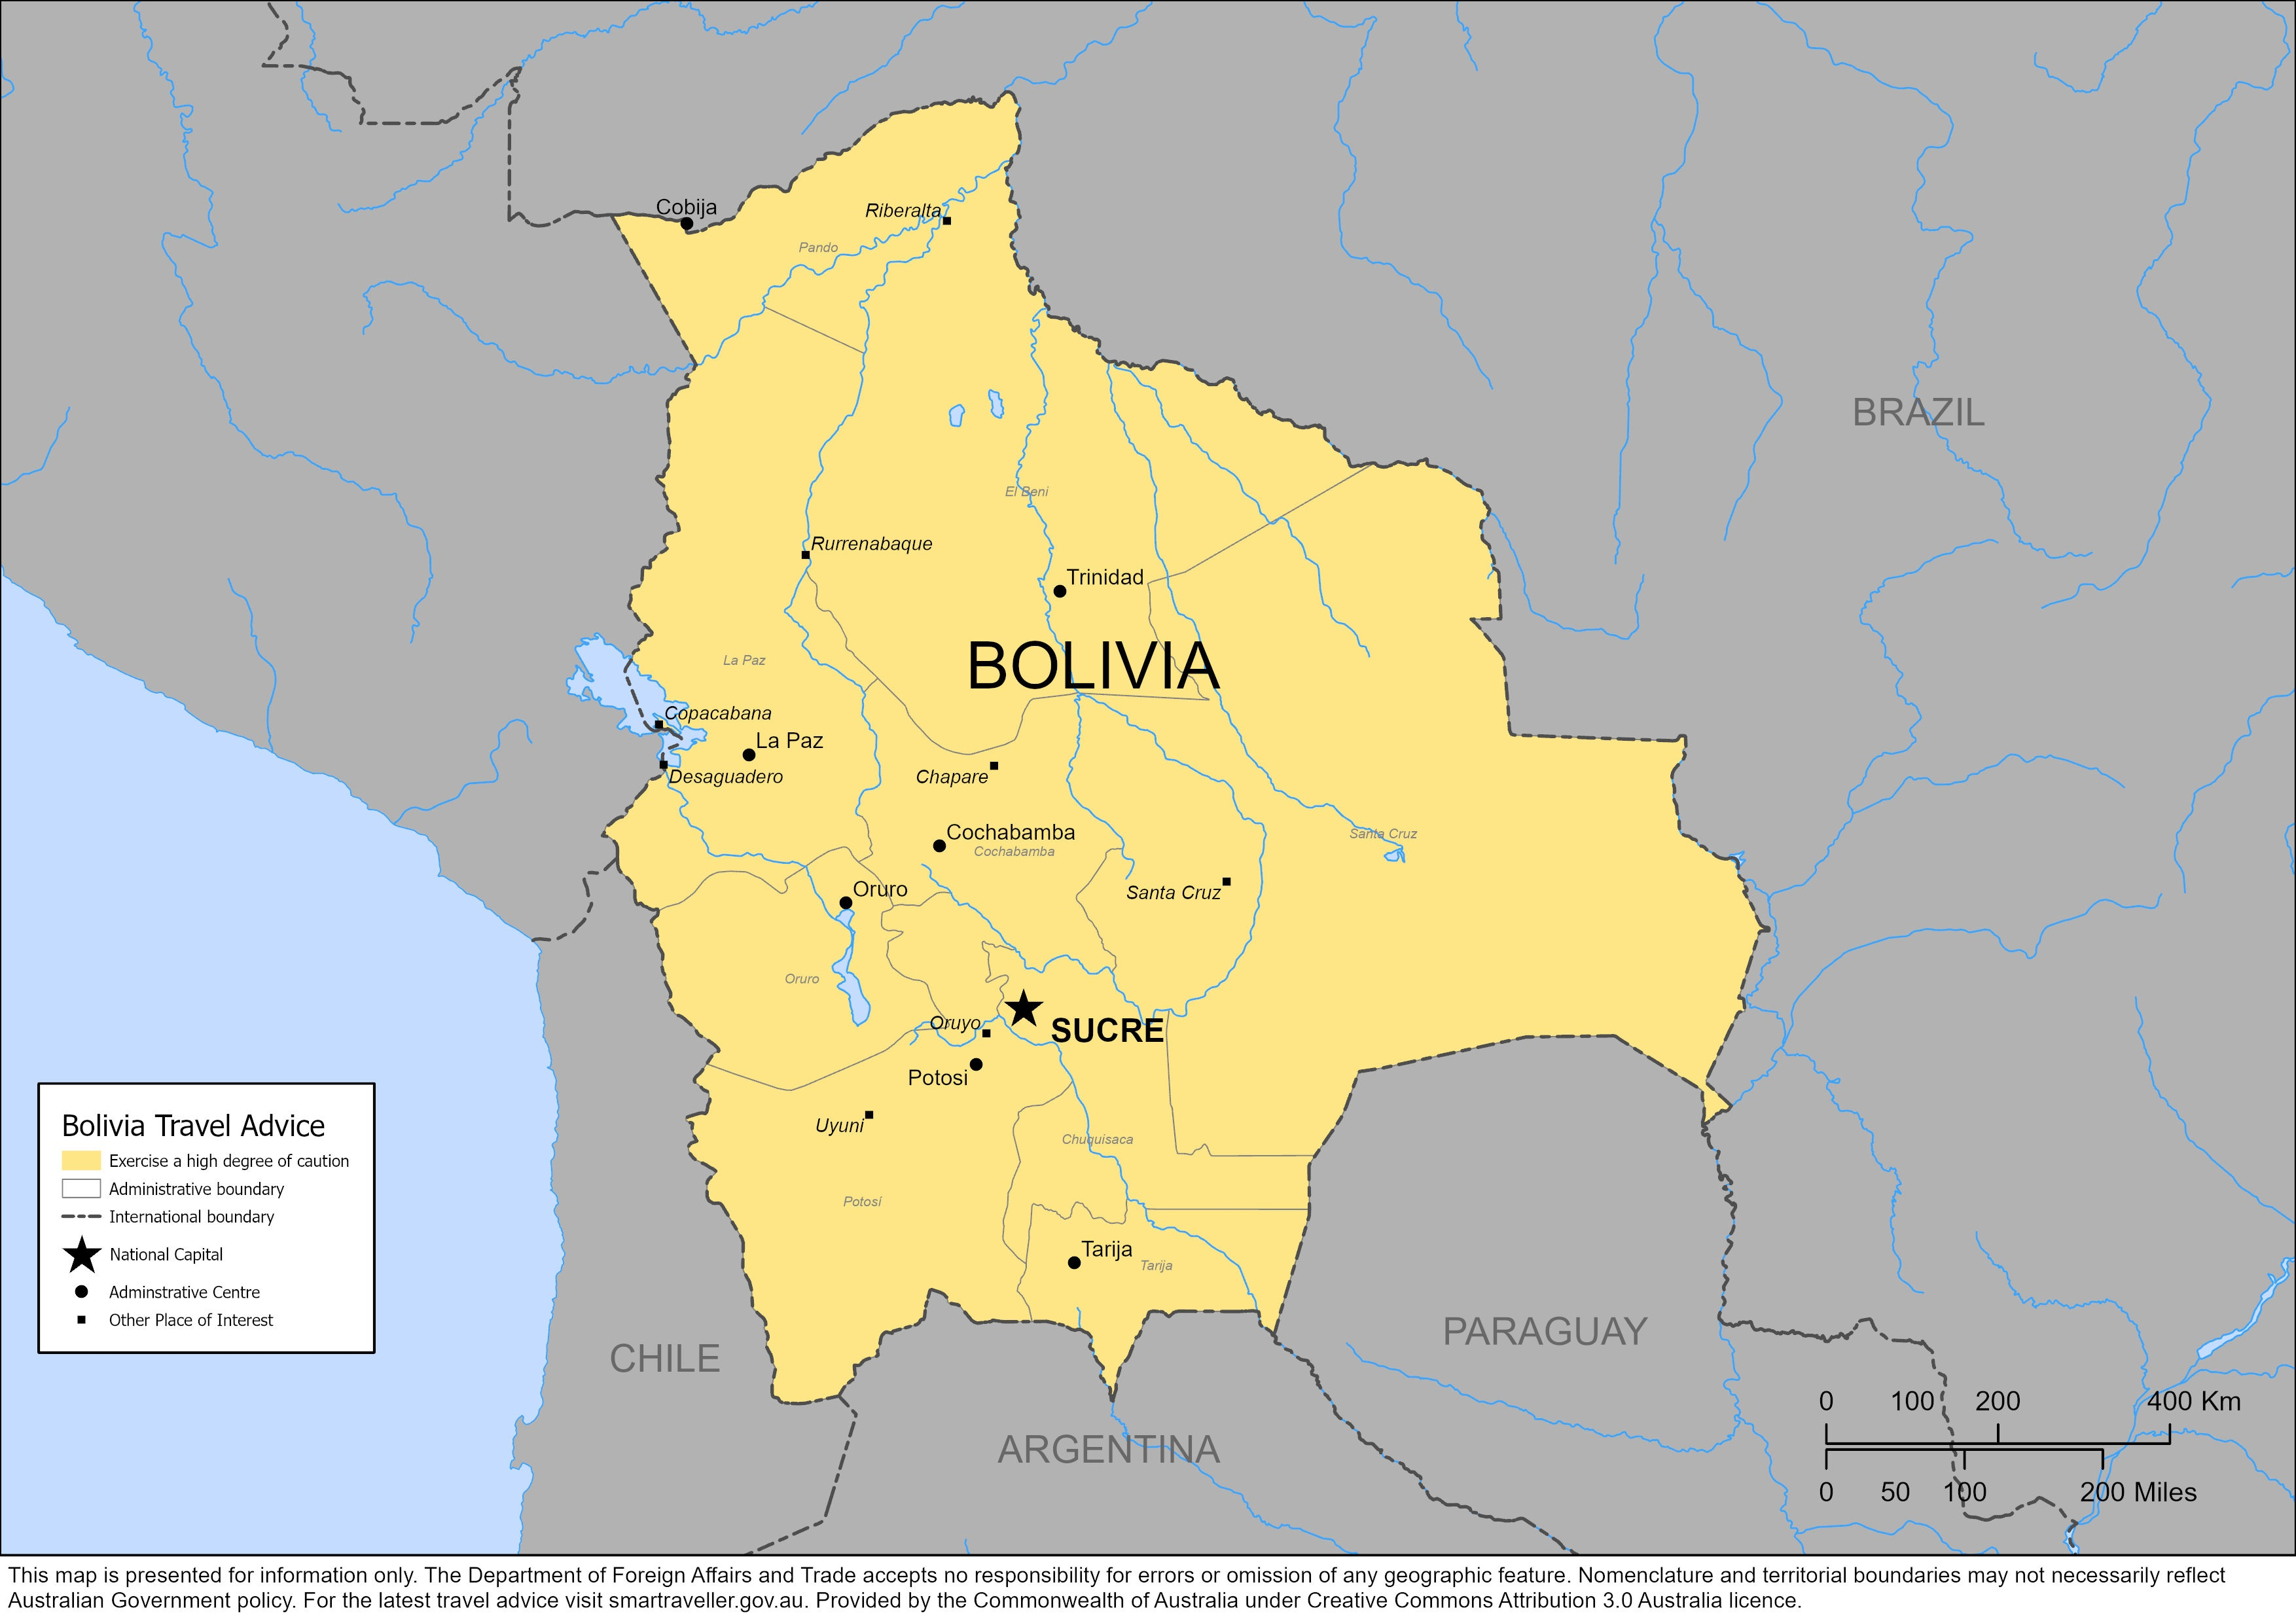
ANSWER # 5
BOLIVIA

Slide 13
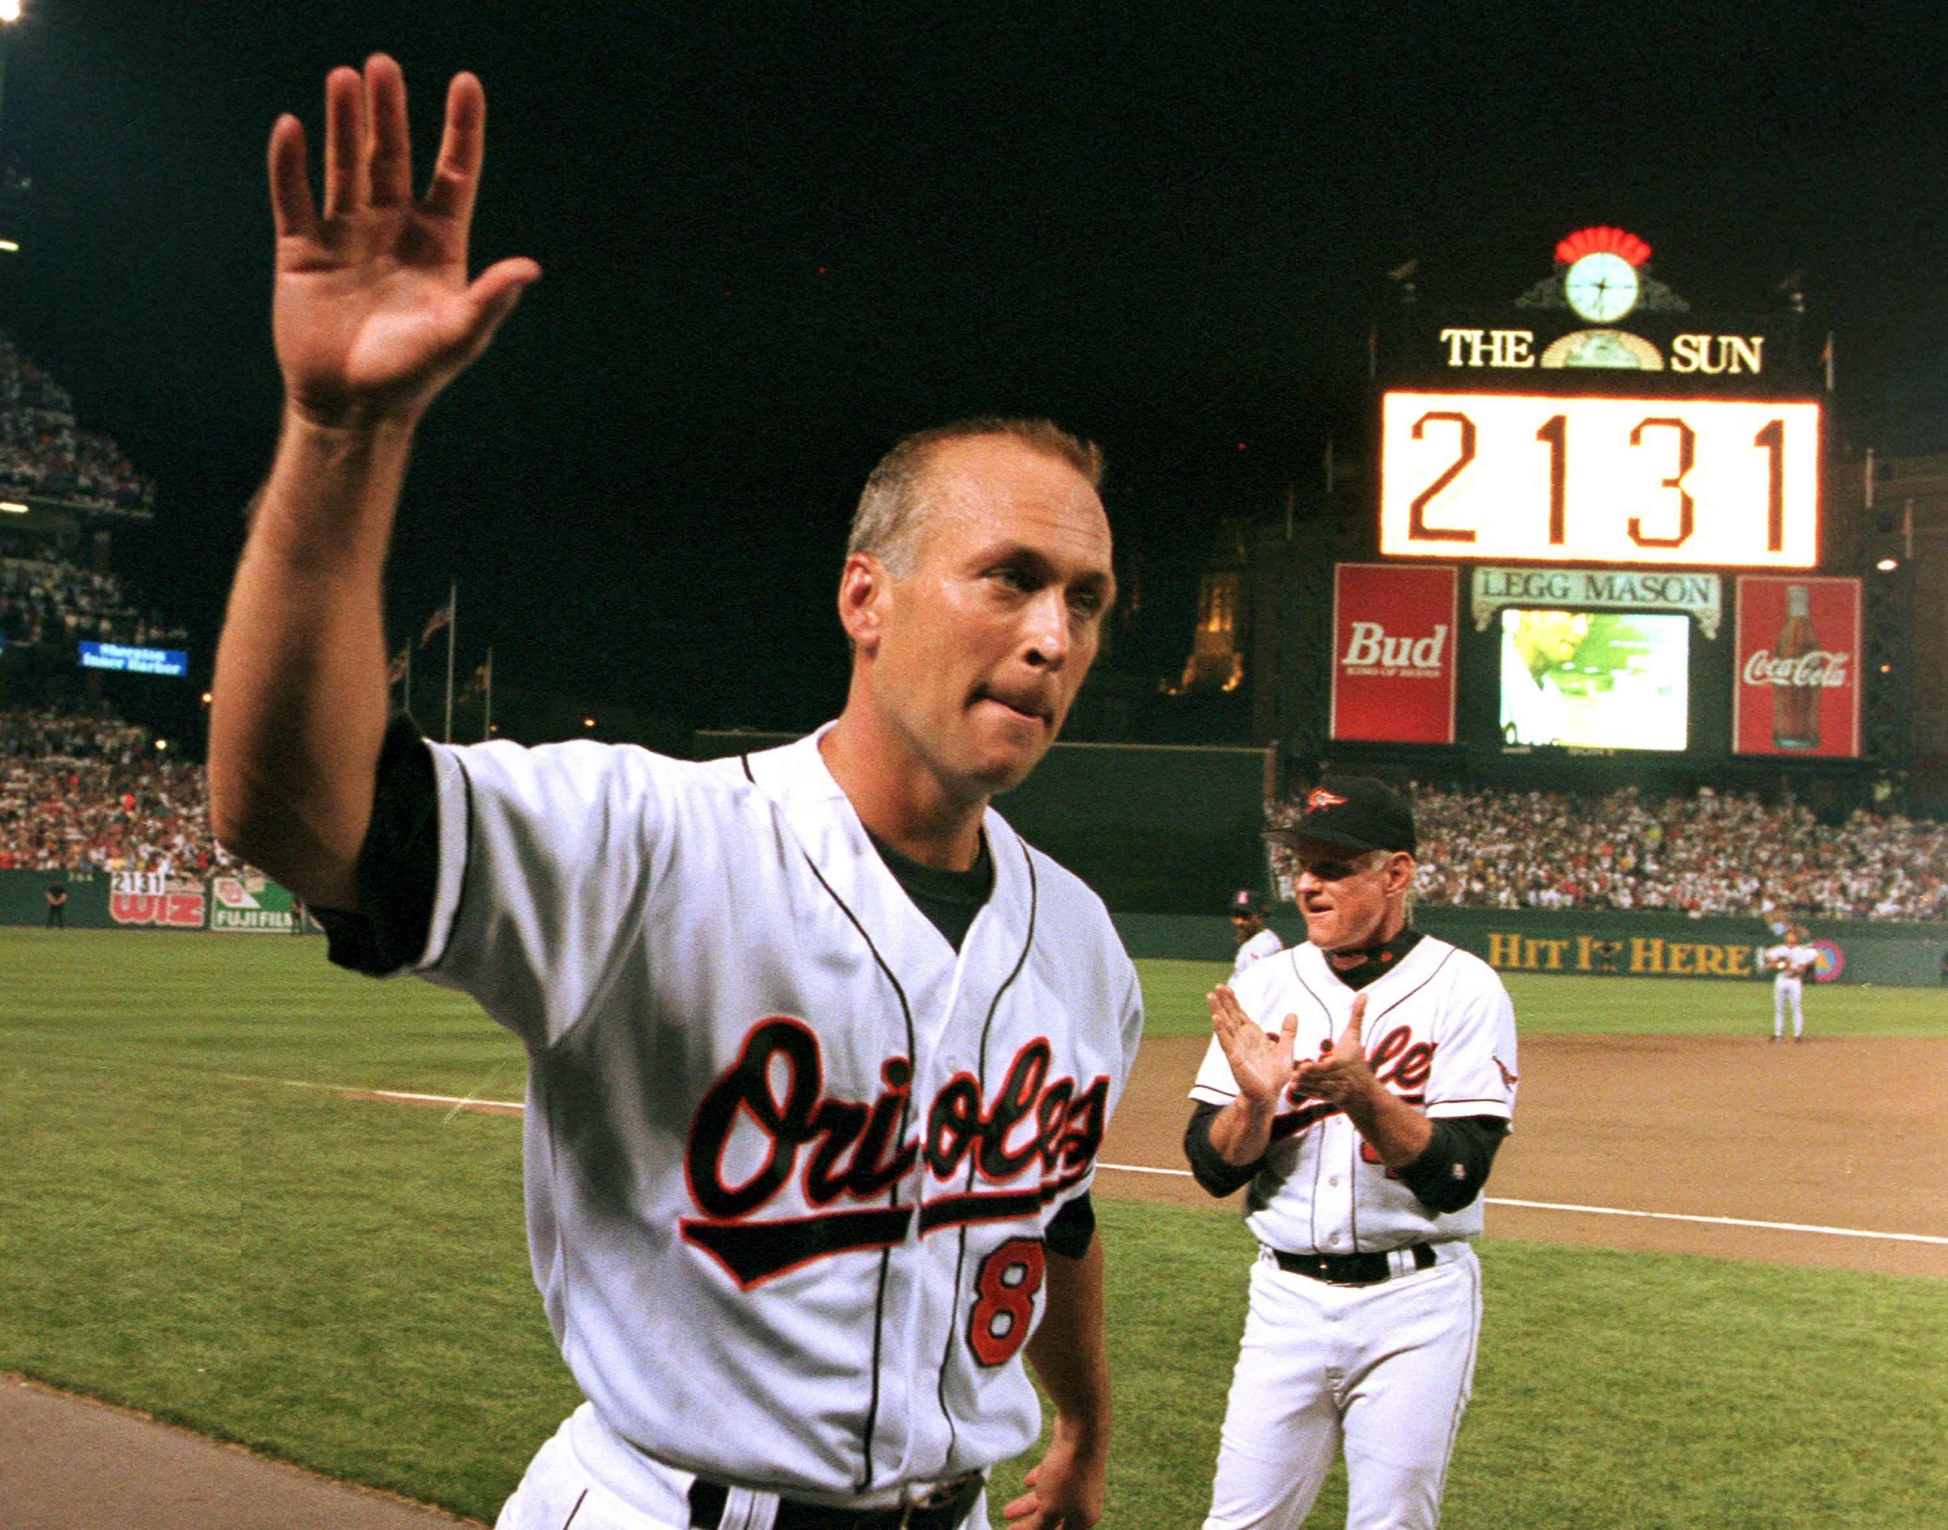
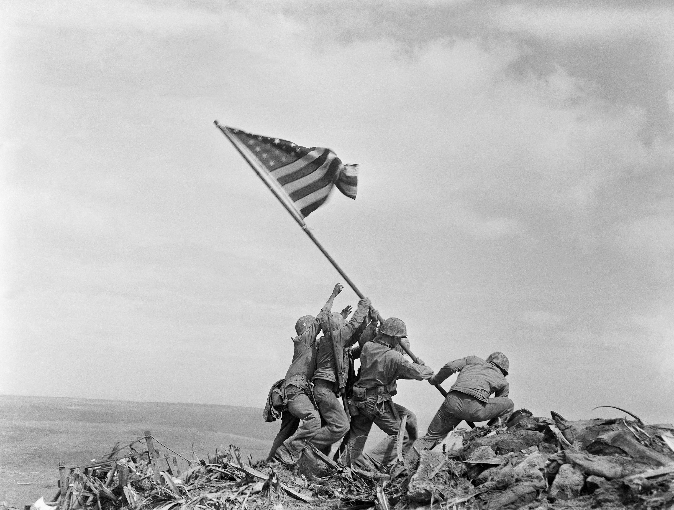
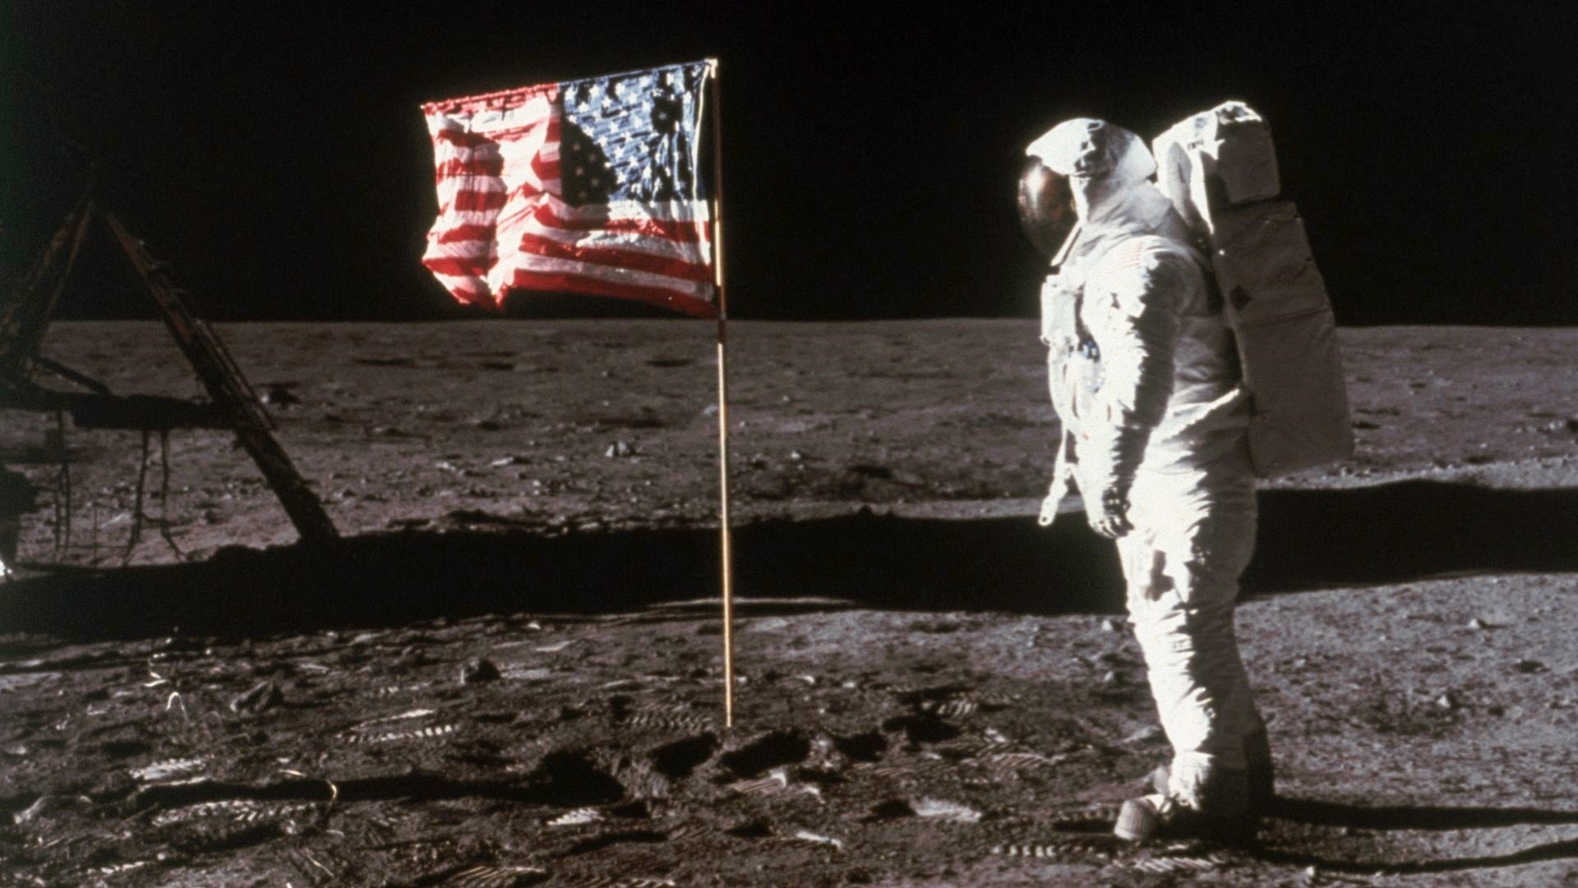
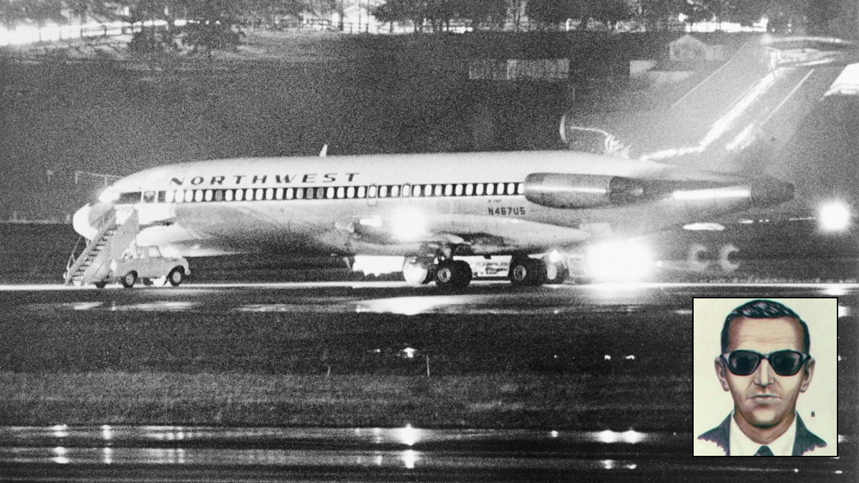
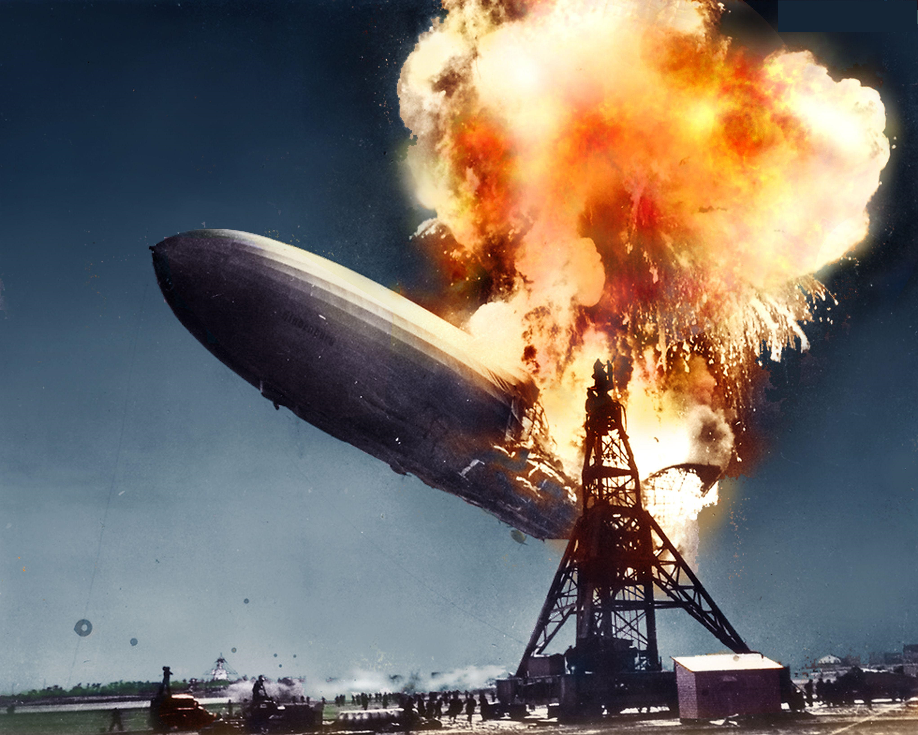
QUESTION # 6
NAME THE MONTHS IN WHICH THE FOLLOWING EVENTS HAPPENED

Slide 14
ANSWER # 6
JULY
(APOLLO 11 LANDED ON THE MOON)

Slide 15
FEBRUARY
(U.S. FLAG RAISED ON IWO JIMA)

Slide 16
NOVEMBER
(D.B. COOPER SKYJACKING)

Slide 17
MAY
(THE HINDENBURG DISASTER)

Slide 18
SEPTEMBER
(CAL RIPKEN SURPASSES LOU GEHRIG’S CONSECUTIVE GAMES PLAYED RECORD)

Slide 19
QUESTION # 7
MAJOR LEAGUE BASEBALL
SPENDING FIVE OF HIS 20 YEARS WITH THE BIRDS, WHO IS THE ONLY HALL OF FAME PLAYER TO HIT A HOMERUN IN HIS FIRST MLB AT BAT THEN NEVER HIT ANOTHER ONE FOR THE REST OF HIS CAREER?

Slide 20
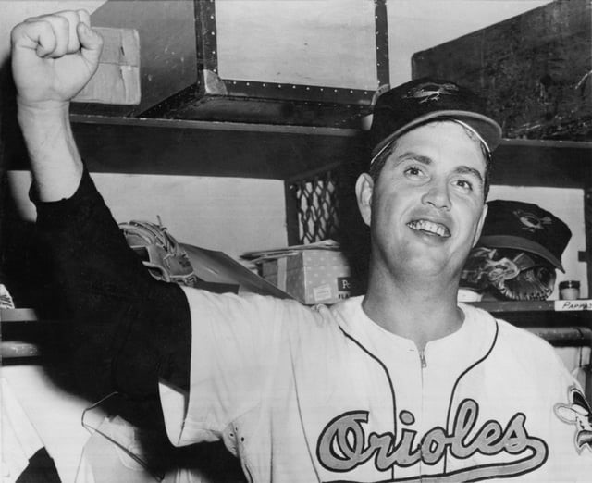
ANSWER # 7
HOYT WILHELM

Slide 21
QUESTION # 8
TELEVISION
2 - PART
LAUNCHED IN 2006, THE CW NETWORK WAS FORMED FROM THE MERGER OF WHICH TWO NETWORKS?

Slide 22
ANSWER # 8
• THE WB
• UPN

Slide 23
QUESTION # 9
IN THE NEWS
MEANING “RESERVED, MODEST, AND SHY,” WHAT WAS DICTIONARY.COM’S 2024 WORD OF THE YEAR?

Slide 24
ANSWER # 9
DEMURE

Slide 25
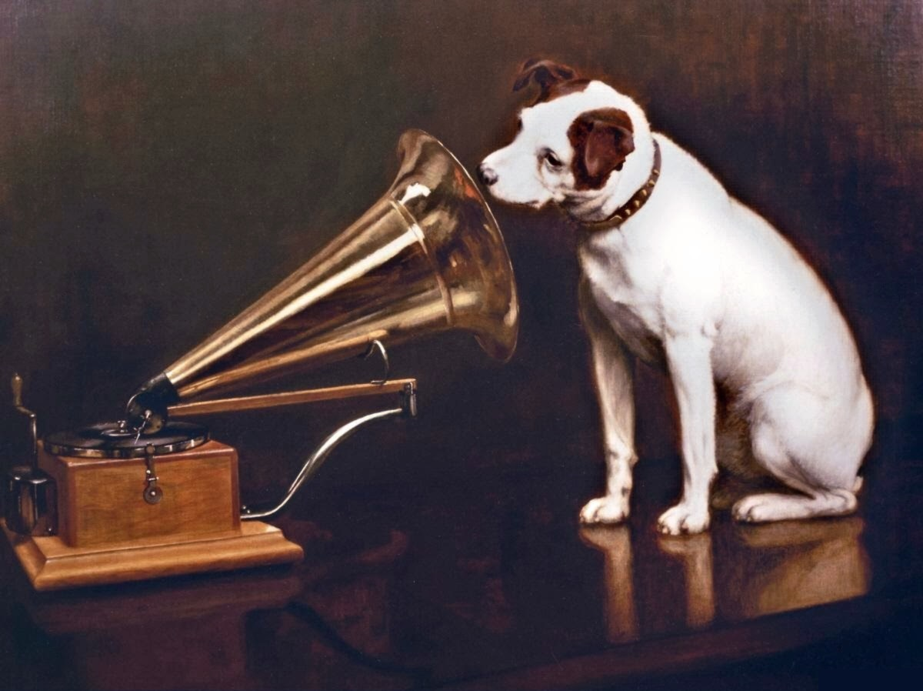

QUESTION # 10 SOUND
3 - PART
NAME THE THREE FILMS FEATURING COMPOSITIONS BY JOHN WILLIAMS FROM THE FOLLOWING MUSICAL CLIPS:

Slide 26
ANSWER # 10
MOVIE # 1
MOVIE # 3
HOME ALONE
JAWS
MOVIE # 2
THE PATRIOT

Slide 27
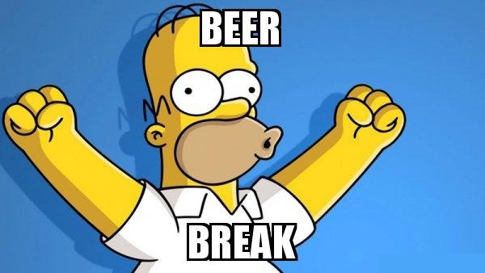
halftime
halftime
100% THIS IS BEER

Slide 28
QUESTION # 11
THE BODY HUMAN
THE ACRONYM “BE FAST” IS USED BY HEALTH CARE PROVIDERS TO DETECT THE SIGNS OF WHAT SERIOUS MEDICAL CONDITION?

Slide 29
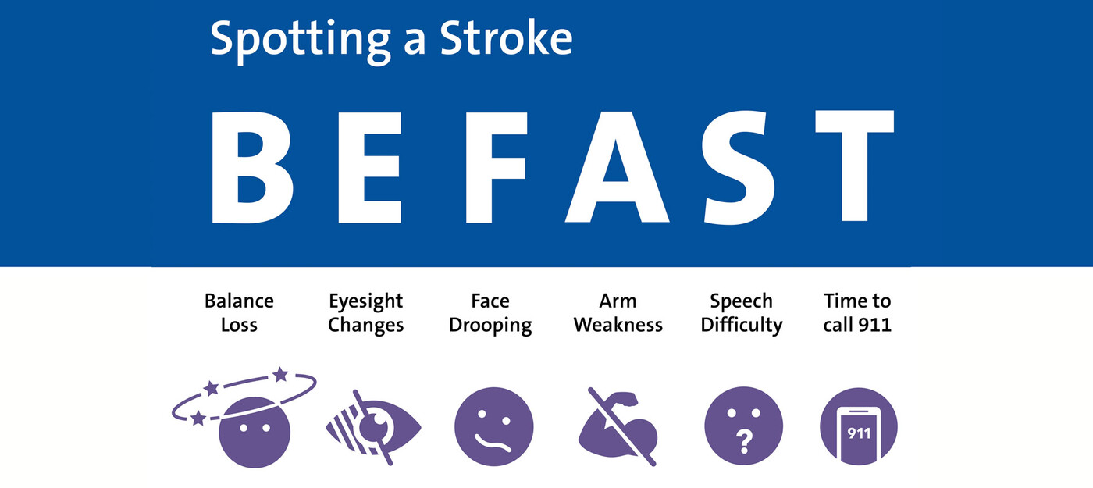
ANSWER # 11
STROKE

Slide 30
QUESTION # 12
THE NATIONAL FOOTBALL LEAGUE
3 - PART
OF ALL YEARS IN WHICH A MINIMUM OF 14 GAMES WERE PLAYED, WHAT ARE THE ONLY THREE TEAMS TO GO WINLESS FOR THE ENTIRE SEASON?

Slide 31
ANSWER # 12
• CLEVELAND BROWNS
• DETROIT LIONS
• TAMPA BAY BUCCANEERS

Slide 32
QUESTION # 13
MOVIES
ONLY TWO FILMS HAVE GROSSED OVER A BILLION DOLLARS AT THE WORLDWIDE BOX OFFICE WHILE HAVING A PERFORMER WIN AN ACTING ACADEMY AWARD; BOTH TIMES WERE FOR AN ACTOR/ESS PLAYING WHAT CHARACTER?

Slide 33
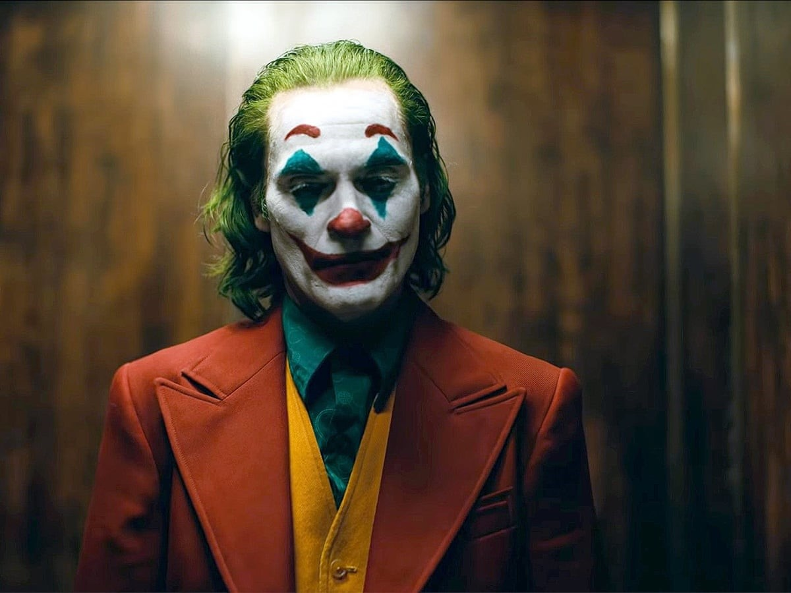
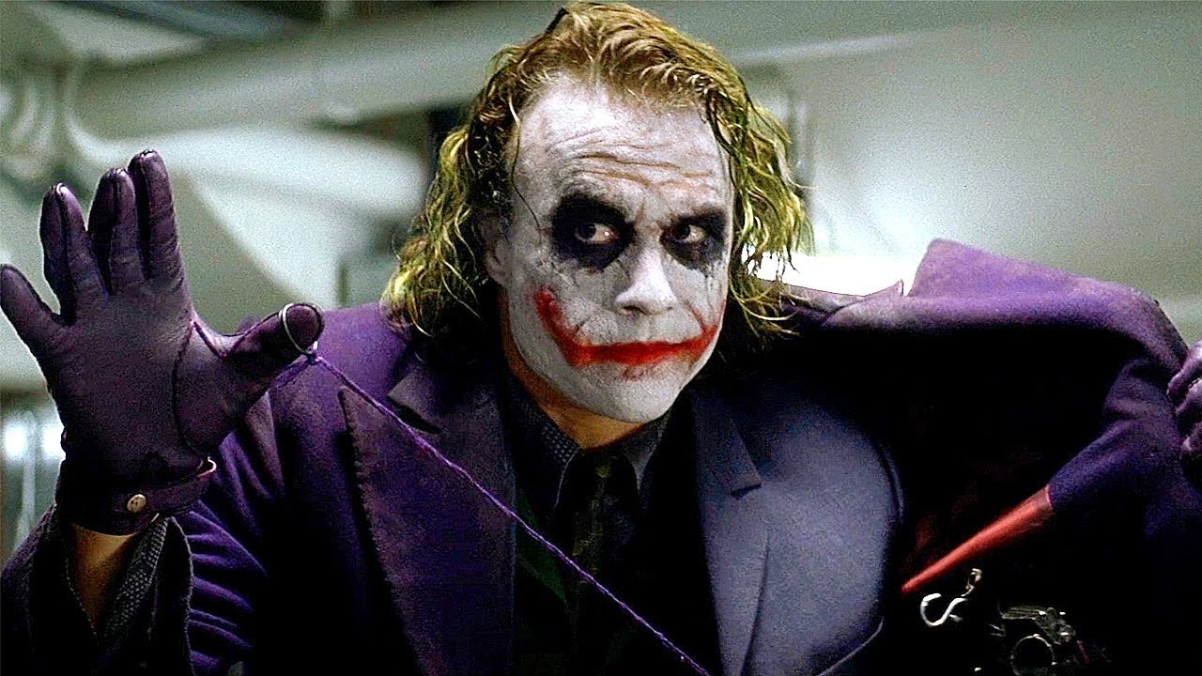
ANSWER # 13
THE JOKER

Slide 34
QUESTION # 14
AMERICA
2 - PART
BASED ON DATA FROM THE 2020 U.S. CENSUS, OF ALL U.S. STATES THAT HAVE EXACTLY SIX LETTERS IN THEIR NAME, WHICH TWO HAVE STATE CAPITALS THAT HAVE A POPULATION OF LESS THAN 100,000 PEOPLE?

Slide 35
ANSWER # 14
• ALASKA
• NEVADA

Slide 36
QUESTION # 15
THE WIZARDING WORLD
SERVING THE MAGICAL COMMUNITY OF GREAT BRITAIN, AZKABAN PRISON IS “LOCATED” IN WHAT REAL BODY OF WATER?

Slide 37
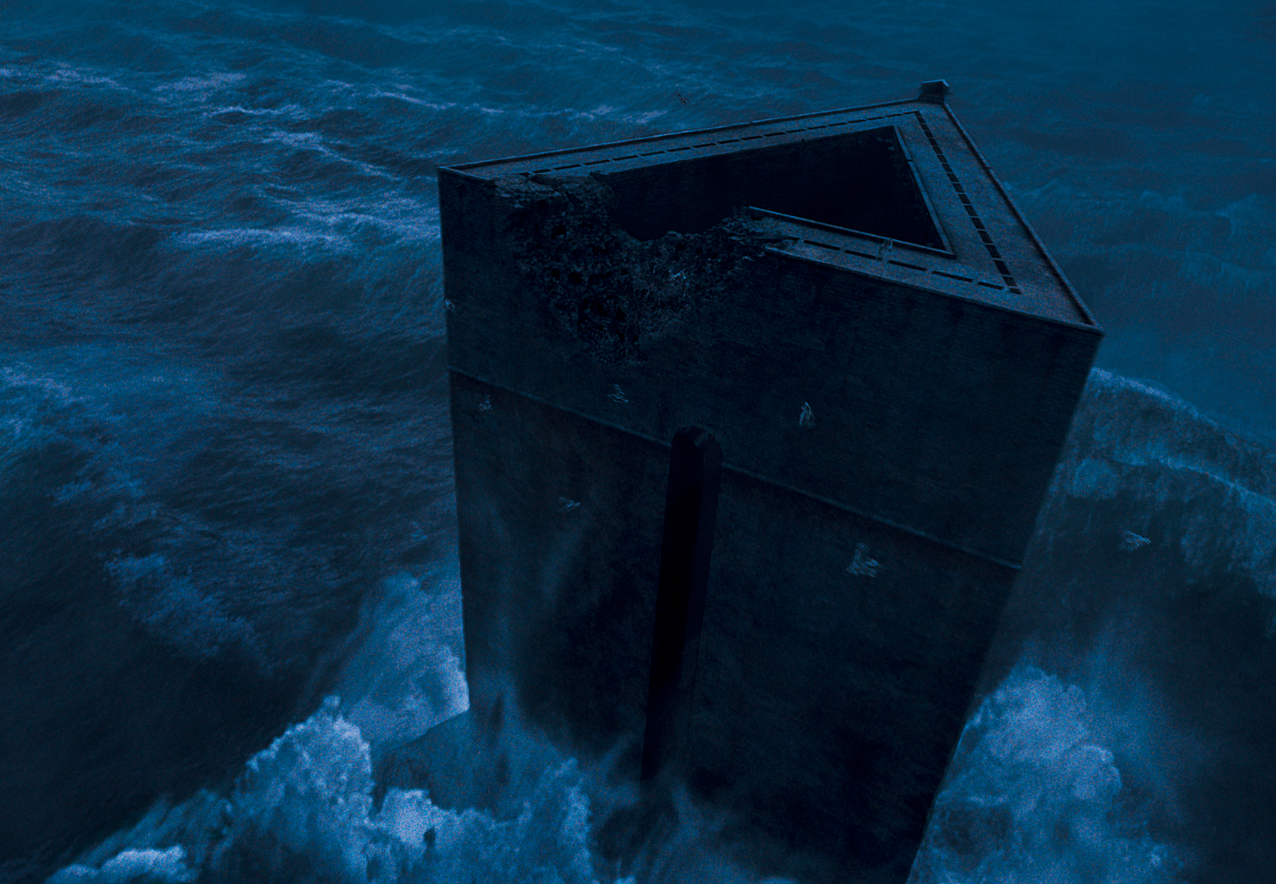
ANSWER # 15
THE NORTH SEA

Slide 38
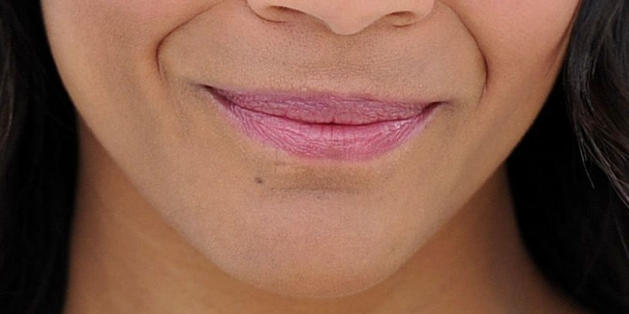
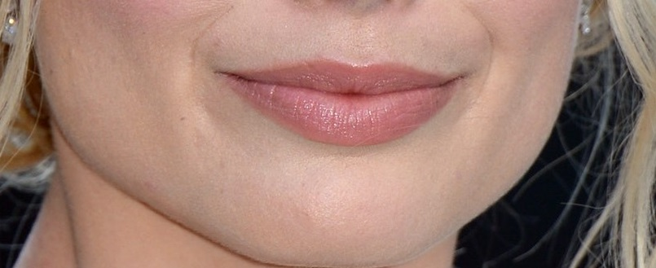
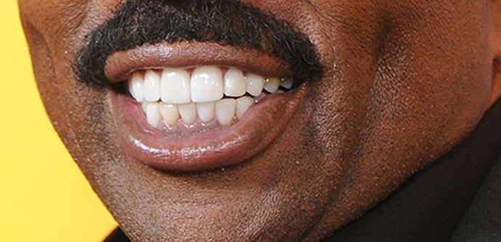
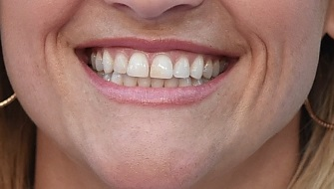
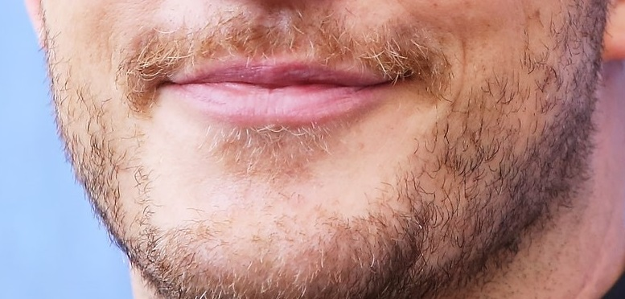
QUESTION # 16
THE EYES SMILES HAVE IT!
WHO ARE WE?!

Slide 39
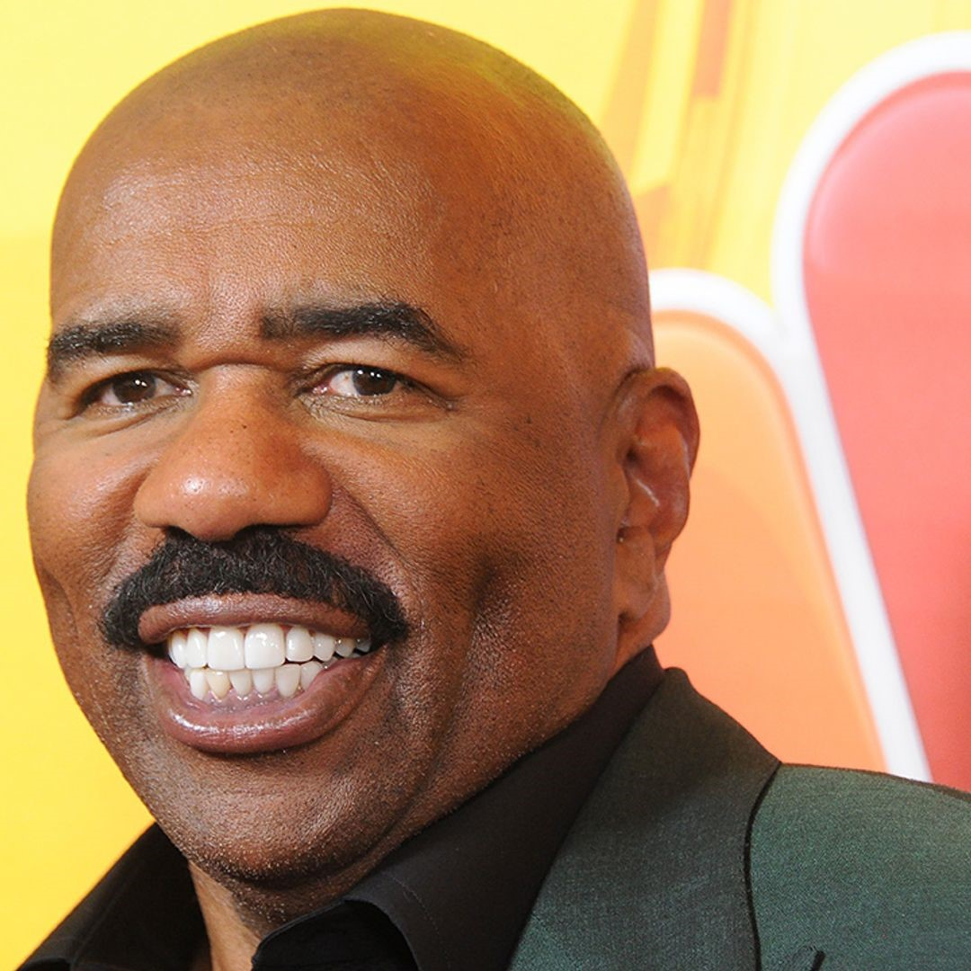
ANSWER # 16
STEVE HARVEY

Slide 40
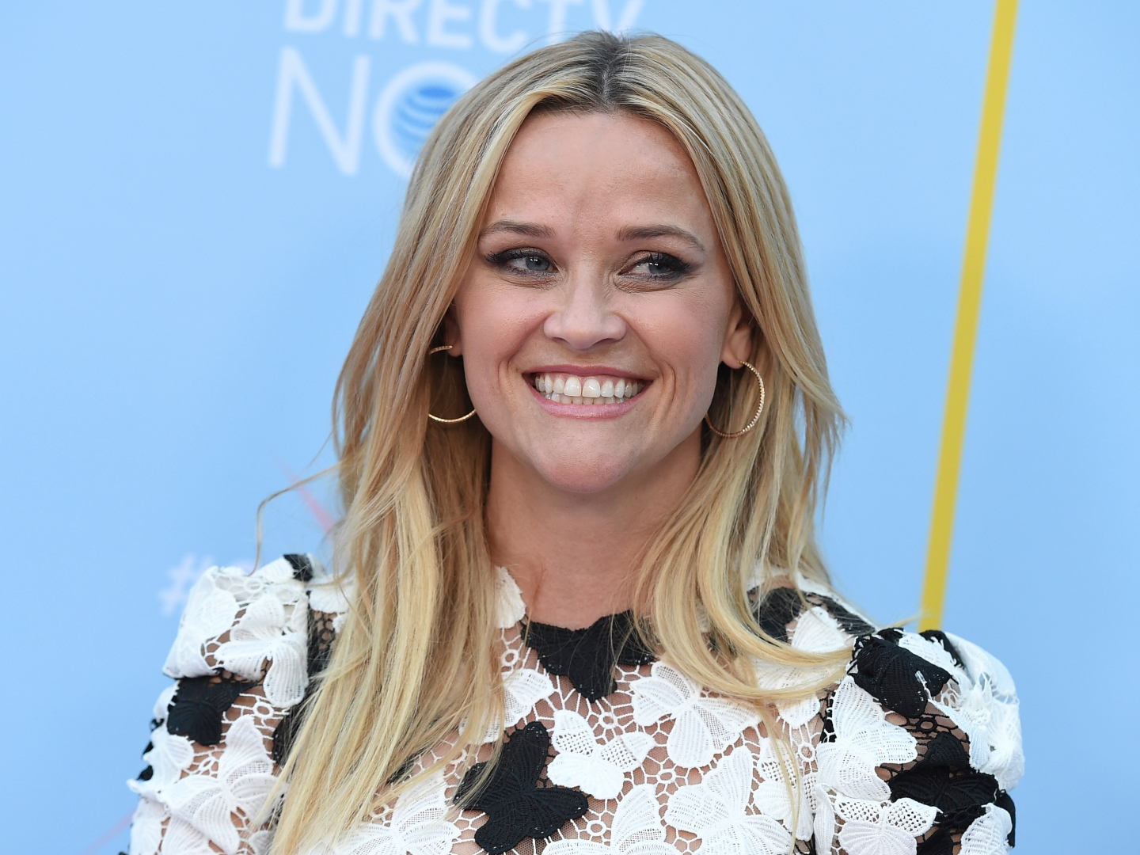
REESE WITHERSPOON

Slide 41
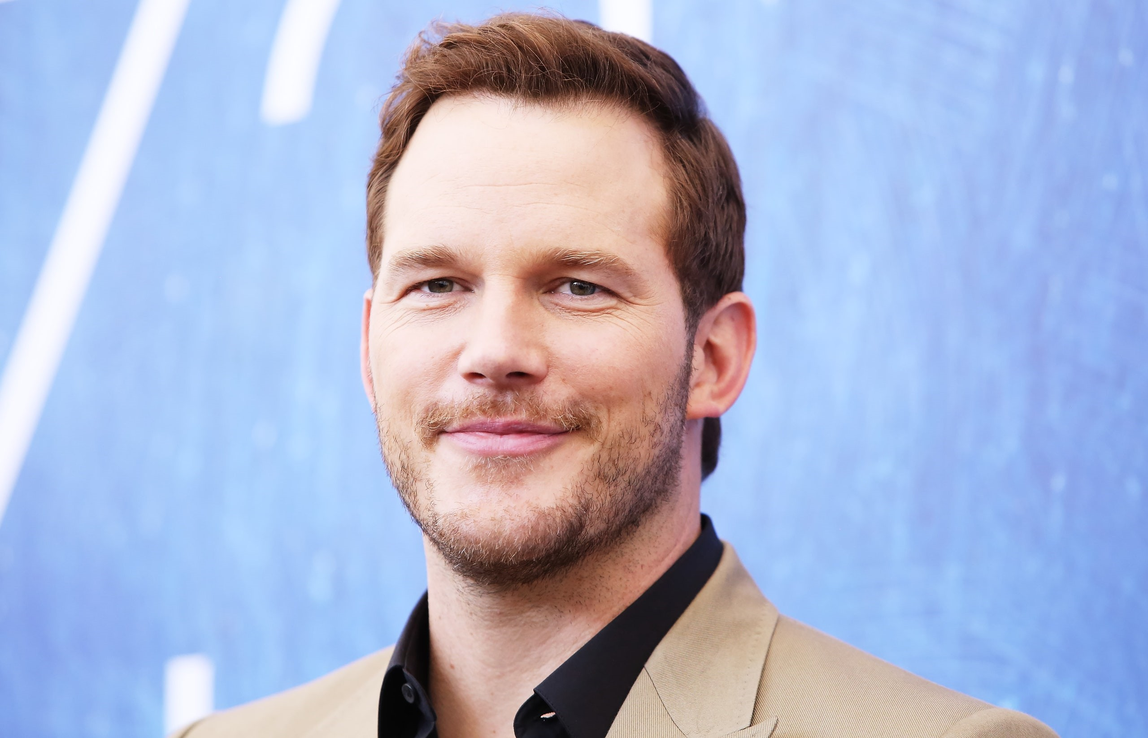
CHRIS PRATT

Slide 42
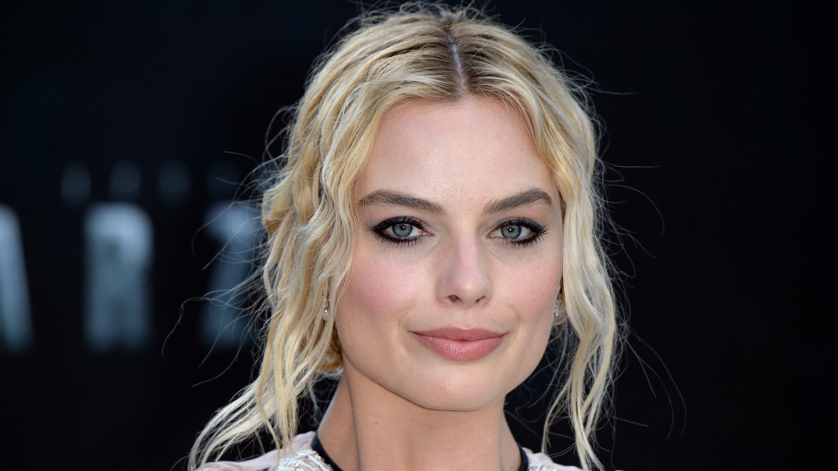
MARGOT ROBBIE

Slide 43
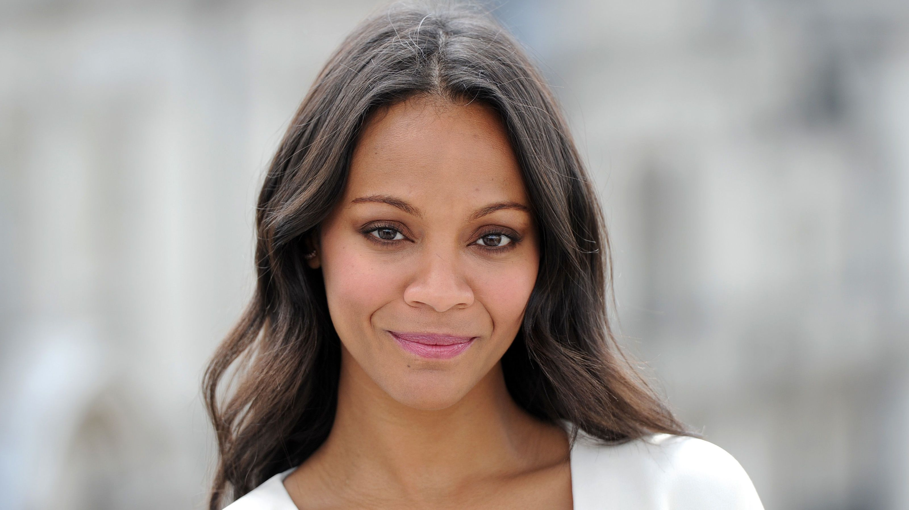
ZOE SALDANA

Slide 44
QUESTION # 17
MUSIC
JOHN LENNON’S LAST MAJOR CONCERT APPEARANCE CAME ON NOVEMBER 28, 1974 WHEN HE JOINED WHAT MUSICIAN ONSTAGE AT MADISON SQUARE GARDEN?

Slide 45
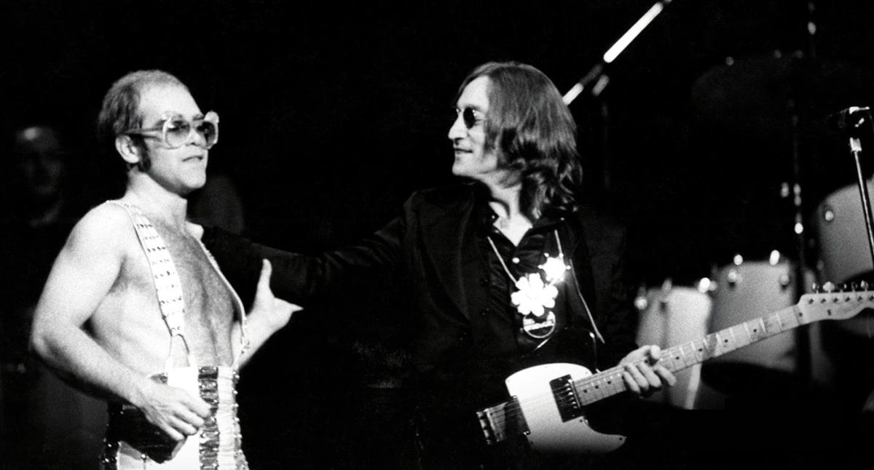
ANSWER # 17
ELTON JOHN

Slide 46
QUESTION # 18
THE SPEED BUMP
LIST AS MANY ANSWERS AS YOU FEEL ARE CORRECT. FOR EACH CORRECT ANSWER, YOU GET ONE POINT. HOWEVER FOR AN INCORRECT ANSWER, YOU GET ZERO POINTS FOR THE ENTIRE QUESTION
ACCORDING TO THE U.S. SOCIAL SECURITY ADMINISTRATION, LIST A BABY NAME THAT WAS USED MORE THAN 50,000 TIMES FROM 1900 – 1909?

Slide 47
ANSWER # 18
• MARY (161,504)
• JOHN (84,591)
• HELEN (69,428)
• WILLIAM (69,320)
• JAMES (62,170)
• MARGARET (57,920)
• ANNA (54,918)
• RUTH (51,010)

Slide 48
QUESTION # 19
BOOKS AND LIT
“LATER ON HE WILL UNDERSTAND HOW SOME MEN SO LOVED HER, THAT THEY DID DARE MUCH FOR HER SAKE” IS THE FINAL LINE IN WHAT ICONIC 19TH CENTURY NOVEL?

Slide 49

ANSWER # 19
DRACULA

Slide 50
QUESTION # 20
VENUES
WAGER UP TO 15 POINTS
NAMED IN HONOR OF TWO SONGWRITERS, WHAT IS THE CURRENT NAME OF THE LARGEST BROADWAY THEATER BY SEATING CAPACITY?

Slide 51
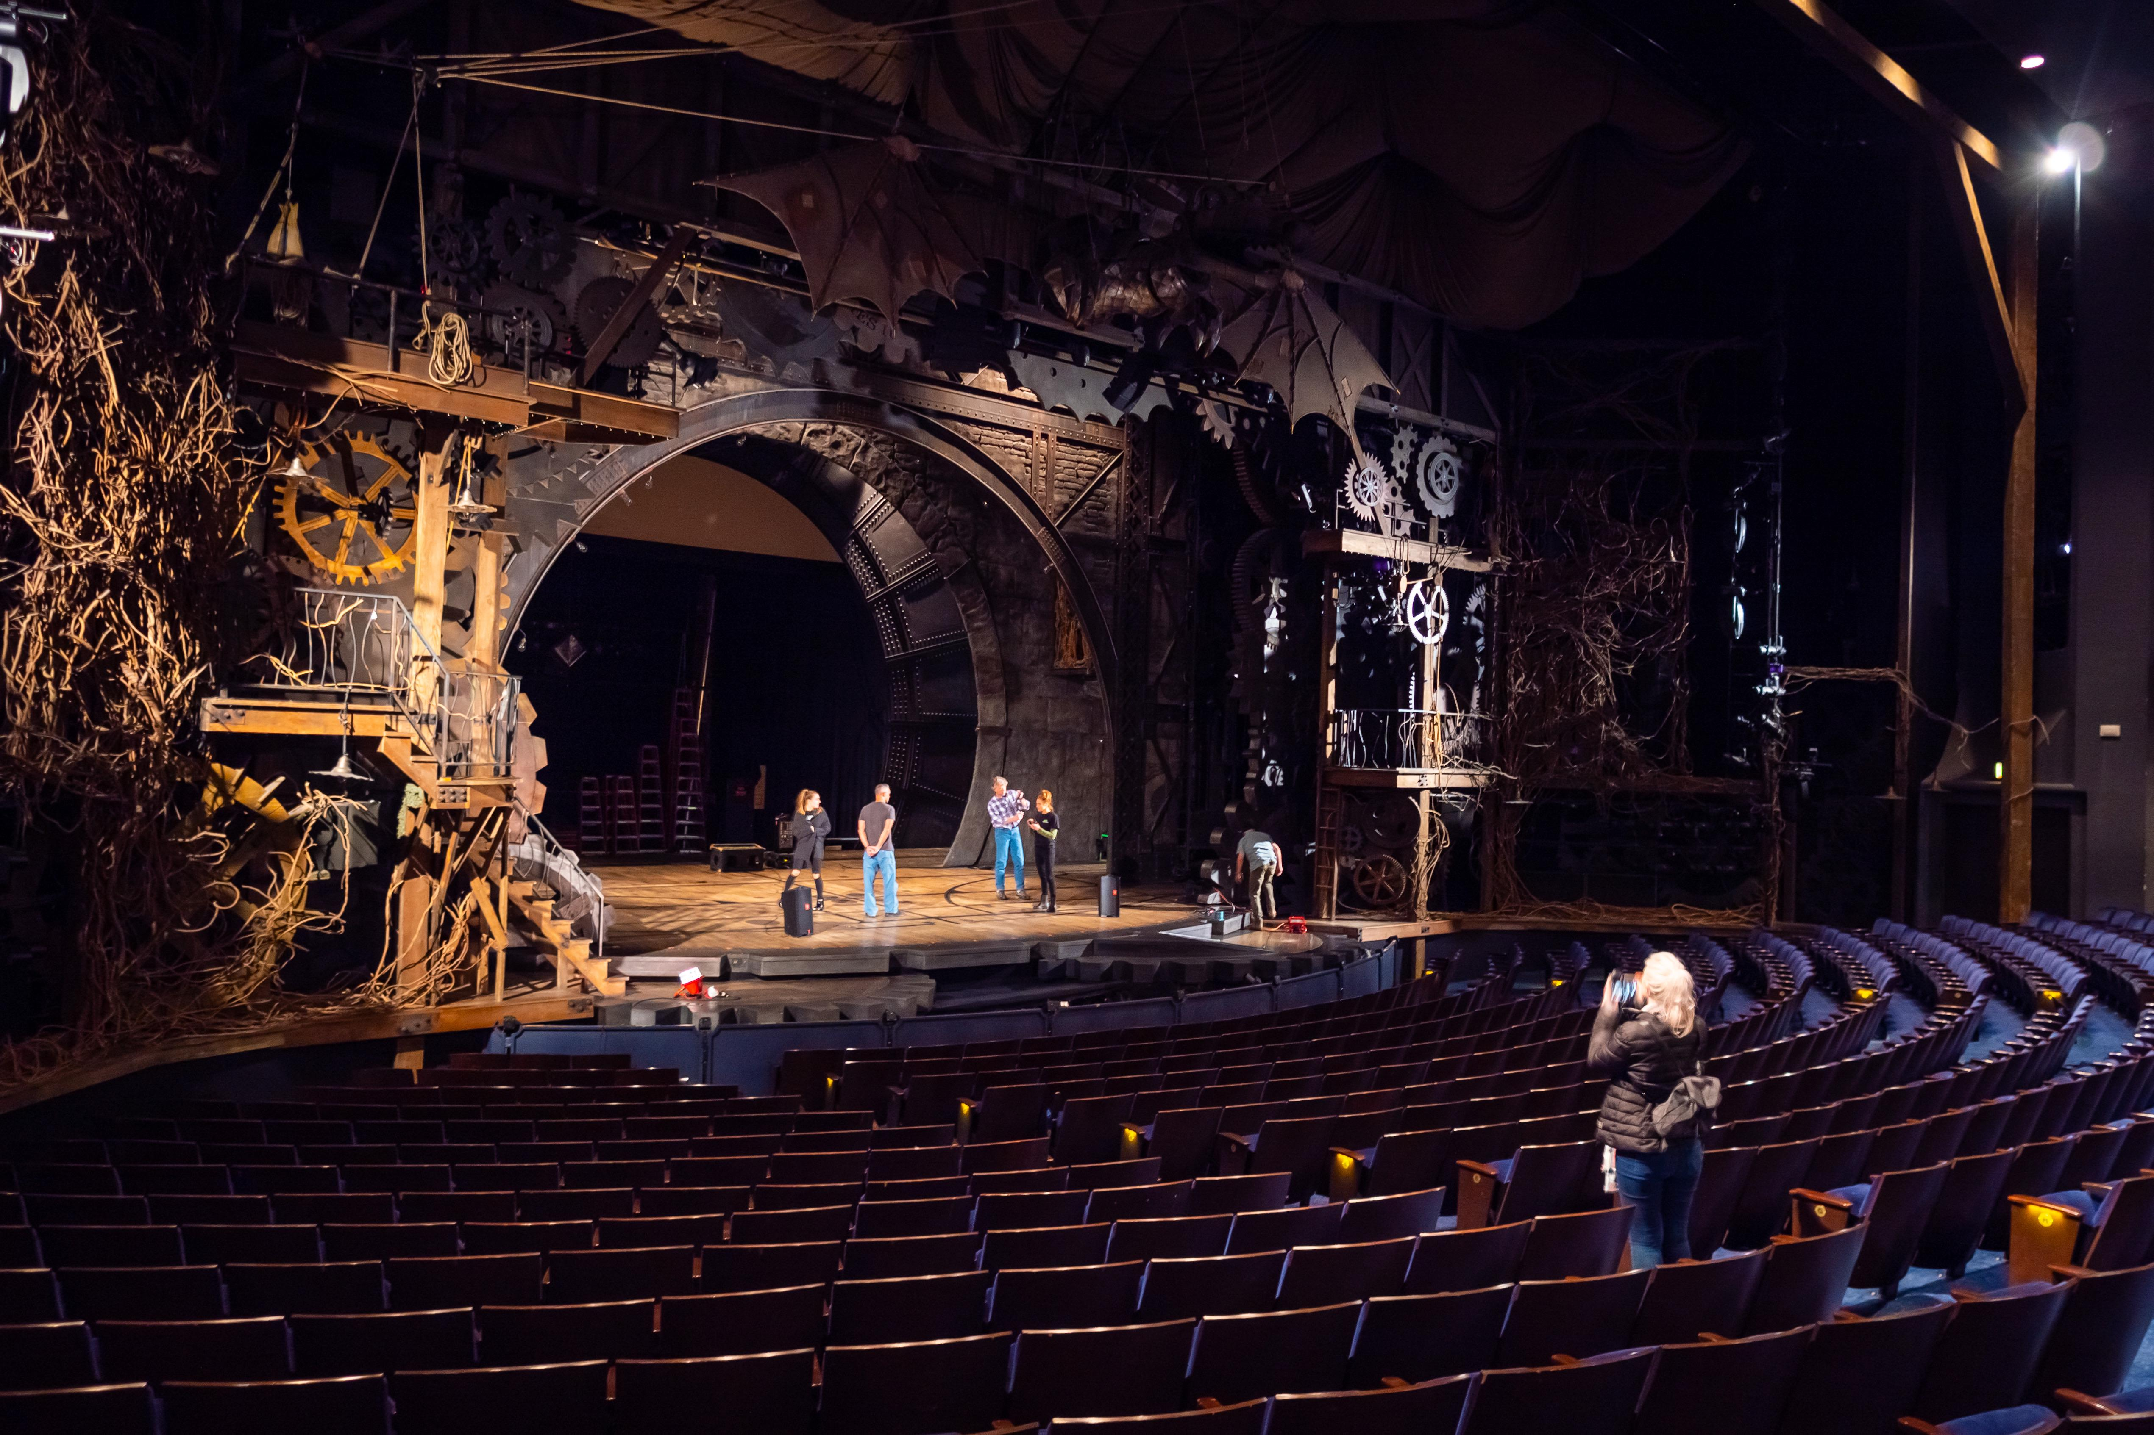
ANSWER # 20
THE GERSHWIN THEATRE

Slide 52
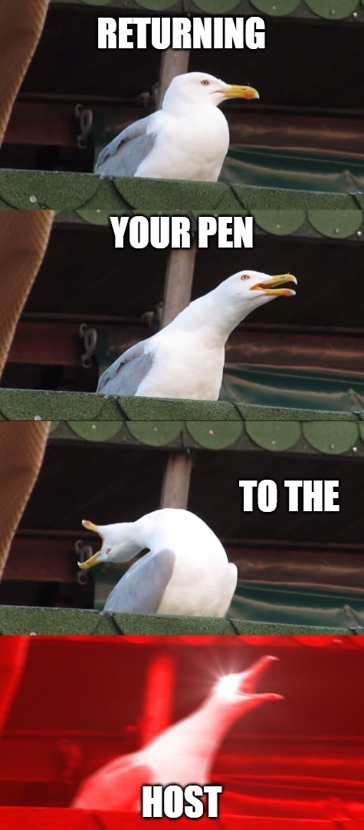
triviamaryland
triviamaryland

Slide 53
TIE BREAKER QUESTION
ACCORDING TO THE SOCIAL SECURITY ADMINISTRATION, FROM 1900 – 1909, HOW MANY BABIES WERE NAMED RUDOLPH?

Slide 54
TIE BREAKER ANSWER
1,339

