Slide 1


TRIVIAMARYLAND
WORLD
SERIES
triviamaryland.com
@triviamaryland

Slide 2

I’M WITH STUPID
JUNE BUGS
BRASSERS
JIMMY’S NEUTRONS
FRESH PRICKS OF BEL AIR
MASTER DEBATORS
LINCOLN LOVES ZJ’S
B SQUAD
FEAR THE CRAB
LITE
BUTTER CHURNS & PEPPER MILLS
SWEEP THE LEG
PICKACHUBCRABS
PARTIAL RECALL
SENIOR MOMENTS
EVERYTHING’S COMING UP MILHOUSE
ALL OR NOTHING

Slide 3
QUESTION # 1
TELEVISION
WHAT ACTOR WHO PLAYED A SITCOM DAD IN THE 1980s CO-WROTE SEVERAL TV THEME SONGS, INCLUDING DIFF’RENT STROKES AND
THE FACTS OF LIFE?

Slide 4

ANSWER # 1
ALAN THICKE

Slide 5
QUESTION # 2
BODIES OF WATER
4-PARTER
NAME THE BODIES OF WATER THAT FLOW UNDERNEATH THE FOLLOWING BRIDGES:
TOWER BRIDGE
BROOKLYN BRIDGE
PONTE VECCHIO
FRANCIS SCOTT KEY BRIDGE

Slide 6
ANSWER # 2
TOWER BRIDGE -
RIVER THAMES
BROOKLYN BRIDGE -
EAST RIVER
PONTE VECCHIO - ARNO RIVER
FRANCIS SCOTT KEY BRIDGE - PATAPSCO RIVER

Slide 7

QUESTION # 3
ASTRONOMY
WHAT TERM REFERS TO A STRAIGHT-LINE CONFIGURATION OF THREE OR MORE CELESTIAL BODIES, USUALLY THE EARTH, MOON, AND SUN?

Slide 8
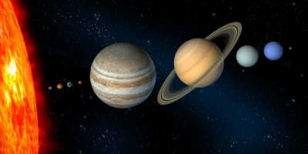
ANSWER # 3
SYZYGY

Slide 9
QUESTION # 4
FOOTBALL
3-PARTER
WHICH THREE TEAMS HAVE THREE WINS OR FEWER IN
THE CURRENT
NFL SEASON?

Slide 10



ANSWER # 4

Slide 11
QUESTION # 5
DEFINITIONS
WHAT MILITARY RANK IS ALSO A WORD THAT CAN MEAN “RELATED TO THE
HUMAN BODY”?

Slide 12

ANSWER # 5
CORPORAL

Slide 13
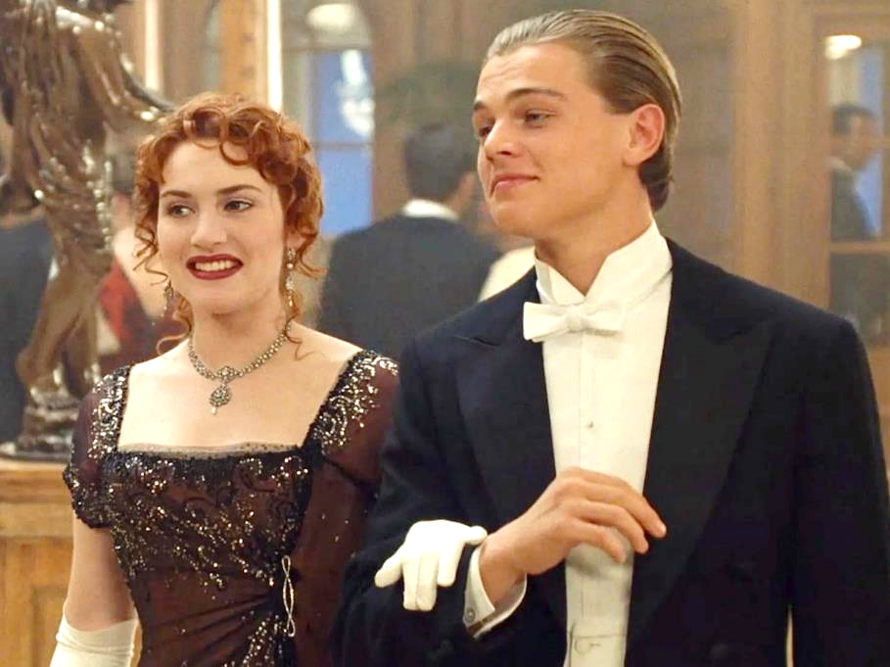
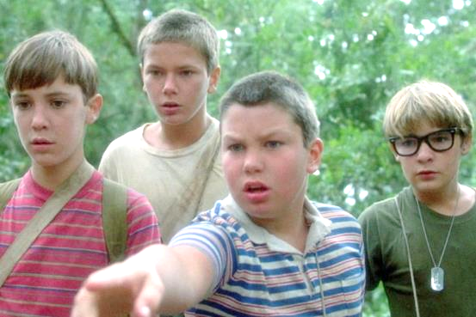
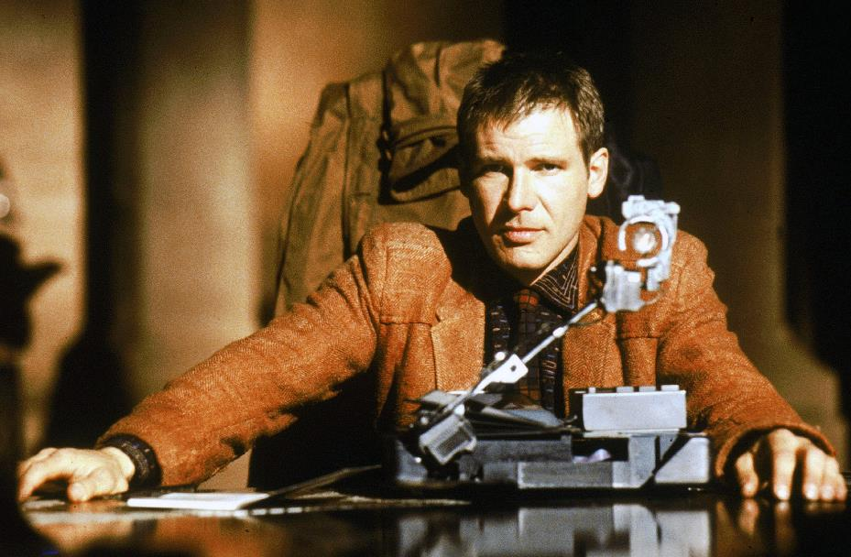
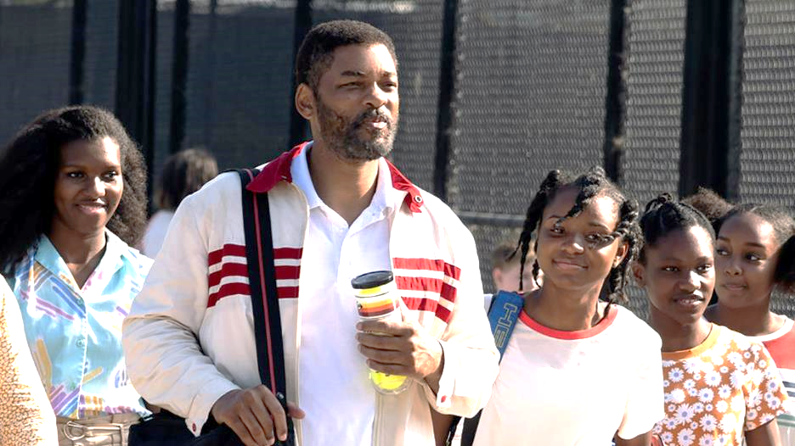
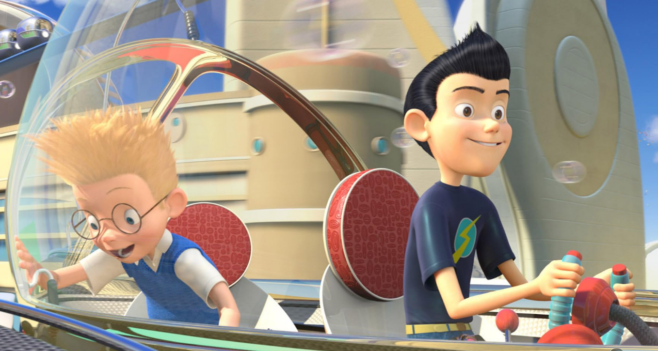
QUESTION # 6
NAME THE DECADES IN WHICH THE FOLLOWING MOVIES WERE SET

Slide 14

2010s
BLADE RUNNER

Slide 15

1910s
TITANIC

Slide 16

1990s
KING RICHARD

Slide 17
1950s
STAND BY ME

Slide 18
2030s
MEET THE ROBINSONS

Slide 19
QUESTION # 7
FASHION
SHOES WITH RED SOLES ARE THE SIGNATURE OF WHAT FASHION COMPANY FOUNDED IN 1991?

Slide 20
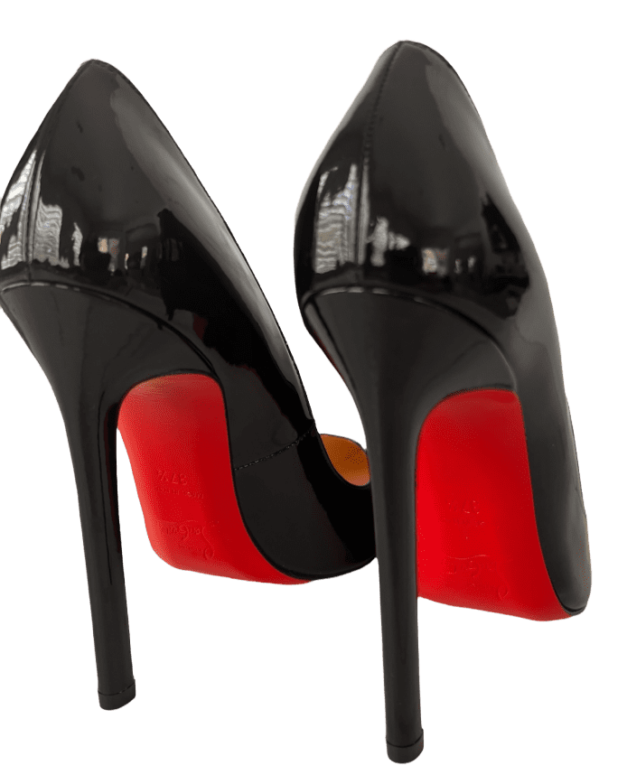
ANSWER # 7
CHRISTIAN LOUBOUTIN

Slide 21
QUESTION # 8
FOOD & DRINK
2-PARTER
ACCORDING TO THE USDA, WHAT ARE THE OFFICIAL TERMS FOR THE LARGEST AND SMALLEST SIZES OF EGGS?

Slide 22


ANSWER # 8
JUMBO
PEEWEE

Slide 23
QUESTION # 9
MARYLAND
WHAT DOCUMENT WAS SIGNED IN MARYLAND IN 1649, ENSURING RELIGIOUS FREEDOM FOR ALL CHRISTIANS?

Slide 24
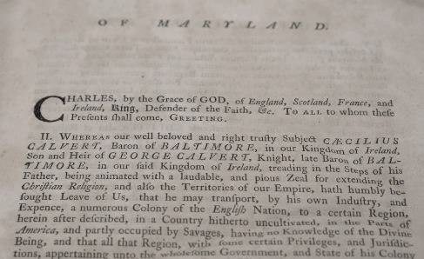
ANSWER # 9
MARYLAND TOLERATION ACT

Slide 25

QUESTION # 10
MUSIC
3-PARTER
NAME THE THREE SONGS BY THEIR HARMONICA SOLOS

Slide 26

ANSWER # 10
“TIMBER”
PITBULL/KESHA
“FOR ONCE IN MY LIFE”
STEVIE WONDER
“FOLLOW YOU DOWN”
GIN BLOSSOMS

Slide 27


HALFTIME
triviamaryland.com
@triviamaryland

Slide 28
QUESTION # 11
BEFORE & AFTER
THE AMERICAN POET OF “THE RED WHEELBARROW” WHO MOONLIGHTS AS A STORE THAT SELLS GOURMET COOKWARE

Slide 29
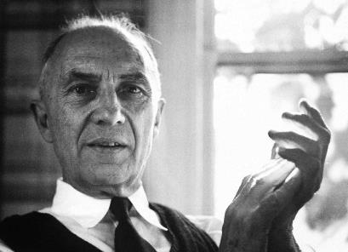

ANSWER # 11
WILLIAM CARLOS WILLIAMS SONOMA

Slide 30
QUESTION # 12
U.S. PRESIDENTS
3-PARTER
WHAT THREE PRESIDENTS RAN ON THIRD-PARTY TICKETS AFTER HAVING SERVED AS PRESIDENT?

Slide 31
ANSWER # 12
THEODORE ROOSEVELT
MARTIN VAN BUREN
MILLARD FILLMORE

Slide 32
QUESTION # 13
TOYS & GAMES
WHAT GAME, BASED ON A SERIES OF NOVELS, IS THE BEST-SELLING VIDEO GAME OF 2023?

Slide 33

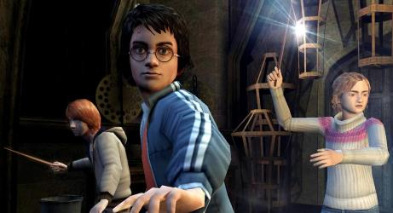
ANSWER # 13

Slide 34
QUESTION # 14
RELIGION
4-PARTER
ACCORDING TO THE BOOK OF GENESIS, ALPHABETICALLY, WHO WERE THE FIRST FOUR SONS OF JACOB?

Slide 35
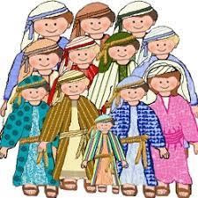
ANSWER # 14
ASHER
BENJAMIN
DAN
GAD

Slide 36
QUESTION # 15
RADIO
IN 2019, SIRIUS XM PURCHASED WHAT MUSIC STREAMING SERVICE FOR
$3.5 BILLION?

Slide 37

ANSWER # 15

Slide 38
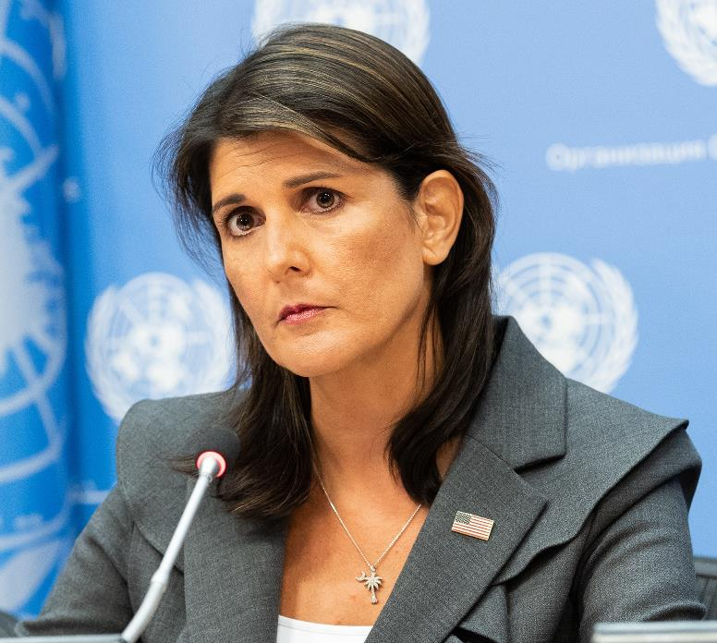
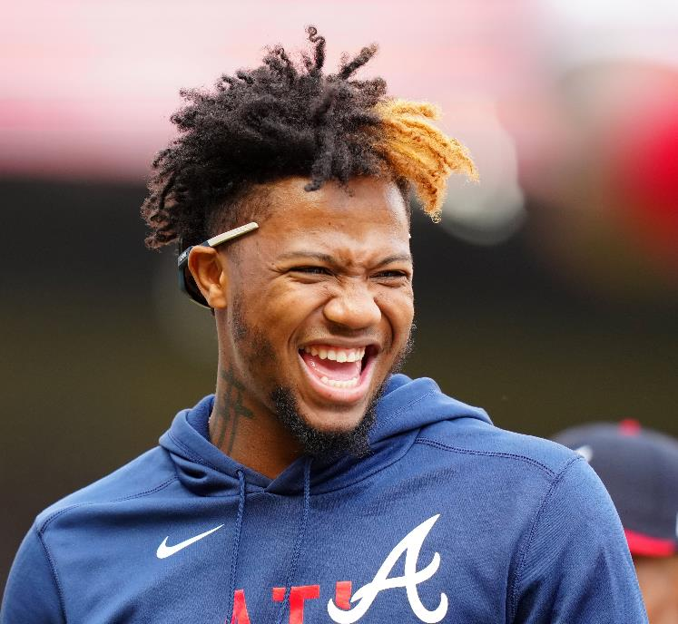

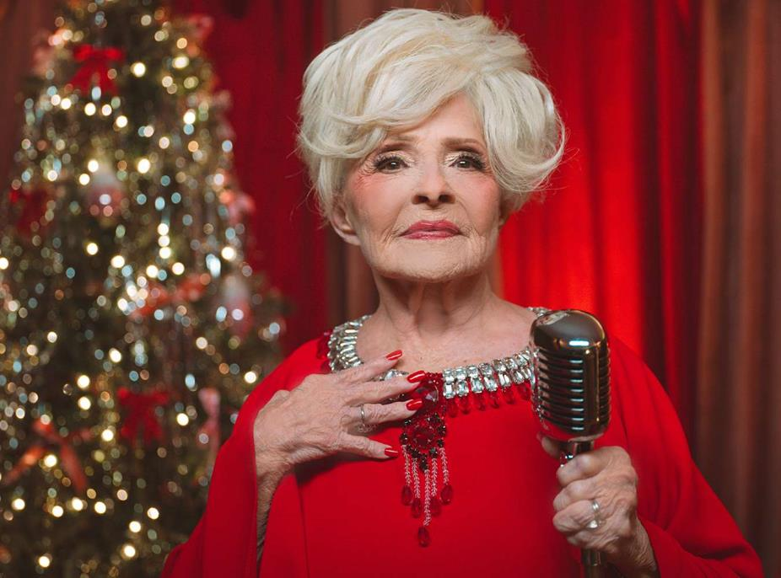

QUESTION # 16
NAME THE 2023 NEWSMAKERS

Slide 39

NIKKI HALEY

Slide 40

JORAN VAN DER SLOOT

Slide 41

RONALD ACUÑA, JR.

Slide 42

BRENDA LEE

Slide 43

MR BEAST

Slide 44
QUESTION # 17
BOOKS & AUTHORS
PUBLISHED IN 1936, GAYLORD DUBOIS WROTE THE FIRST NOVEL ABOUT WHAT MASKED CHARACTER?

Slide 45

ANSWER # 17

Slide 46
QUESTION # 18
OCCUPATIONS
2-PARTER
WHAT TWO PRODUCTS WERE SOLD BY TALLOW MAKERS IN THE
19TH CENTURY?

Slide 47
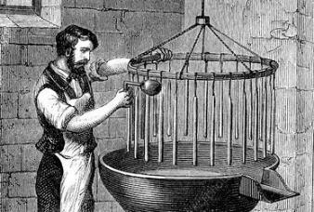
ANSWER # 18
CANDLES
SOAP

Slide 48
QUESTION # 19
THE HUMAN BODY
IN THE ARM, THE NAME OF WHAT MUSCLE PRECEDES THE WORD BRACHII, WHILE IN THE LEG IT PRECEDES THE WORD FEMORIS?

Slide 49
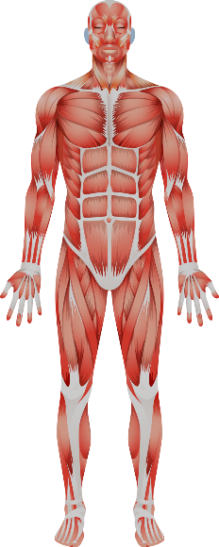
ANSWER # 19
BICEPS

Slide 50
QUESTION # 20
BET UP TO 15 POINTS
ENTERTAINMENT
  THE TWO MOST POPULOUS CITIES IN WHAT U.S. STATE HAVE LENT THEIR NAMES TO A MOVIE NOMINATED FOR BEST PICTURE AND A
  TONY-WINNING MUSICAL?

Slide 51

ANSWER # 20
TENNESSEE
NASHVILLE - BEST PICTURE NOMINEE, 1976
MEMPHIS - BEST MUSICAL, 2010

Slide 52
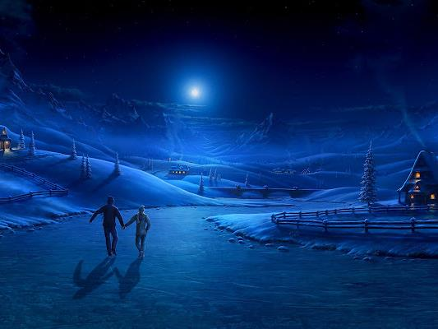

TRIVIAMARYLAND
triviamaryland.com @triviamaryland

Slide 53
TIEBREAKER QUESTION
FOR HOW MANY PERFORMANCES DID MEMPHIS RUN ON BROADWAY?

Slide 54
TIEBREAKER ANSWER
1,165

