Slide 1
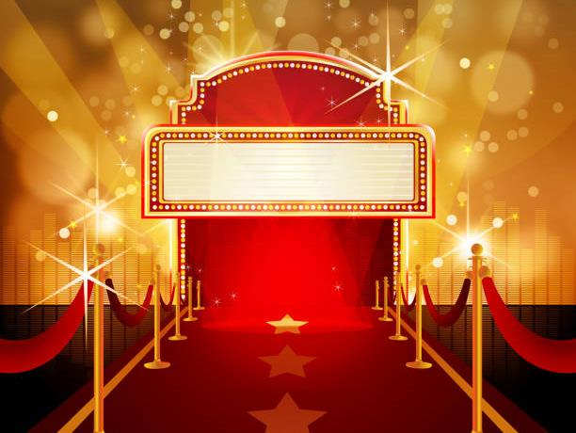
TRIVIAMARYLAND
WORLD SERIES

Slide 2

69¢ WING NIGHT
KISS ME, I’M VAXXED
MASTER DEBATORS
REBEL ALLIANCE
ESTROGENIUS
PANTS PEERS
MARKSMEN
FEAR THE CRAB
INANIMATE CARBON
RED
MOIST TOWELETTES
PETE SAMPRAS
JUNE BUGS
SENIOR MOMENTS
UNDERDAWGZ
SMOKEY & SISSY
M AS IN MANCY
ALL OR NOTHING
JOPPATOWNE CHRISTIAN CHURCH FIGHTING COMMUNION WAFERS

Slide 3
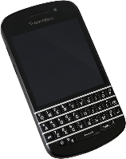
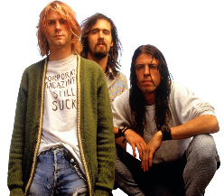
CHECK OUT OUR THEME GAMES
NEXT WEEK!
MONDAY, NOVEMBER 21
ALL-2000s GAME
ALL MONDAY
LOCATIONS (PLUS HUMAGALAS)
TUESDAY, NOVEMBER 22
ALL-MUSIC GAME
ALL TUESDAY
LOCATIONS

Slide 4
QUESTION # 1
GOVERNMENT
FRANCES PERKINS BECAME THE FIRST WOMAN APPOINTED TO THE U.S. CABINET WHEN SHE WAS CHOSEN TO HEAD WHICH DEPARTMENT?
2-POINT BONUS: WHICH PRESIDENT APPOINTED HER TO THIS POSITION?

Slide 5
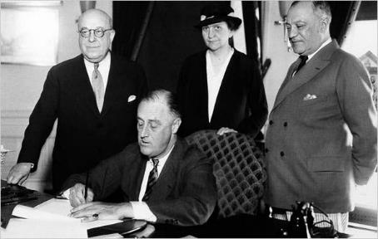
ANSWER # 1
DEPARTMENT OF LABOR
BONUS: FRANKLIN ROOSEVELT

Slide 6
QUESTION # 2
TELEVISION
2-PARTER
BOTH AIRING IN THE LATE ’80s AND EARLY ’90s, WHAT TWO SHOWS FEATURED COVERS OF BEATLES SONGS AS THEIR THEMES?

Slide 7
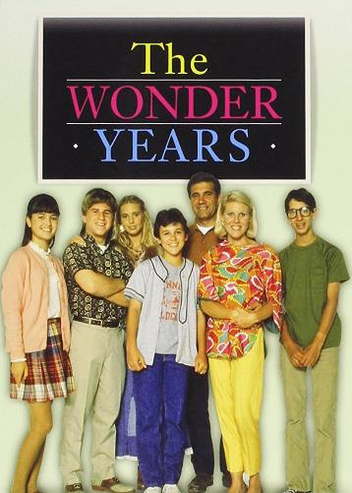
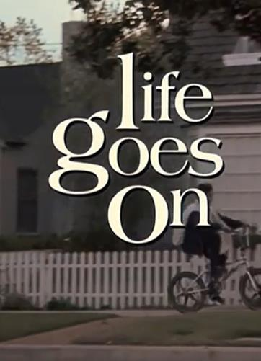
ANSWER # 2
“WITH A LITTLE HELP FROM MY FRIENDS”
“OB-LA-DI,
OB-LA-DA”

Slide 8
QUESTION # 3
BASKETBALL
AFTER HIS DEATH IN 2020, WHAT NBA AWARD WAS RENAMED IN KOBE BRYANT’S HONOR?

Slide 9
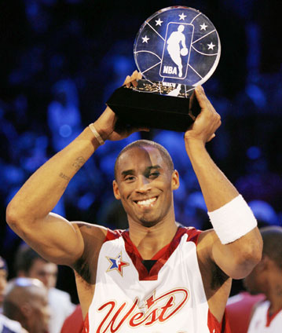
ANSWER # 3
ALL-STAR GAME MVP

Slide 10
QUESTION # 4
WORLD GEOGRAPHY
2-PARTER
OF THE WORLD’S TEN LARGEST ISLANDS BY AREA, WHICH TWO HAVE TERRITORY IN MORE THAN ONE COUNTRY?

Slide 11
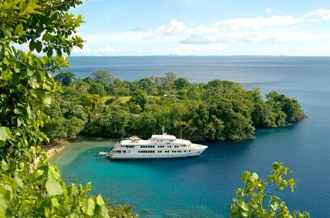
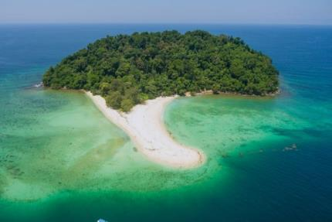
ANSWER # 4
NEW GUINEA
BORNEO

Slide 12
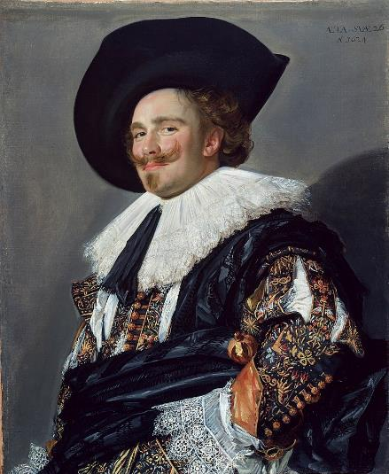
QUESTION # 5
ART
THE SUBJECT OF THIS PAINTING BY FRANS HALS IS NOT DOING WHAT ACTION THAT IS PART OF THE TITLE OF THIS WORK?

Slide 13

ANSWER # 5
LAUGHING
(THE LAUGHING CAVALIER)

Slide 14
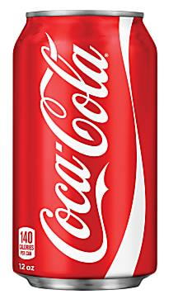
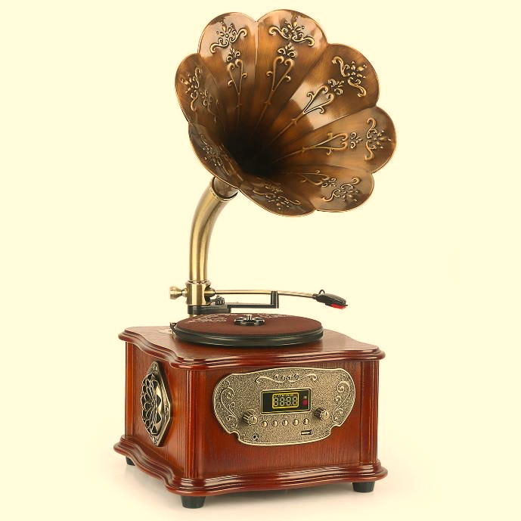
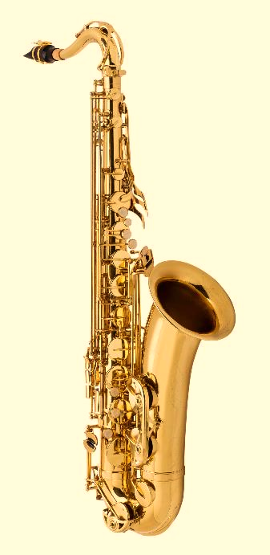
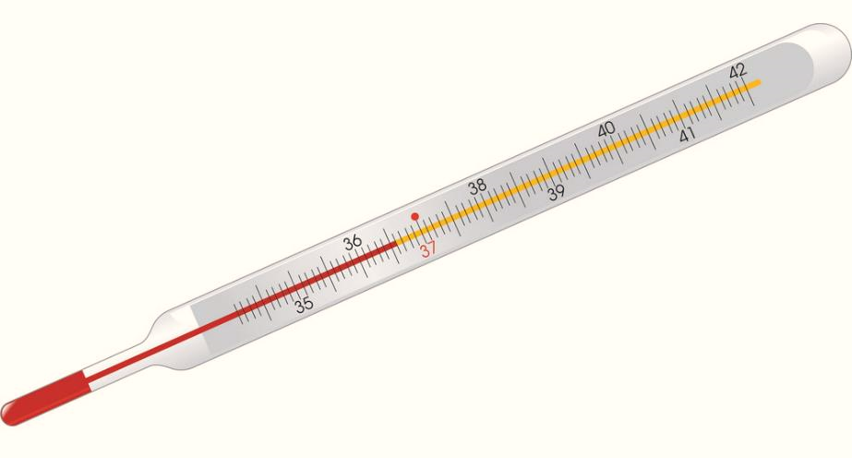
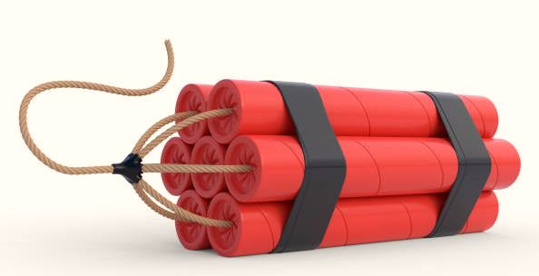
QUESTION # 6
NAME THE
INVENTORS

Slide 15
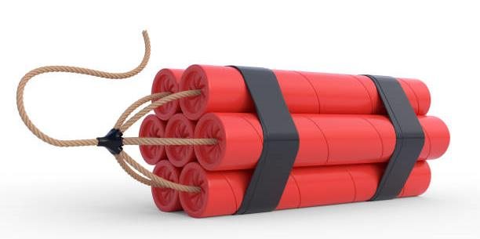
ALFRED NOBEL
DYNAMITE
ANSWER #6

Slide 16
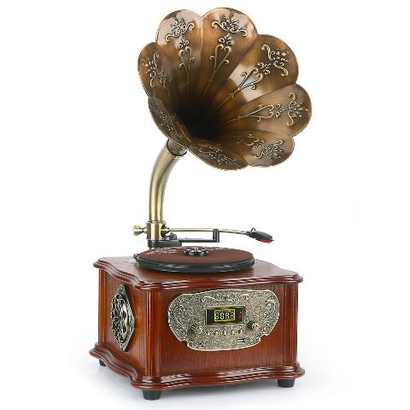
THOMAS EDISON
PHONOGRAPH

Slide 17
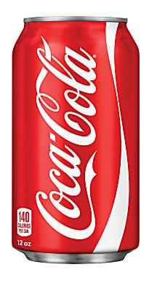
JOHN PEMBERTON
COCA-COLA

Slide 18
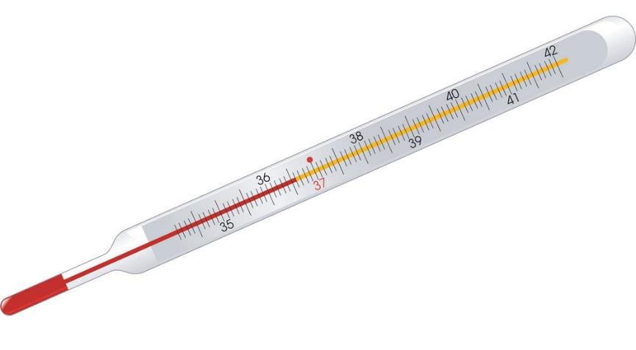
DANIEL FAHRENHEIT
MERCURY THERMOMETER

Slide 19
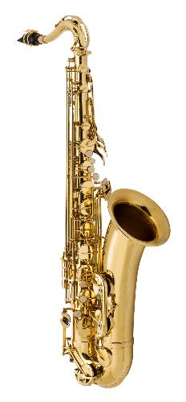
ADOLPHE SAX
SAXOPHONE

Slide 20
QUESTION # 7
FOREIGN WORDS & PHRASES
IN LATIN, IF SOMETHING IS HAPPENING “JANUIS CLAUSIS”, WHERE IS IT HAPPENING?

Slide 21
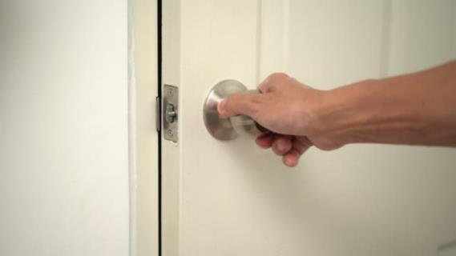
ANSWER # 7
BEHIND CLOSED DOORS

Slide 22
QUESTION # 8
BOOKS & AUTHORS
4-PARTER
WHAT FOUR NOVELS WRITTEN BY STEPHEN KING IN THE 1990s FEATURE A CHARACTER’S NAME IN THE TITLE?

Slide 23
ANSWER # 8
GERALD’S GAME
DOLORES CLAIBORNE
ROSE MADDER
THE GIRL WHO LOVED TOM GORDON

Slide 24
QUESTION # 9
IN THE NEWS
THE SENATE RACE IN GEORGIA WILL BE DECIDED BY A RUNOFF NEXT MONTH AS WHICH LIBERTARIAN CANDIDATE PREVENTED THE OTHER CANDIDATES FROM GETTING THE NECESSARY 50% OF THE VOTE NEEDED TO WIN?

Slide 25

ANSWER # 9
CHASE OLIVER

Slide 26

QUESTION # 10
MUSIC
3-PARTER
NAME THE THREE SONGS
(AS PERFORMED BY THE TRIVIAMARYLAND ORCHESTRA)

Slide 27
ANSWER # 10
SONG #1
“EVERLONG” - FOO FIGHTERS
SONG #2
“ISN’T SHE LOVELY” - STEVIE WONDER
SONG #3
“BEFORE HE CHEATS” - CARRIE UNDERWOOD

Slide 28
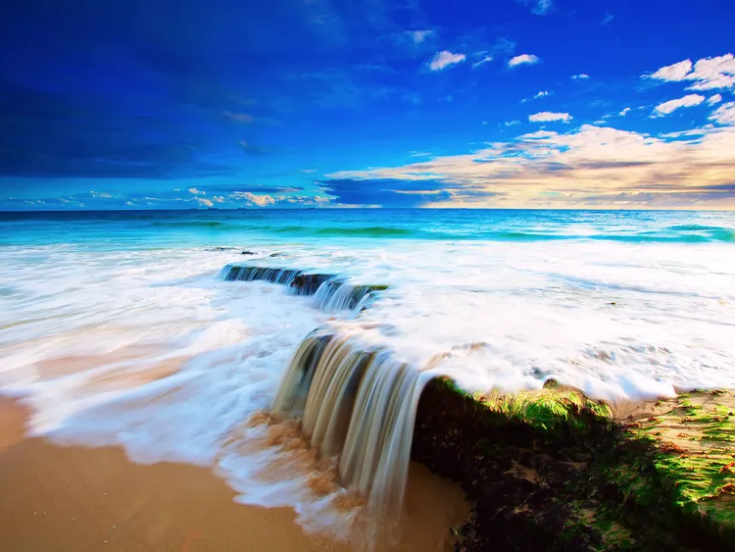


HALFTIME
triviamaryland.com @triviamaryland

Slide 29
QUESTION # 11
FASHION
NAMED FOR A BRITISH ACTRESS, WHAT LEATHER HANDBAG FROM HERMÉS TYPICALLY COSTS AT LEAST $10,000?

Slide 30
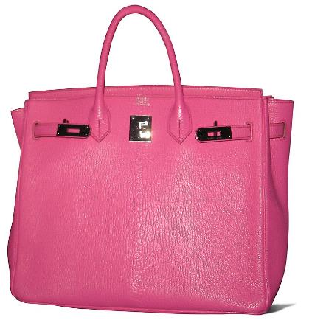
ANSWER # 11
BIRKIN BAG

Slide 31
QUESTION # 12
FIRST LADIES
4-PARTER
WHAT ARE THE GIVEN FIRST NAMES OF THE FOUR FIRST LADIES WHO SERVED IN THE 1960s?

Slide 32
ANSWER # 12
MARY
(MAMIE EISENHOWER)
JACQUELINE
(JACKIE KENNEDY)
CLAUDIA
(LADY BIRD JOHNSON)
THELMA
(PAT NIXON)

Slide 33
QUESTION # 13
ADVERTISING
  SITAGIN HEMORRHOID CREAM, ROTTENBRAU BEER, AND GOLDEN GRENADES CEREAL WERE FICTIONAL BRANDS INTRODUCED IN A 1990s ADVERTISING CAMPAIGN FOR WHAT REAL-LIFE BRAND?

Slide 34
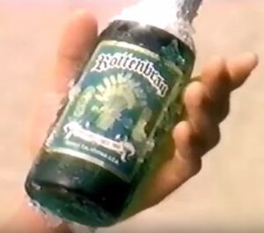
ANSWER # 13
ENERGIZER

Slide 35
QUESTION # 14
CHEMISTRY
2-PARTER
BOTH WITH ‘TRANSFER’ IN THEIR NAMES, WHAT ARE THE TWO CLASSES OF THE CHEMICAL REACTION REDOX?

Slide 36
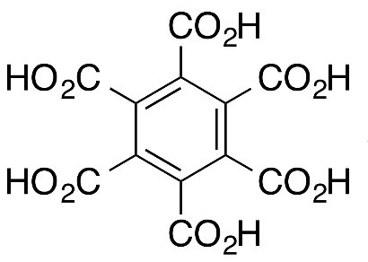
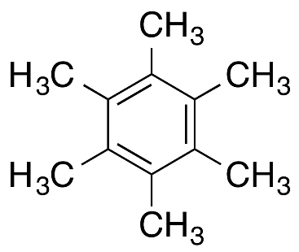
ANSWER # 14
ELECTRON TRANSFER
ATOM TRANSFER

Slide 37
QUESTION # 15
MOVIES
WHO IS THE ONLY LIVING WOMAN TO HAVE WON THREE ACADEMY AWARDS FOR BEST ACTRESS?

Slide 38
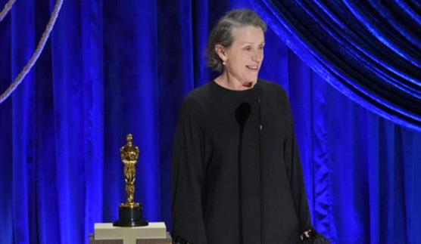
ANSWER # 15
FRANCES McDORMAND

Slide 39


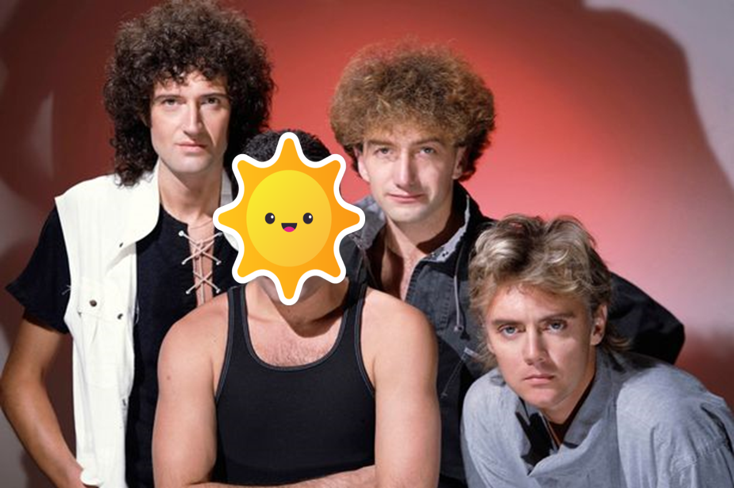
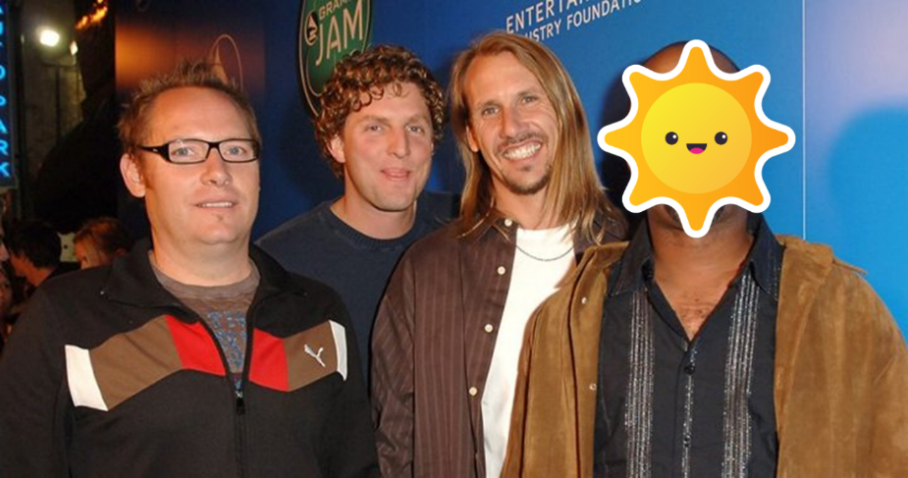
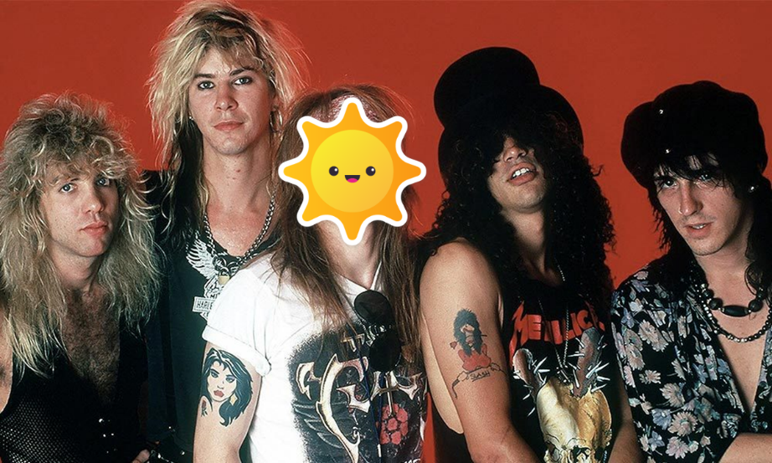
QUESTION # 16
NAME THE BANDS
(WITHOUT THE LEAD SINGERS)

Slide 40
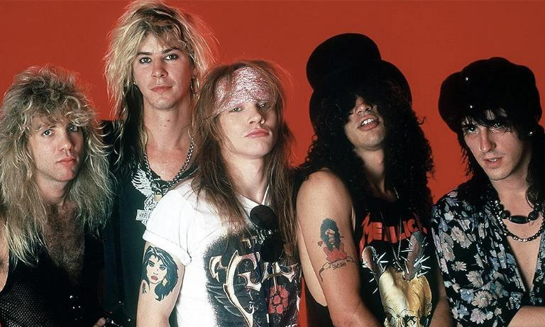
ANSWER #16
GUNS N’ ROSES

Slide 41
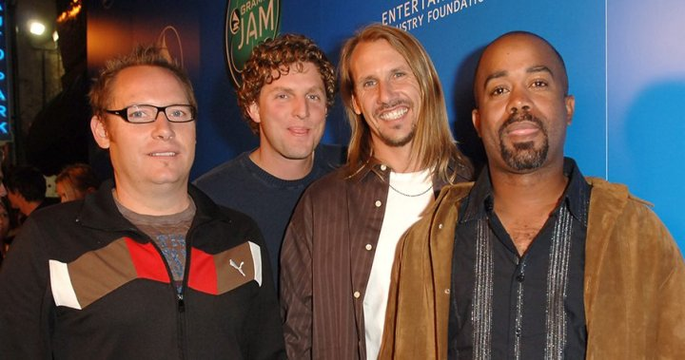
HOOTIE & THE BLOWFISH

Slide 42
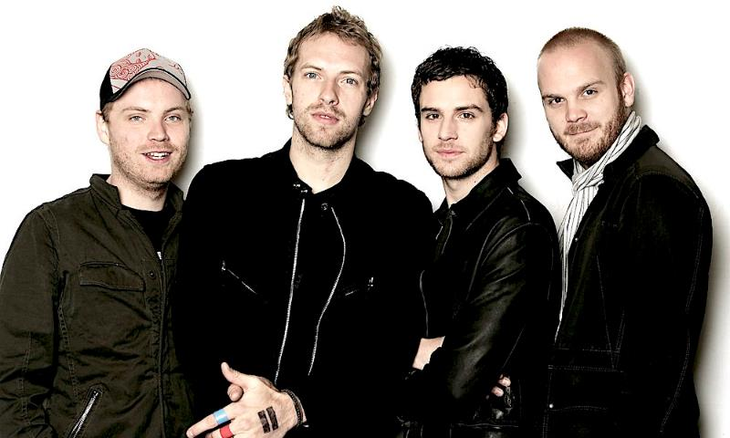
COLDPLAY

Slide 43
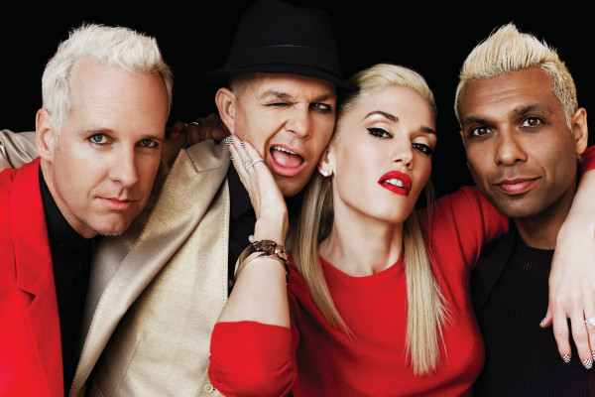
NO DOUBT

Slide 44
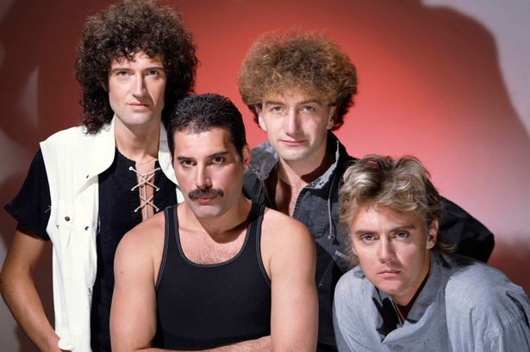
QUEEN

Slide 45
QUESTION # 17
LABOR
WHAT IS THE ANIMAL TERM FOR A LABOR STRIKE THAT IS NOT AUTHORIZED OR APPROVED BY A UNION’S LEADERSHIP?

Slide 46
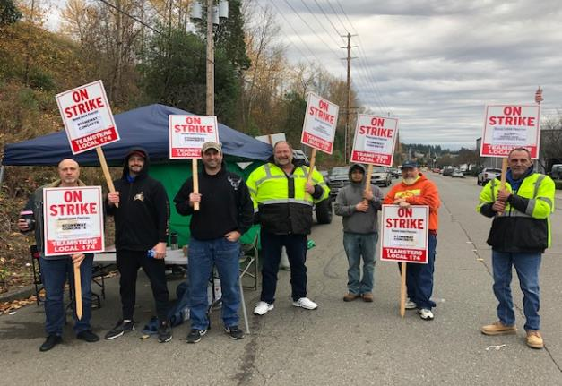
ANSWER # 17
WILDCAT STRIKE

Slide 47
QUESTION # 18
LANGUAGE
2-PARTER
WHICH TWO LETTERS ARE REPRESENTED BY ONE-SYLLABLE WORDS IN THE NATO PHONETIC ALPHABET?

Slide 48
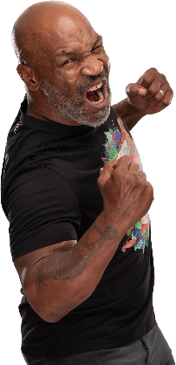

ANSWER # 18
G(OLF)
M(IKE)

Slide 49
QUESTION # 19
AWARDS
THE TROPHIES PRESENTED AT THE TEEN CHOICE AWARDS ARE SHAPED LIKE WHAT PIECE OF SPORTING EQUIPMENT?

Slide 50
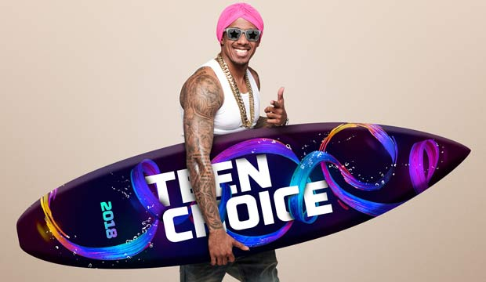
ANSWER # 19
SURFBOARD

Slide 51
QUESTION # 20
BET UP TO 15 POINTS
WE’RE NUMBER TWO!
  AFTER THE DEPARTMENT OF DEFENSE, WHO IS AMERICA’S LARGEST PURCHASER OF EXPLOSIVES?

Slide 52
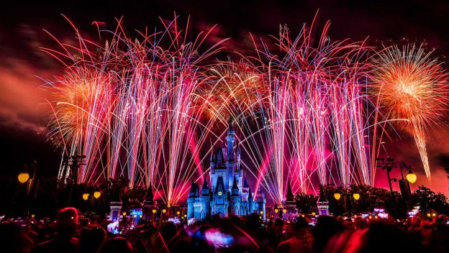
ANSWER # 20
WALT DISNEY WORLD

Slide 53
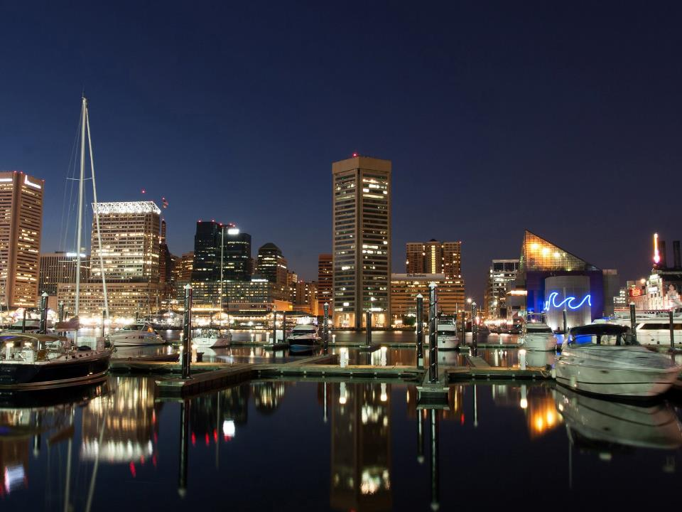
TRIVIAMARYLAND
triviamaryland.com @triviamaryland

Slide 54
TIEBREAKER
WHAT IS THE CURRENT PRICE OF A ONE-PARK, ONE-DAY ADULT TICKET TO DISNEY WORLD?

Slide 55
TIEBREAKER ANSWER
$109

