Slide 1

TRIVIAMARYLAND
WORLD SERIES
TRIVIAMARYLAND.COM FACEBOOK.COM/TRIVIAMARYLAND

Slide 2
QUESTION # 1
GRAMMAR
WHAT IS THE TERM FOR THE NOUN TO WHICH A PRONOUN REFERS?

Slide 3

ANSWER # 1
ANTECEDENT

Slide 4
QUESTION # 2
O CANADA
2-PARTER
OF CANADA’S TEN PROVINCES, WHICH TWO ARE LANDLOCKED?

Slide 5
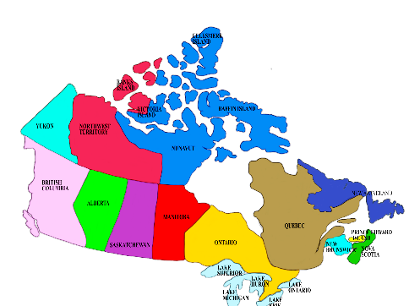
ANSWER # 2
SASKATCHEWAN
ALBERTA

Slide 6
QUESTION # 3
THEATRE
ALSO A 2001 MOVIE, WHAT PLAY WON 10 AWARDS AT THE 2021 TONYS, INCLUDING BEST MUSICAL?

Slide 7

ANSWER # 3

Slide 8
QUESTION # 4
BASEBALL
2-PARTER
WHO ARE THE ONLY TWO PLAYERS IN THE BASEBALL HALL OF FAME WEARING A NEW YORK METS HAT ON THEIR PLAQUES?

Slide 9
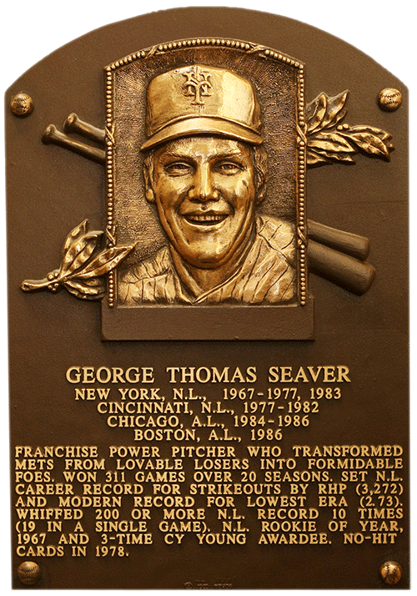
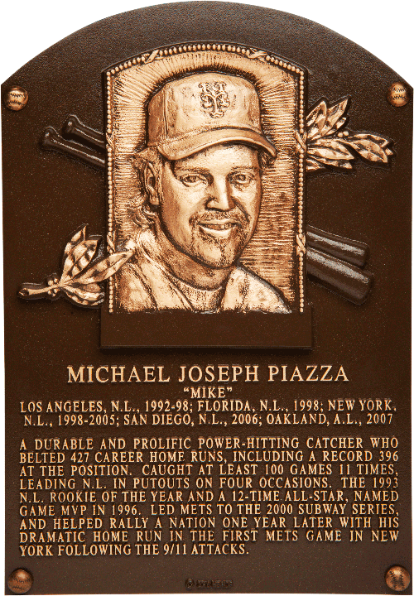
ANSWER # 4
TOM SEAVER
MIKE PIAZZA

Slide 10
QUESTION # 5
SCIENCE
BY DEFINITION, A SUBSTANCE DESCRIBED AS STANNIC CONTAINS WHAT ELEMENT?

Slide 11
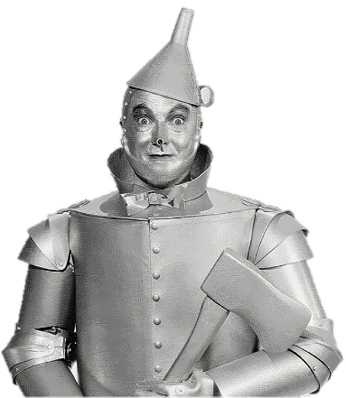
ANSWER # 5
TIN

Slide 12
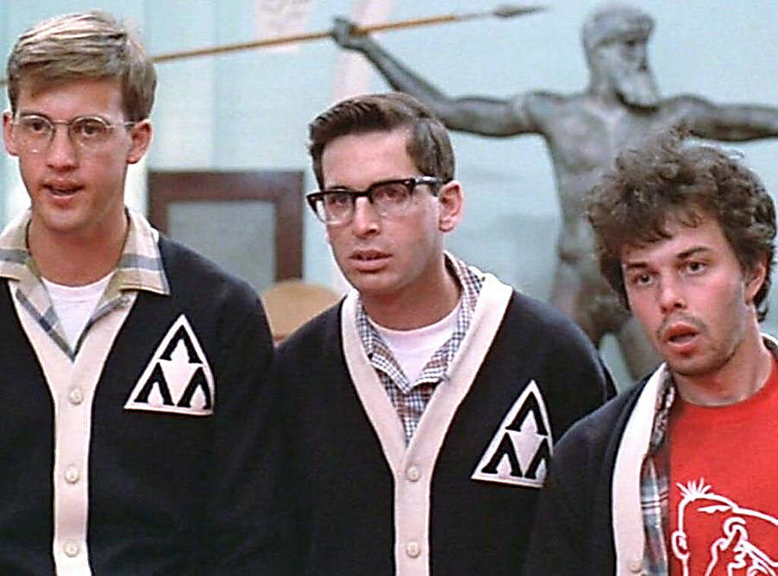
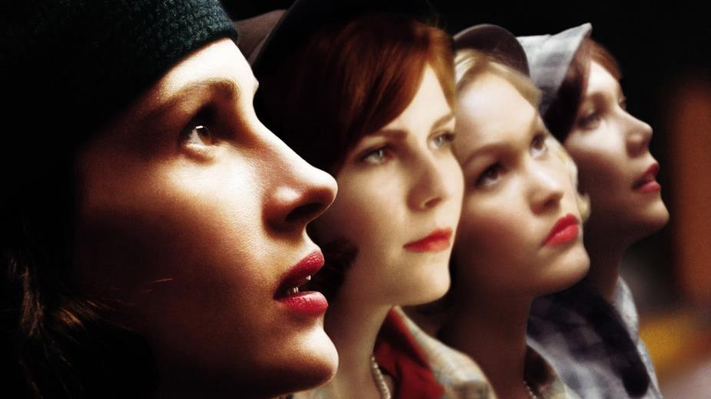
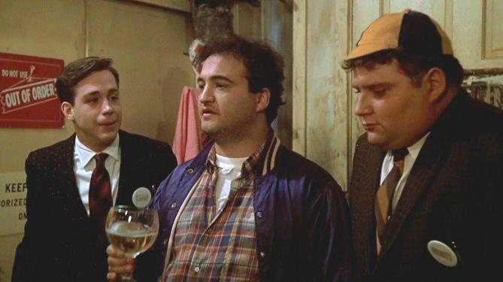
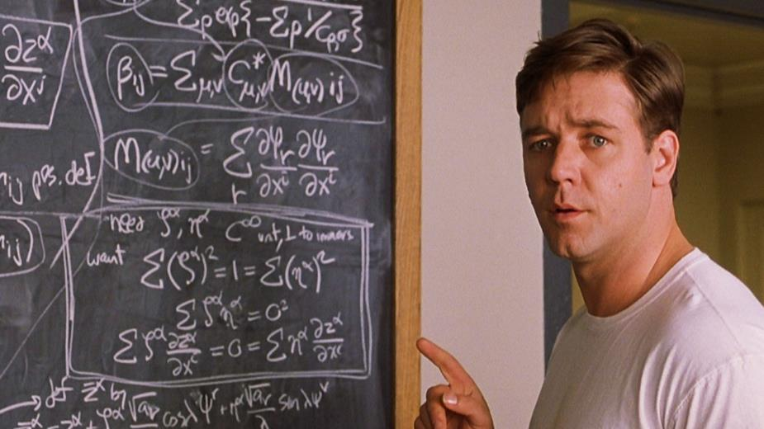
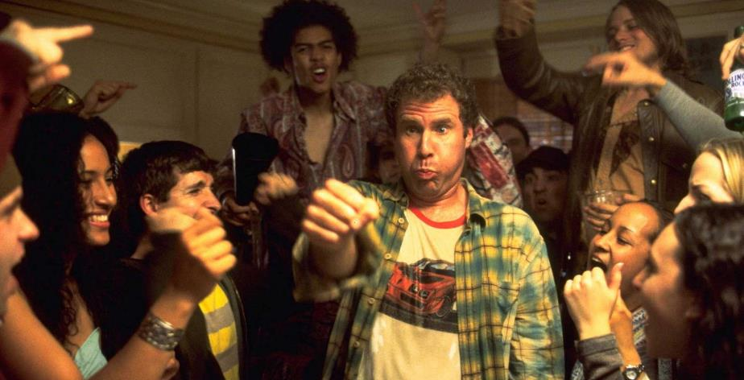
QUESTION # 6
NAME THE COLLEGES IN THE MOVIES

Slide 13
ANSWER #6
FABER COLLEGE
ANIMAL HOUSE

Slide 14

HARRISON UNIVERSITY
OLD SCHOOL

Slide 15

PRINCETON UNIVERSITY
A BEAUTIFUL MIND

Slide 16

ADAMS COLLEGE
REVENGE OF THE NERDS

Slide 17

WELLESLEY COLLEGE
MONA LISA SMILE

Slide 18
QUESTION # 7
FOOD & DRINK
PEPPAR AND KURANT ARE PRODUCTS FROM WHAT ALCOHOL BRAND THAT WAS FOUNDED IN 1879?

Slide 19
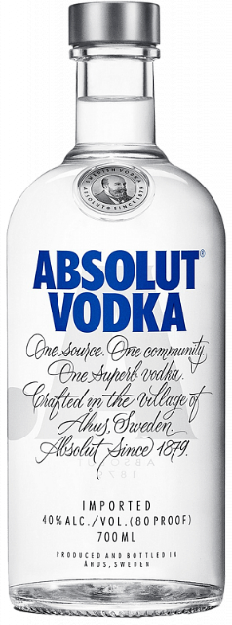
ANSWER # 7

Slide 20
QUESTION # 8
ANIMALS
5-PARTER
BESIDES THE NOVA SCOTIA DUCK TOLLING RETRIEVER, WHAT FIVE OTHER TYPES OF RETRIEVERS ARE RECOGNIZED BY THE AMERICAN KENNEL CLUB?

Slide 21
ANSWER # 8
CHESAPEAKE BAY
GOLDEN
LABRADOR
CURLY-COATED
FLAT-COATED

Slide 22
QUESTION # 9
BEFORE & AFTER
CAPITOL HILL NEWSPAPER FEATURING A VIDEO GAME THAT DEBUTED IN 2003

Slide 23

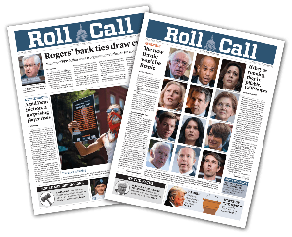
ANSWER # 9
ROLL CALL OF DUTY

Slide 24


QUESTION # 10
MUSIC
3-PARTER
NAME THE TITLE, ORIGINAL GROUP, AND COVER GROUP FOR THE FOLLOWING SONG

Slide 25
ANSWER # 10
TITLE:
“the living years”
ORIGINAL GROUP:
mike + the mechanics
COVER group:
alabama

Slide 26

HALFTIME
TRIVIAMARYLAND.COM FACEBOOK.COM/TRIVIAMARYLAND

Slide 27
QUESTION # 11
MARYLAND
WHAT IS THE SHAPE OF THE ‘SYMBOL OF WISDOM’ THAT TOPS THE DOME OF THE MARYLAND STATE HOUSE IN ANNAPOLIS?

Slide 28
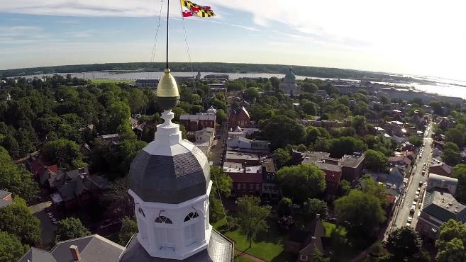
ANSWER # 11
ACORN

Slide 29
QUESTION # 12
TELEVISION
3-PARTER
WHAT THREE MEN SERVED AS BANDLEADERS FOR THE TONIGHT SHOW WITH JAY LENO?

Slide 30

ANSWER # 12
BRANFORD MARSALIS
KEVIN EUBANKS
RICKEY MINOR

Slide 31
QUESTION # 13
NAME’S THE SAME
THE NAME OF WHAT COMPUTER SOFTWARE COMPANY IS ALSO THE SYMBOL FOR REBIRTH AND ENLIGHTENMENT IN HINDUISM AND BUDDHISM?

Slide 32

ANSWER # 13

Slide 33
QUESTION # 14
TOYS & GAMES
2-PARTER
IN THE ORIGINAL VERSION OF OPERATION, THE NAMES OF WHICH TWO GAME PIECES CONTAIN A COMMON MALE FIRST NAME?

Slide 34
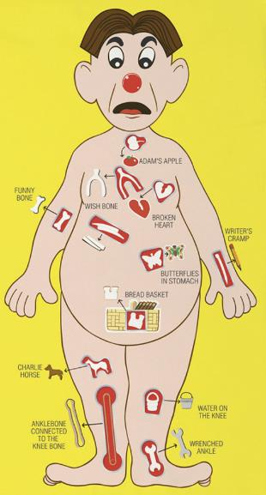
ANSWER # 14
ADAM’S APPLE
CHARLIE HORSE

Slide 35
QUESTION # 15
U.S. HISTORY
OF THE FOUR MEN WHO HAVE BEEN BOTH VICE PRESIDENT AND PRESIDENT, AND SERVED IN BOTH HOUSES OF CONGRESS, TWO OF THEM SHARED WHAT LAST NAME?

Slide 36
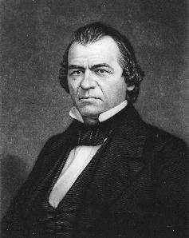
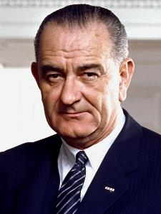
ANSWER # 15
JOHNSON
(ANDREW AND LYNDON)

Slide 37

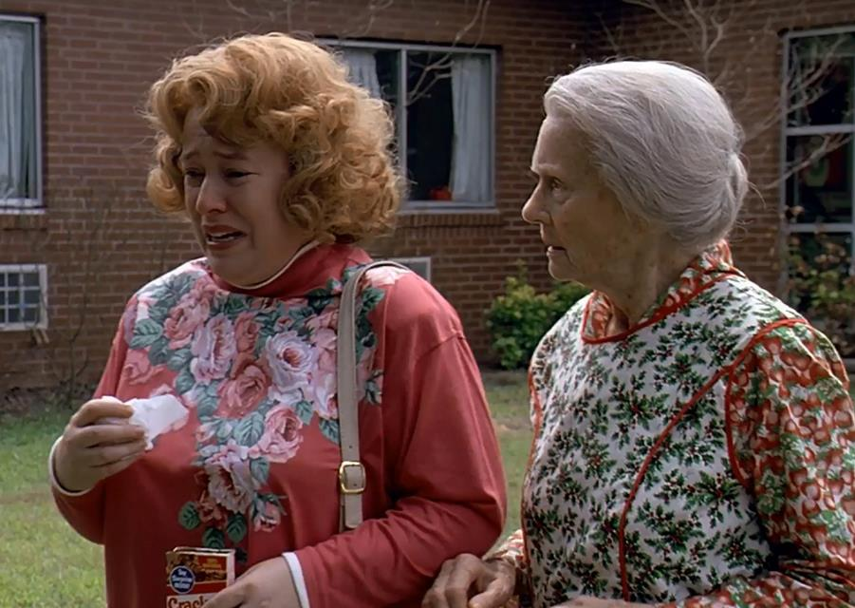
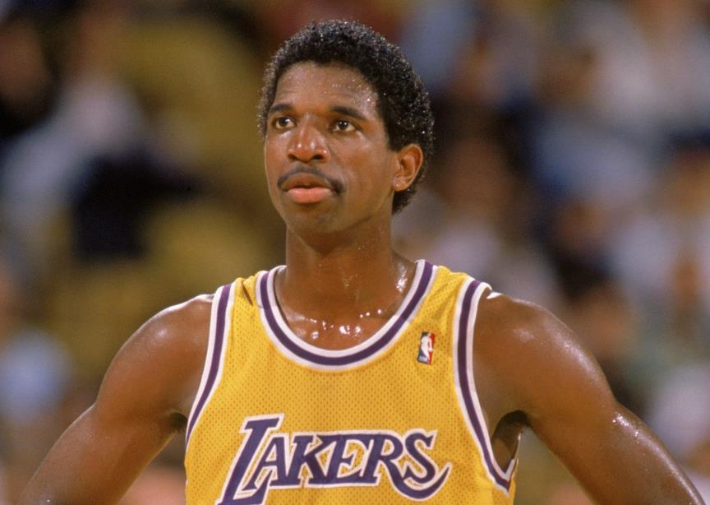

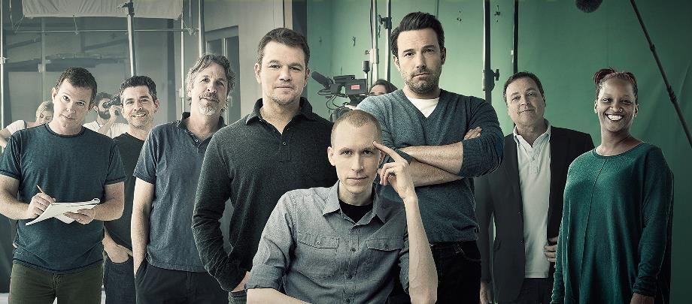
QUESTION # 16
WHO/WHAT
ARE WE?

Slide 38

ANSWER #16
GREEN DAY

Slide 39

A.C. GREEN

Slide 40


Slide 41

FRIED GREEN TOMATOES

Slide 42


Slide 43
QUESTION # 17
U.S. STATES
WHAT IS THE LEAST POPULOUS U.S. STATE WITH A HOME VENUE FOR AT LEAST ONE TEAM IN ONE OF THE FOUR MAJOR U.S. SPORTS?

Slide 44


ANSWER # 17
NEVADA

Slide 45
QUESTION # 18
AWARDS & HONORS
2-PARTER
WHICH TWO PEOPLE, A MAN BORN IN 1874 AND A WOMAN BORN IN 1910, ARE THE ONLY TWO PEOPLE TO HAVE EARNED HONORARY U.S. CITIZENSHIP DURING THEIR LIFETIMES?

Slide 46
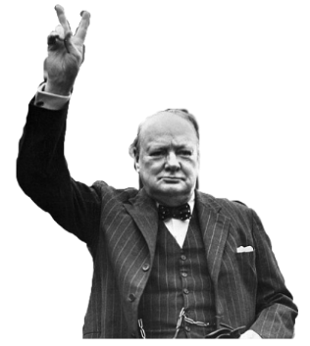
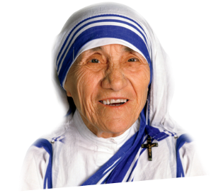
ANSWER # 18
WINSTON CHURCHILL
MOTHER TERESA

Slide 47
QUESTION # 19
GOVERNMENT
IN 1924, WHO SUCCEEDED WILLIAM J. BURNS, WHO HAD RESIGNED, AND REMAINED IN THE POSITION FOR 48 YEARS?

Slide 48
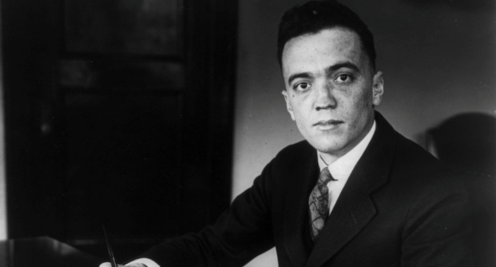
ANSWER # 19
J. EDGAR HOOVER
(F.B.I. DIRECTOR)

Slide 49
QUESTION # 20
BET UP TO 15 POINTS
WORD ORIGINS
WHAT WORD, WHICH WAS INVENTED IN A 1900 NOVEL, IS NOW (IN ITS PLURAL FORM) A U.S. TRADEMARK OWNED BY AN ENTITY NAMED DD IP HOLDER LLC?

Slide 50


ANSWER # 20
MUNCHKIN

Slide 51

TRIVIAMARYLAND
TRIVIAMARYLAND.COM FACEBOOK.COM/TRIVIAMARYLAND

Slide 52
TIEBREAKER QUESTION
ACCORDING TO THEIR WEBSITE, HOW MANY WEGMANS LOCATIONS ARE THERE IN THE UNITED STATES?

Slide 53
TIEBREAKER ANSWER
106

