Slide 1


TRIVIAMARYLAND
WORLD SERIES
TRIVIAMARYLAND.COM FACEBOOK.COM/TRIVIAMARYLAND

Slide 2

WORLD SERIES TEAMS
LIL KIM JUNG UN
SCRUFFY NERD HERDERS
MAMBO 69
HIGH SCHOOL PROM
THE BROWN NOTES
MORGAN STATION
RUN OVER BY A PUFFIN
UNDECIDED
THRONE OF LIES
MARKSMEN
MOIST TOWELETTES
COUSIN EDDIE’S KIDS
SNITZELS GET SNITCHES
SWEEP THE LEG
INFINITY
FRESH PRICKS OF BEL AIR
PUB CRAWL LIECHTENSTEIN
MISCHIEF MANAGED
BEL AIR BOMB TECHS
JOPPATOWNE CHRISTIAN CHURCH FIGHTING COMMUNION WAFERS

Slide 3
QUESTION # 1
TERMINOLOGY
IF THINGS THAT COME FROM MARS ARE REFERRED TO AS ‘MARTIAN’, WHAT IS THE CORRECT DEMONYM FOR THINGS THAT COME FROM JUPITER?

Slide 4
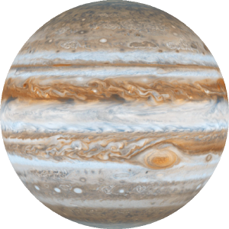
ANSWER # 1
JOVIAN

Slide 5
QUESTION # 2
U.S. PRESIDENTS
2-PARTER
WHO ARE THE ONLY TWO U.S. PRESIDENTS WHOSE BIRTH NAME INITIALS SPELL A WORD THAT CAN BE FOUND IN THE MERRIAM-WEBSTER DICTIONARY?

Slide 6
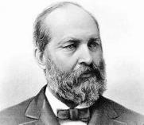
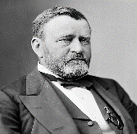
ANSWER # 2
JAMES ABRAM GARFIELD (JAG)
HIRAM ULYSSES GRANT (HUG)

Slide 7
QUESTION # 3
BOOKS & AUTHORS
WHAT AUTHOR, WHO PASSED AWAY IN 2004, WAS THE FIRST TO SELL MORE THAN ONE MILLION E-BOOKS ON AMAZON.COM?

Slide 8
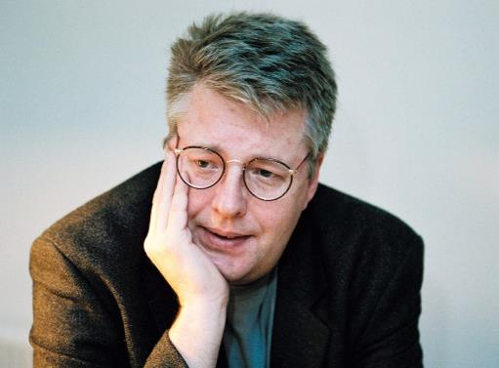
ANSWER # 3
STIEG LARSSON

Slide 9
QUESTION # 4
TELEVISION
2-PARTER
WHAT TWO TV GAME SHOWS HAVE AIRED ORIGINAL EPISODES IN EVERY DECADE SINCE THE 1950s?

Slide 10


ANSWER # 4

Slide 11
QUESTION # 5
BUSINESS
IN SEPTEMBER 2019, HEWLETT PACKARD ACQUIRED WHAT SUPERCOMPUTER MANUFACTURER FOR $1.4 BILLION?

Slide 12
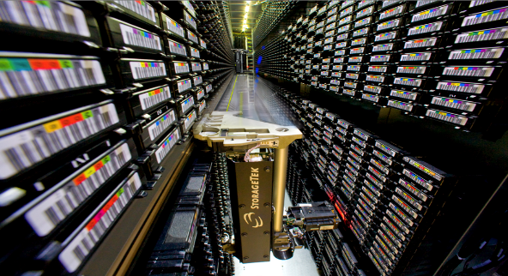
ANSWER # 5
CRAY

Slide 13
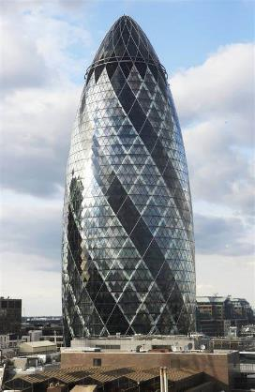
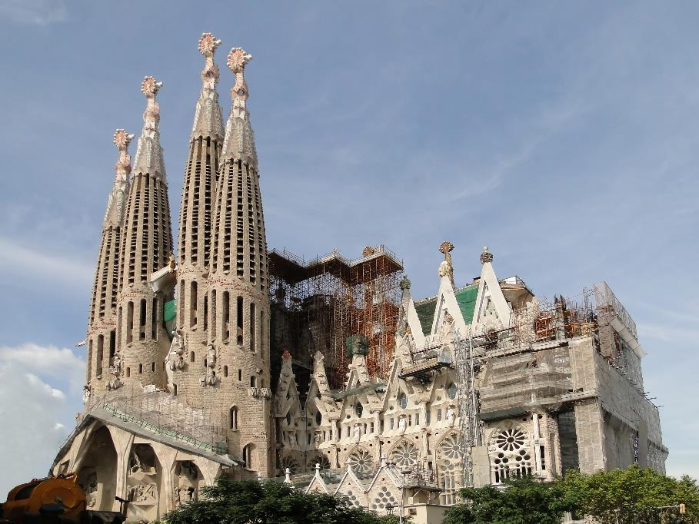
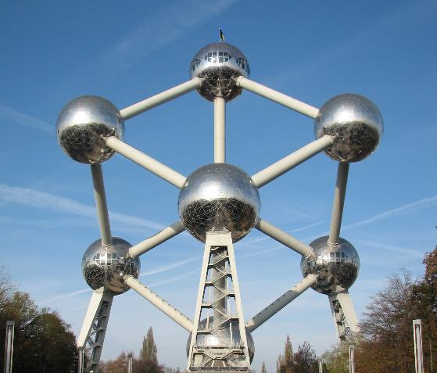
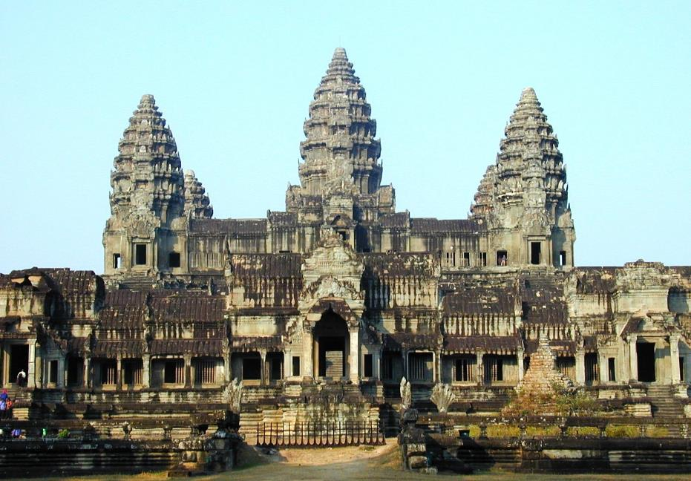
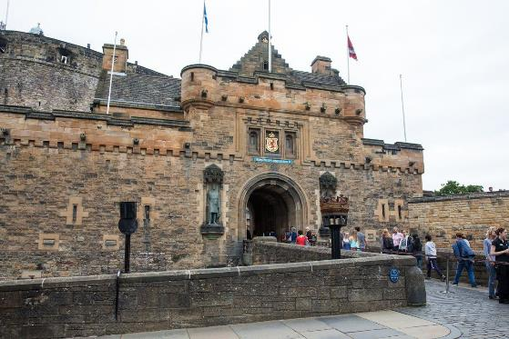
QUESTION # 6
NAME THE LANDMARKS

Slide 14
ANSWER #6
THE GHERKIN

Slide 15
EDINBURGH CASTLE

Slide 16
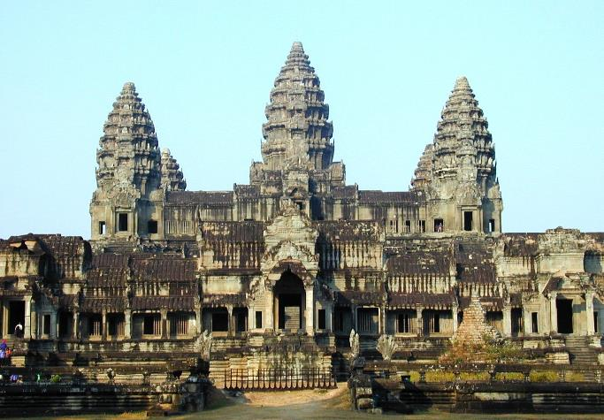
ANGKOR WAT

Slide 17

SAGRADA FAMÍLIA

Slide 18
ATOMIUM

Slide 19
QUESTION # 7
FICTIONAL CHARACTERS
INTRODUCED IN 1963, WHAT FICTIONAL CHARACTER HELMS THE S.S. GUPPY?

Slide 20
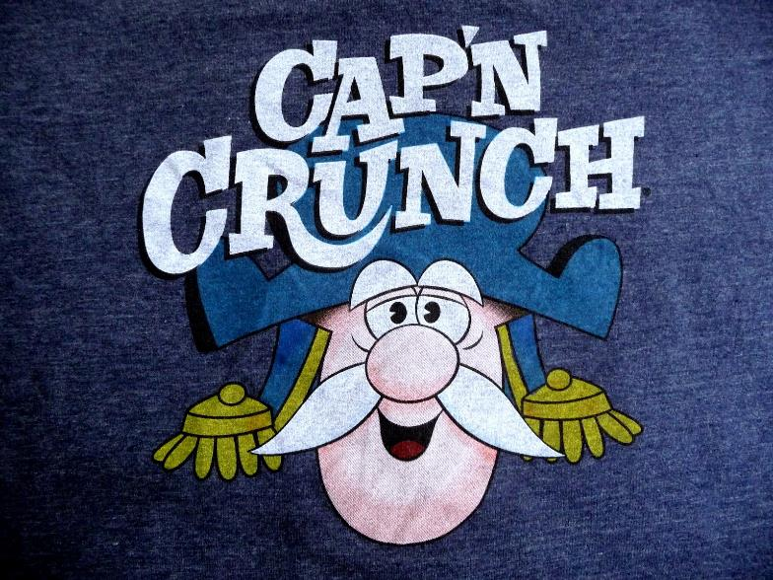
ANSWER # 7

Slide 21
QUESTION # 8
FOOTBALL
4-PARTER
FOR WHAT NFL TEAMS DO THESE FORMER RAVENS CURRENTLY PLAY?
KYLE JUSZCZYK
C.J. MOSLEY
BUCK ALLEN
BRESHAD PERRIMAN

Slide 22
ANSWER # 8
KYLE JUSZCZYK - 49ERS
C.J. MOSLEY - JETS
BUCK ALLEN - GIANTS
BRESHAD PERRIMAN - BUCCANEERS

Slide 23
QUESTION # 9
COLLEGES & UNIVERSITIES
IN HONOR OF ITS RECENTLY DECEASED PRESIDENT, WHAT WAS WASHINGTON COLLEGE IN VIRGINIA RENAMED IN 1870?

Slide 24

ANSWER # 9

Slide 25

QUESTION # 10
MUSIC
3-PARTER
NAME THE SONGS

Slide 26
ANSWER # 10
“THE STRANGER”
BILLY JOEL
“WIND OF CHANGE”
THE SCORPIONS
“PATIENCE”
GUNS N’ ROSES

Slide 27

HALFTIME
TRIVIAMARYLAND.COM FACEBOOK.COM/TRIVIAMARYLAND

Slide 28
QUESTION # 11
LANGUAGE
WHAT IS THE TERM FOR THIS DIACRETIC MARK USED IN MANY EUROPEAN LANGUAGES?
CHÂTEAU

Slide 29

ANSWER # 11
CIRCUMFLEX

Slide 30
QUESTION # 12
MARYLAND
2-PARTER
THE STATE FLAG OF MARYLAND CONTAINS THE COATS OF ARMS OF WHAT TWO FAMILIES?

Slide 31

ANSWER # 12
CALVERT
CROSSLAND

Slide 32
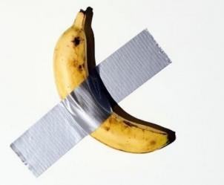
QUESTION # 13
IN THE NEWS
WHAT IS THE NAME OF THIS PIECE OF ART THAT SOLD FOR $120,000 LAST WEEK?

Slide 33

ANSWER # 13
COMEDIAN

Slide 34
QUESTION # 14
MOVIES
4-PARTER
WHAT WERE THE LAST FOUR ANIMATED SEQUELS RELEASED BY WALT DISNEY STUDIOS?

Slide 35
ANSWER # 14
FROZEN II
TOY STORY 4
RALPH BREAKS THE INTERNET
INCREDIBLES 2

Slide 36
QUESTION # 15
HISTORY
IN 1977, NASA LAUNCHED TWO DIFFERENT SPACE PROBES WITH WHAT NAME?

Slide 37
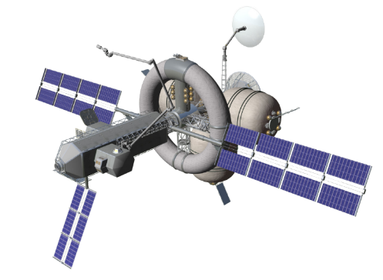
ANSWER # 15
VOYAGER

Slide 38
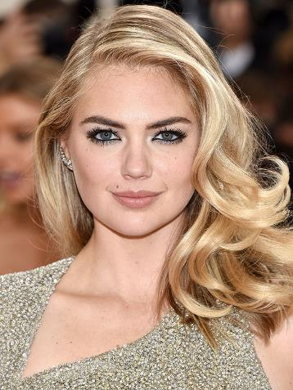
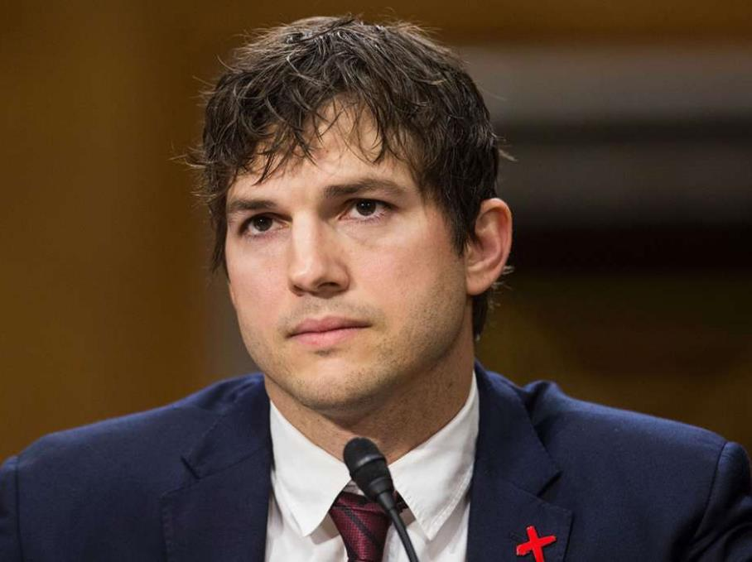
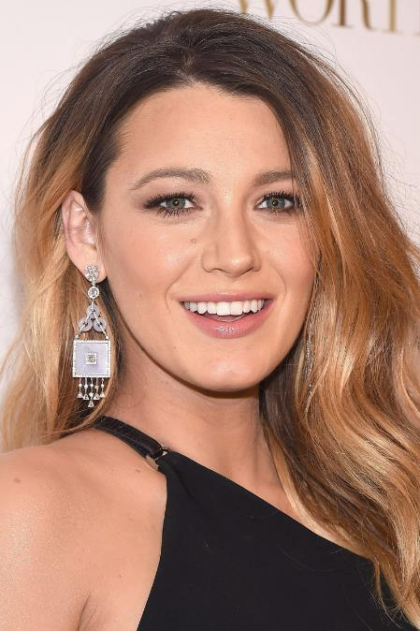
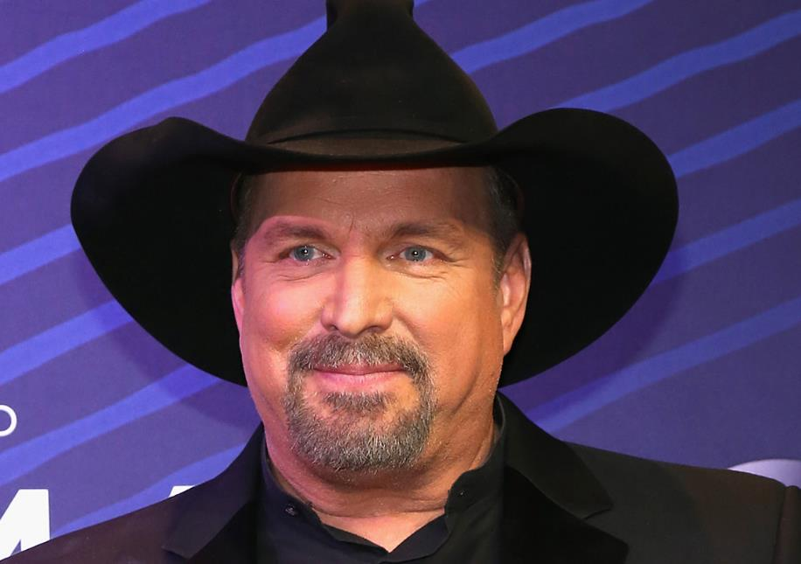

QUESTION # 16
NAME THE SPOUSES

Slide 39

ANSWER #16
TRISHA YEARWOOD
(GARTH BROOKS)

Slide 40

RYAN REYNOLDS
(BLAKE LIVELY)

Slide 41
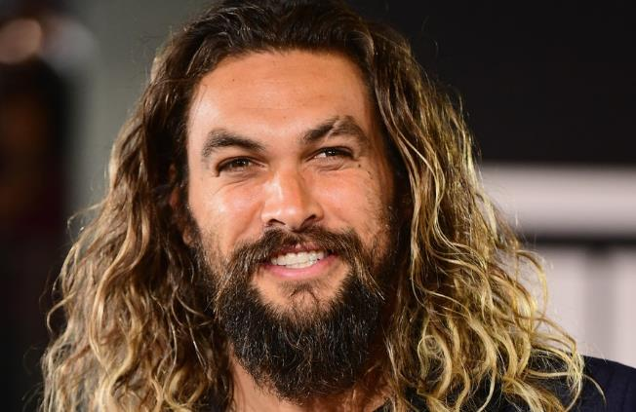
LISA BONET
(JASON MOMOA)

Slide 42
JUSTIN VERLANDER
(KATE UPTON)

Slide 43

MILA KUNIS
(ASHTON KUTCHER)

Slide 44
QUESTION # 17
BASEBALL
IF YOU WERE TO ARRANGE THE 30 MLB TEAMS ALPHABETICALLY BY TEAM NICKNAMES, FOUR OF THE LAST FIVE TEAMS WOULD BE MEMBERS OF WHAT DIVISION?

Slide 45
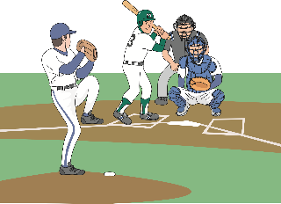
ANSWER # 17
AMERICAN LEAGUE CENTRAL
(ROYALS, TIGERS, TWINS, WHITE SOX)

Slide 46
QUESTION # 18
WORLD COUNTRIES
3-PARTER
IN THE LATE 18TH CENTURY, POLAND WAS DIVIDED AMONG WHAT THREE COUNTRIES?

Slide 47

ANSWER # 18
PRUSSIA
RUSSIA
AUSTRIA

Slide 48
QUESTION # 19
MUSIC
WHAT SONG TITLE WAS A TOP 10 HIT FOR BOTH STING AND TIFFANY?

Slide 49


ANSWER # 19

Slide 50
QUESTION # 20
BET UP TO 15 POINTS
LAWS
A 2002 LAW REQUIRING CEOs TO PERSONALLY CERTIFY THEIR CORPORATE BOOKS WAS NAMED, IN PART, FOR WHAT FORMER MARYLAND-BORN POLITICIAN?

Slide 51
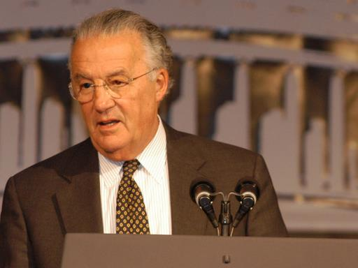
ANSWER # 20
PAUL SARBANES

Slide 52

TRIVIAMARYLAND
TRIVIAMARYLAND.COM FACEBOOK.COM/TRIVIAMARYLAND

Slide 53
TIEBREAKER
ACCORDING TO WIKIPEDIA, ON AVERAGE, HOW MANY NEW ARTICLES ARE ADDED TO THE SITE EVERY DAY?

Slide 54
TIEBREAKER ANSWER
578

