Slide 1
TRIVIAMARYLAND WORLD SERIES
TRIVIAMARYLAND.COM FACEBOOK.COM/TRIVIAMARYLAND

Slide 2
QUESTION # 1 FOR THE BIRDS
RAVENS, CROWS, ROOKS, AND JACKDAWS ARE MEMBERS OF WHAT GENUS?

Slide 3
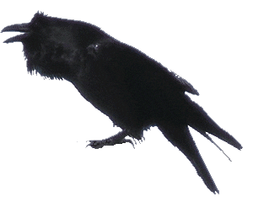
ANSWER # 1
CORVUS

Slide 4
QUESTION # 2 HISTORIC DOCUMENTS 3-PARTER
WHAT THREE LATIN PHRASES ARE USED IN THE U.S. CONSTITUTION?

Slide 5
ANSWER # 2
EX POST FACTO
HABEAS CORPUS
PRO TEMPORE

Slide 6
QUESTION # 3 TELEVISION
AT 154 EPISODES OVER EIGHT SEASONS, WHO WAS THE MOST FREQUENT ANCHOR ON SATURDAY NIGHT LIVE’S “WEEKEND UPDATE”?

Slide 7
ANSWER # 3
SETH MYERS

Slide 8
QUESTION # 4 BASEBALL 3-PARTER
WHAT THREE PLAYERS FROM THE MODERN ERA WERE INDUCTED INTO THE HALL OF FAME AND PLAYED FOR NINE OR MORE MLB TEAMS DURING THEIR CAREERS?

Slide 9
ANSWER # 4
RICKEY HENDERSON
HOYT WILHELM
RICH “GOOSE” GOSSAGE

Slide 10
QUESTION # 5 SCIENCE
WHAT OBJECT WAS NAMED IN 1930 TO BEGIN WITH THE INITIALS OF THE ASTRONOMER WHO SPENT THE LAST DECADE OF HIS LIFE SEARCHING FOR IT?

Slide 11
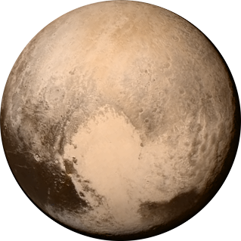
ANSWER # 5
PLUTO

Slide 12
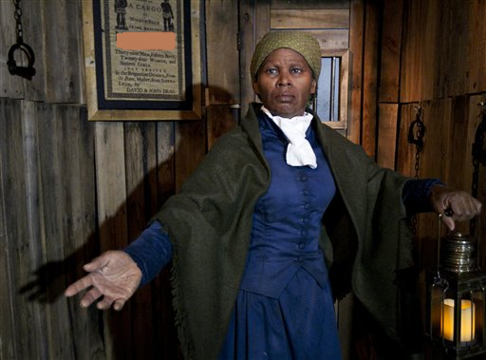
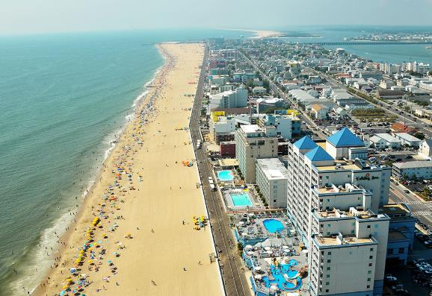
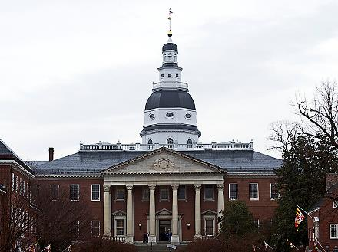
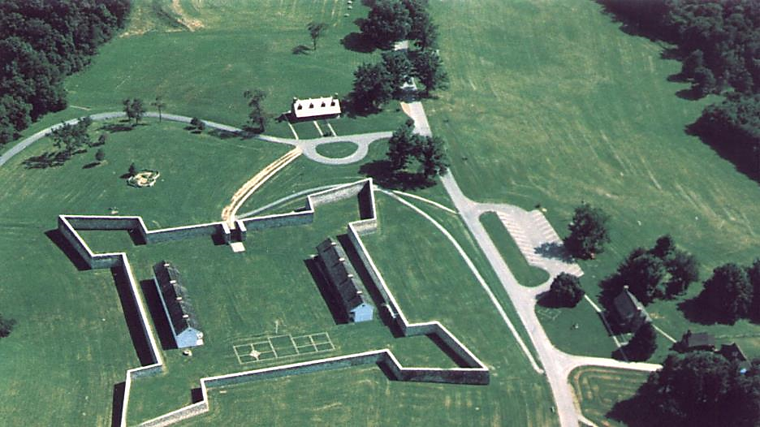
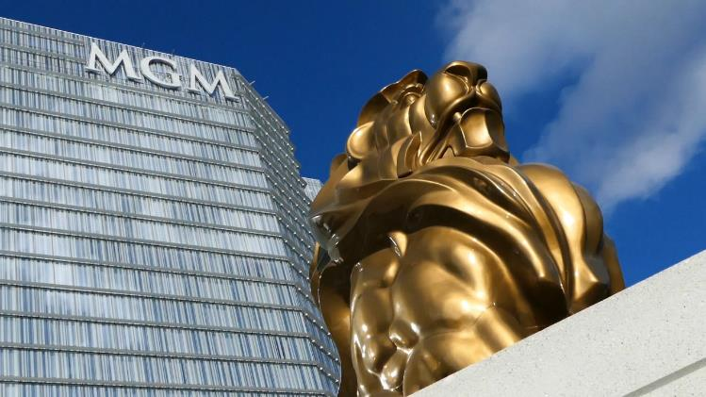
QUESTION # 6
NAME THE MARYLAND COUNTIES

Slide 13
ANSWER #6
ANNE ARUNDEL MARYLAND STATE HOUSE

Slide 14
WASHINGTON FORT FREDERICK

Slide 15
PRINCE GEORGE’S MGM NATIONAL HARBOR

Slide 16
WORCESTER OCEAN CITY

Slide 17
DORCHESTER HARRIET TUBMAN MUSEUM

Slide 18
QUESTION # 7 FOOD & DRINK
WHAT BRAND WON A TOP PRIZE AT THE 1893 CHICAGO EXPO AND HAS USED THE AWARD IN ITS NAME EVER SINCE?

Slide 19
ANSWER # 7

Slide 20
QUESTION # 8 MOVIES 2-PARTER
WHAT TWO ACTRESSES PORTRAYED AMELIA EARHART IN MAJOR MOTION PICTURES IN 2009?

Slide 21
ANSWER # 8
AMY ADAMS NIGHT AT THE MUSEUM 2
HILARY SWANK AMELIA

Slide 22
QUESTION # 9 THE BODY HUMAN
THE MOUNT OF APOLLO, THE MOUNT OF THE MOON, AND THE GIRDLE OF VENUS ARE ALL LOCATED ON WHAT PART OF THE BODY?

Slide 23
ANSWER # 9
HAND

Slide 24
QUESTION # 10 MUSIC
4-PARTER
NAME THE SONG AND THE THREE ARTISTS/GROUPS PERFORMING IT

Slide 25
ANSWER # 10
SONG
“ALL I WANT FOR CHRISTMAS IS YOU”
ARTISTS/GROUPS
HANSON
IDINA MENZEL
JUSTIN BIEBER

Slide 26
HALFTIME
TRIVIAMARYLAND.COM
FACEBOOK.COM/TRIVIAMARYLAND

Slide 27
QUESTION # 11 SHAPES & SIZES
WHAT NATURAL OBJECTS COME IN SUCH SHAPES AS SIMPLE PRISMS, SECTORED PLATES, AND STELLAR DENDRITES?

Slide 28
ANSWER # 11
SNOWFLAKES

Slide 29
QUESTION # 12 CRIME 3-PARTER
ACCORDING TO THE U.S. TREASURY DEPARTMENT, WHAT ARE THE THREE STAGES OF MONEY LAUNDERING?

Slide 30
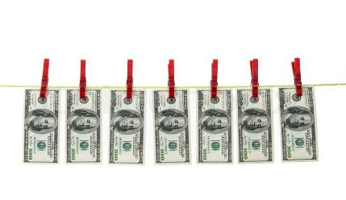
ANSWER # 12
PLACEMENT
LAYERING
INTEGRATION

Slide 31
QUESTION # 13 BOOKS
ACCORDING TO BARNES & NOBLE, THE BEST-SELLING KIDS BOOK OF 2018 WAS THE MELTDOWN, WHICH IS THE 13TH BOOK IN WHAT SERIES?

Slide 32
ANSWER # 13

Slide 33
QUESTION # 14 THE OLYMPICS 3-PARTER
IN WHAT THREE CURRENT OLYMPIC SPORTS DO TEAMS OF SEVEN COMPETE?

Slide 34
ANSWER # 14
WATER POLO
HANDBALL
RUGBY

Slide 35
QUESTION # 15 WORLD HISTORY
WHAT DICTATOR’S LAST BATTLE WAS HIS DEFEAT OF POMPEY’S SONS AT MUNDA IN 45 B.C.?

Slide 36
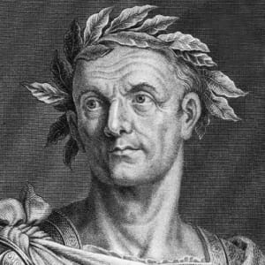
ANSWER # 15
JULIUS CAESAR

Slide 37
QUESTION # 16
THE EYES HAVE IT

Slide 38
ANSWER #16
LANCE BASS

Slide 39
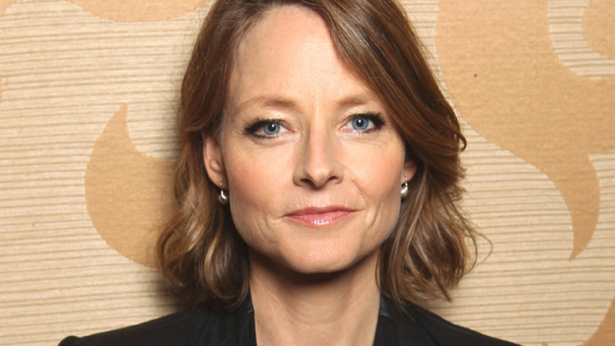
JODIE FOSTER

Slide 40
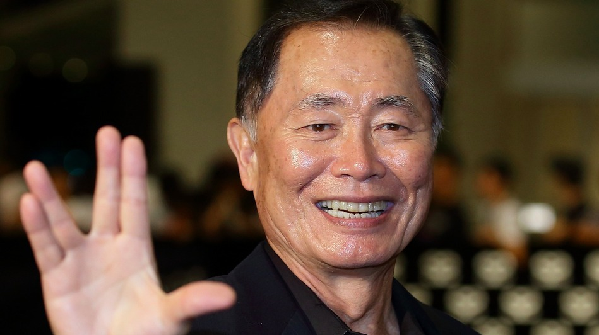
GEORGE TAKEI

Slide 41
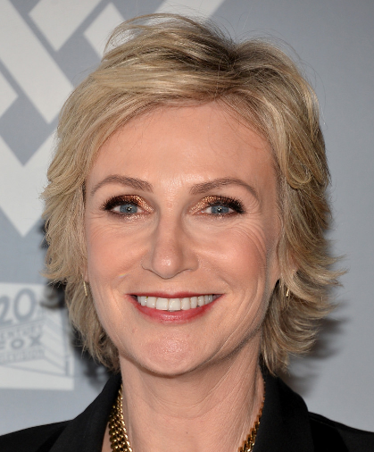
JANE LYNCH

Slide 42
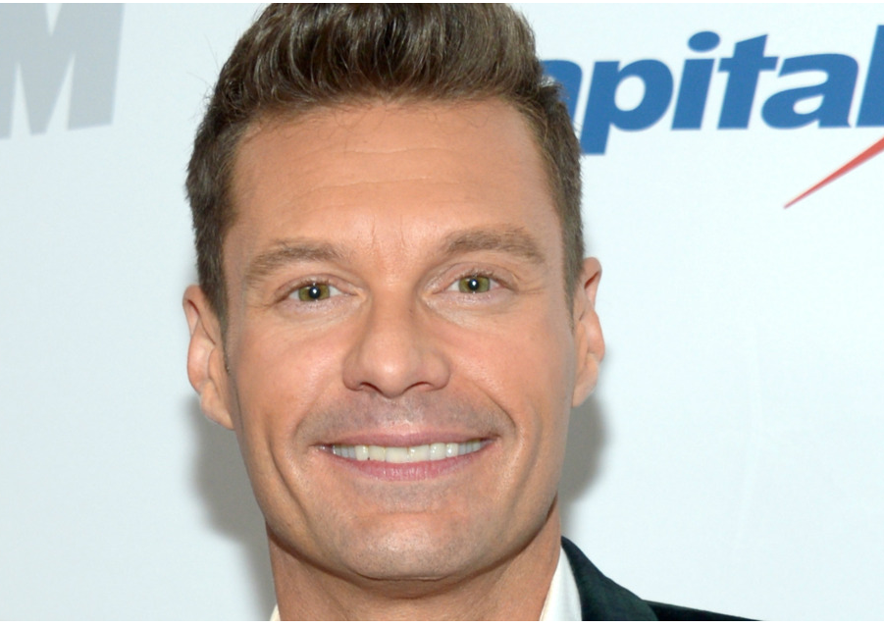
RYAN SEACREST

Slide 43
QUESTION # 17 U.S. GEOGRAPHY
WHAT IS THE ONLY STATE THAT BORDERS THREE OF THE FOUR U.S. STATES THAT ARE CONSIDERED COMMONWEALTHS?

Slide 44
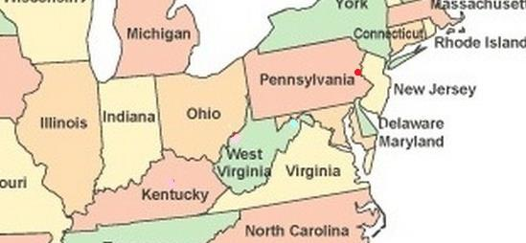
ANSWER # 17
WEST VIRGINIA

Slide 45
QUESTION # 18 TV THEME SONGS 2-PARTER
THE THEME SONGS FOR WHAT TWO SHOWS THAT DEBUTED IN THE 1970s REACHED #1 ON THE U.S. BILLBOARD CHART?

Slide 46
ANSWER # 18

Slide 47
QUESTION # 19 COLLEGES & UNIVERSITIES
FROM 1899 TO 1960, WHAT SCHOOL WAS KNOWN AS ALABAMA POLYTECHNIC INSTITUTE?

Slide 48
ANSWER # 19

Slide 49
QUESTION # 20 BET UP TO 15 POINTS MOVIES
WHO HAS APPEARED IN TWO OF THE FOUR MOVIES THAT HAVE EARNED OVER $2 BILLION AT THE WORLDWIDE BOX OFFICE?

Slide 50
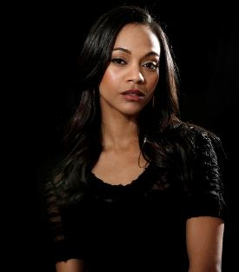
ANSWER # 20
ZOE SALDANA (AVATAR, AVENGERS: INFINITY WAR)

Slide 51
TRIVIAMARYLAND
TRIVIAMARYLAND.COM
FACEBOOK.COM/TRIVIAMARYLAND

Slide 52
TIEBREAKER
ACCORDING TO THEIR WEBSITE, HOW MANY HOME DEPOT LOCATIONS ARE THERE IN MARYLAND?

Slide 53
TIEBREAKER ANSWER
41

